Slide 1


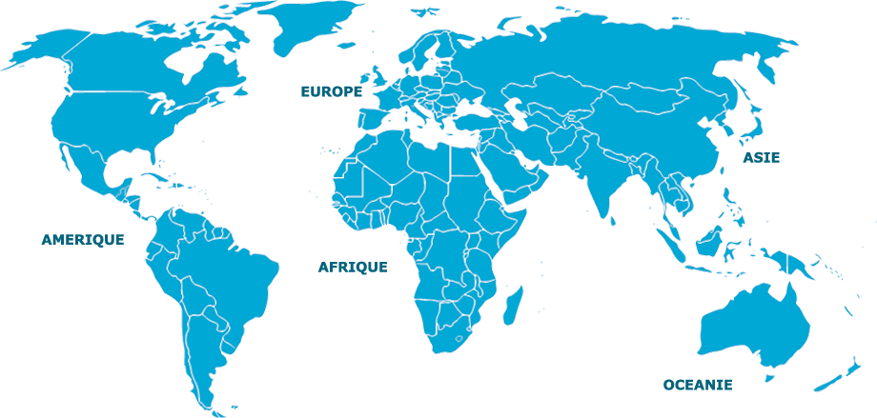


Notes:
There are 3 elements to the standard pricing model:
A fixed standard implementation fee – by standard we mean single country including one location site or more each with its own Office ID.
Then there is a transaction fee for each unique itinerary. This means that however many times a PNR is revisited it is only counted as one transaction so is only paid once.
And lastly there is a fee per SMS. Push notifications to Smartphones are free of charge as handled by the app.
There is also the optional Risk Module, where there are 2 packages (based on a fixed monthly fee):
Standard package:
View and send risk alerts, notifications and PTAs (Pre-Trip Advisory emails)
Premium package:
In addition to the standard package.
Riskline Global 24/7 database access per end-user company to access information for all countries
and be able to customise content and PTA's (Pre-Trip Advisory emails)

