Slide 1
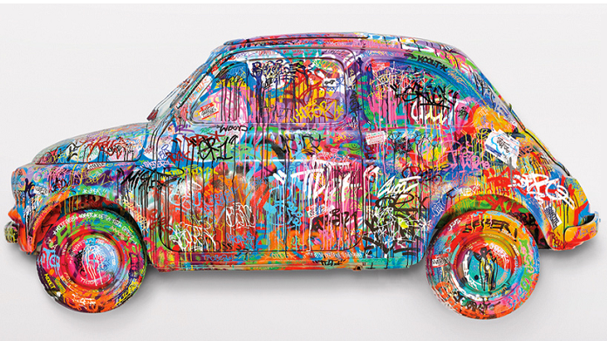

Slide 2
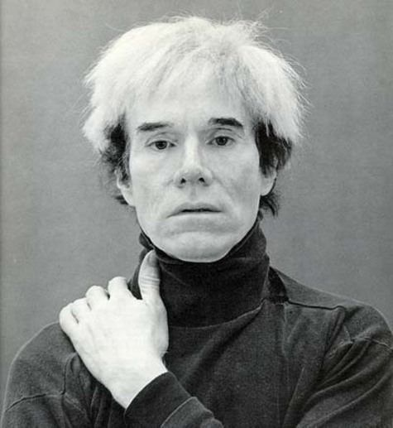
pop art
Pop art is an artistic movement which comes from the Great Britain in 1950.

Slide 3
ANDY WARHOL
Andy Warol was born the 6th of august in 1928 in Pittsburgh. He died on the 22nd of february in 1987 in New York.
He was an American artist, who was a leading figure in the visual art known as pop art. His works explore the relationship between artistic expression, celebrity culture and advertisement that flourished by the 1960s.

Slide 4
SOME WORK…

Slide 5
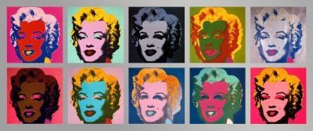
The ten Marylin
This painting is from a picture of the movie « Niagara ». It is made with screenprinting, Andy Warhol was fall in love to Marilyn Monroe and fascinated by her dead.

Slide 6

THE BANANA

Slide 7
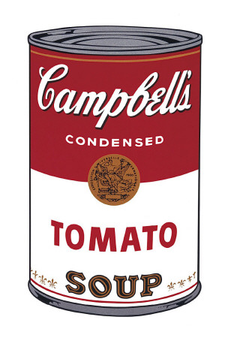
Campbell’s soup

Slide 8
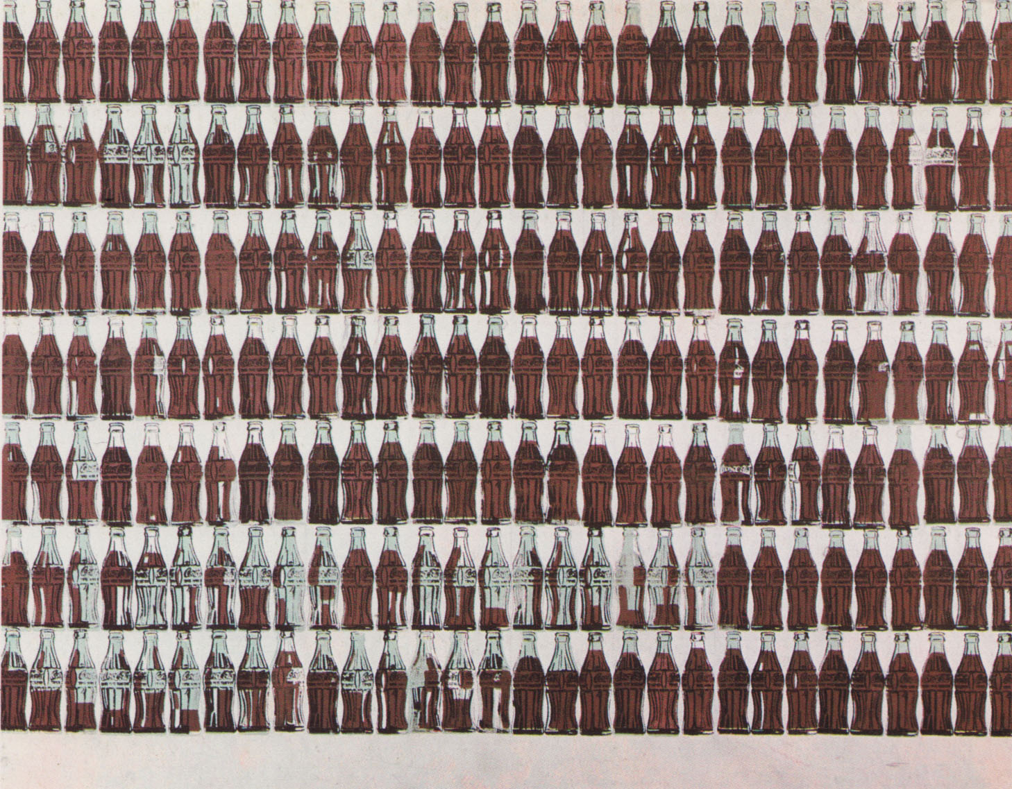
COCA COLA

