Slide 1
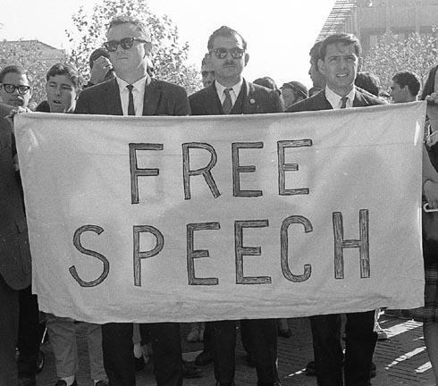
Freedom of speech

Slide 2
Summary (JE PRESENTE LE SOMMAIRE)
What is freedom of speech ? (simo)
Where can this freedom be established ? (simo)
How that freedom is working in « free » countries ? (hamza)
Morocco’s freedom of speech.(hamza)
Conclusion. (simo)

Slide 3
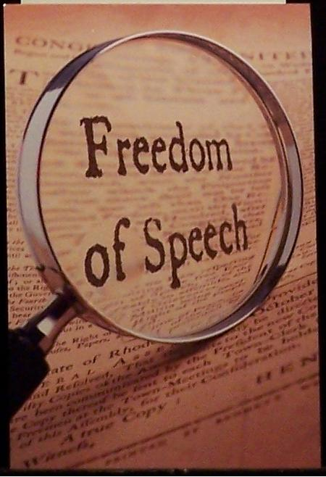
What is freedom of speech ?

Slide 4


Slide 5

Where can that freedom be established ?

Slide 6


Slide 7
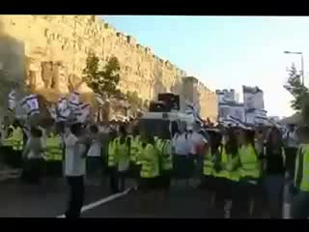
How that freedom is working in « free » countries ?

Slide 8
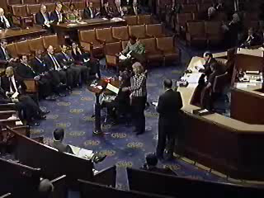
First amendment

Slide 9
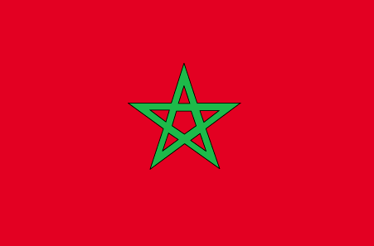
Morocco’s freedom of speech

Slide 10
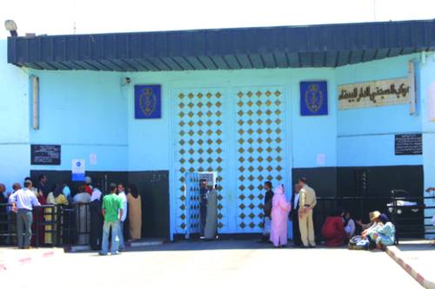

Slide 11
Conclusion
Now as we’ve all expressed our opinions, and watched many videos to understand deeply the meaning of that free speech, we would like to ask everyone of you to give us his opinion about that right, and tell us what he understood from it (les gens doivent tous repondre). Je vais dire : « Now free speech can be a fancy word, however, this might be a big issue as we can’t say if countries themselves respect this right » TOI TU DIS : And so, we encourage you to have a critical mind about rules and rights in our word, and be very careful about what you say, wherever you go. Je finis avec: thank you for your attention and your help, and we hope you enjoyed our work.

