Slide 1
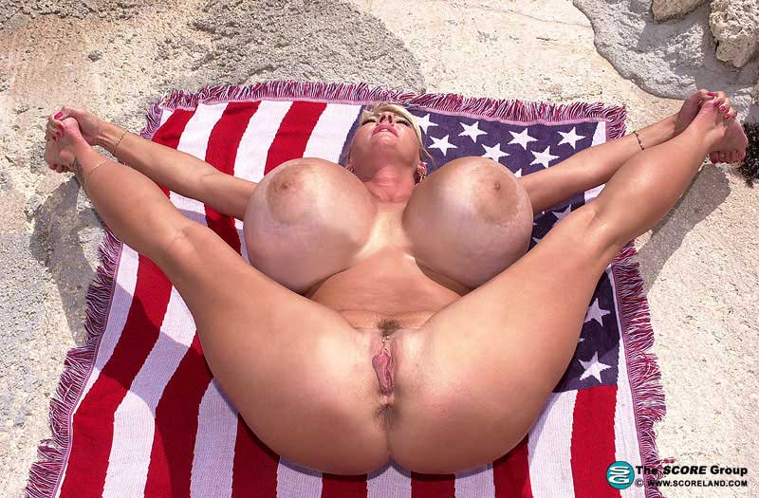
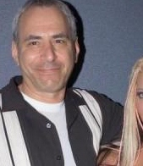

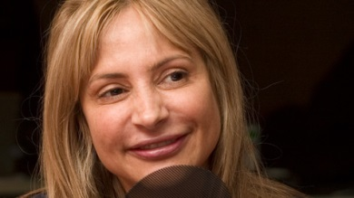

PRIDE TO BE AN AMERICAN SLUT
PRIDE TO BE A MIAMI MOTHERFUCKER
EDITOR
ASSHOLE ELLIOT JAMES
SCORELAND
SHITBAG
AND MONTREAL MOTHERFUCKER
ASSHOLE ANNE-MARIE SHITHOLE LOSIQUE
VANESSA TV
BIG FUCKING FILTH

