Slide 1
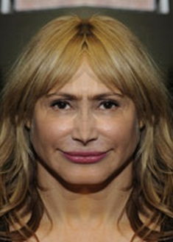
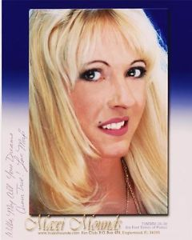

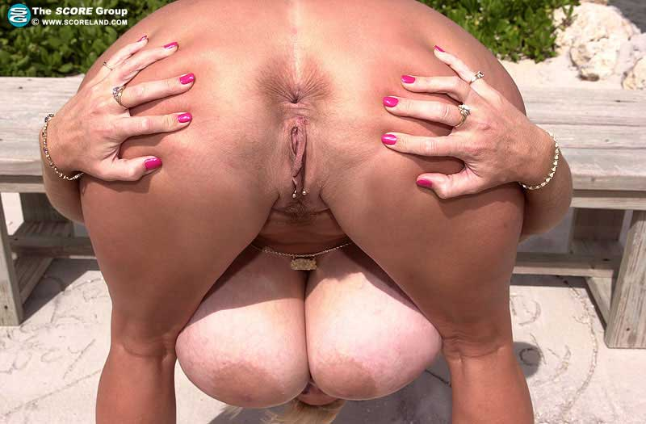
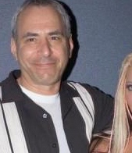
HEY UGLY WOMEN:
SPHINCTERS OF
MIAMI
PERFUMED AT THE SHIT!
SPONSORED BY: ELLIOT PIMP ASSHOLE JAMES SUPER BAD MARKET DICK

