Slide 1


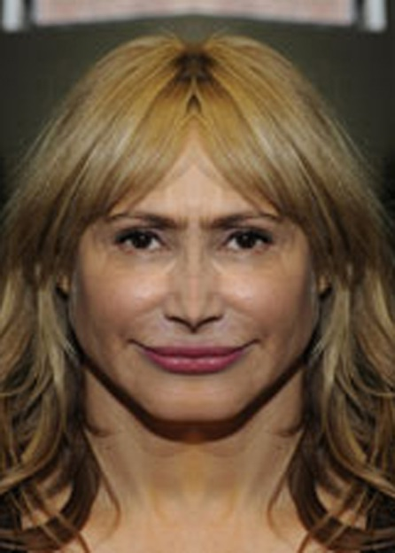
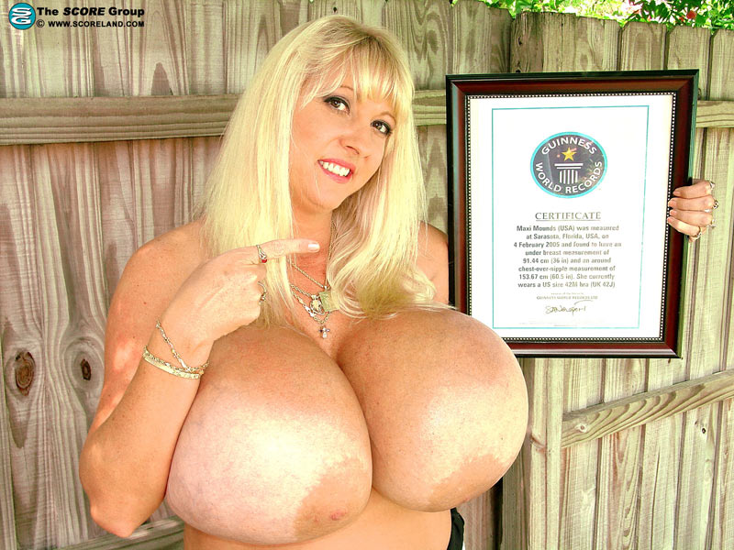

HEY BIG COW DO YOU REMEMBER HIM ?
MONTREAL BITCH MIAMI BITCH
SPONSORED BY:

