Slide 1
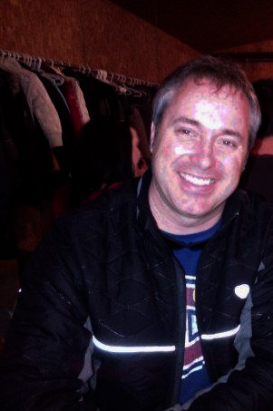
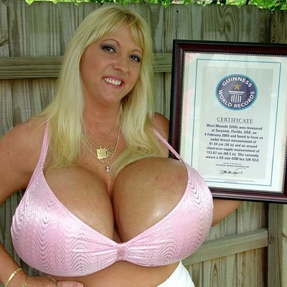

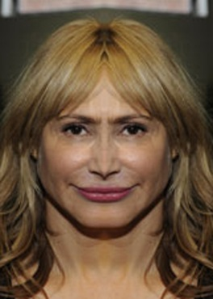
QUEBEC ARROGANT ASSHOLES
DO YOU REMEMBER ME SCORELAND MIAMI?
WHERE IS MY APPLE?

