Slide 1
THE ABORTION
Presented by : ATLAOUI LYES, Bocci Marine, ABBAR NIHAD

Slide 2
SUMMARY
Introduction
THE PORS OF ABORTION
Abortion is a safe medical procedure
The case of rape or incest
The ability of a woman to have control of her body
II. THE CONS OF ABORTION
Adoption is a viable alternative to abortion and accomplishes the same result
women who demand complete control of their body, control should include preventing
Abortion should not be used as another form of contraception.
Conclusion

Slide 3

Introduction
Reasons for choosing the Topic
Abortion is defined as the interruption before the end of the gestation process, that is to say that development begins at conception by the fertilization of an ovum by a sperm and an egg forming, which is followed by the growth of the embryo and fetus, and normally ends term with the birth of a new individual of the species
Controversy surrounding this topic
THE RIGHT OF ABROTION IS IN DANGER ?

Slide 4


Slide 5

THE PORS OF ABORTION
A SAFE MEDICAL PROCEDURE
88% - who have an abortion do so in their first trimester
less than 0.5% risk of serious complications
THE CASE OF RAPE OR INCEST
woman is too afraid to speak up
Unaware she is pregnant
The contrôle of woman on her Body
Women rights

Slide 6
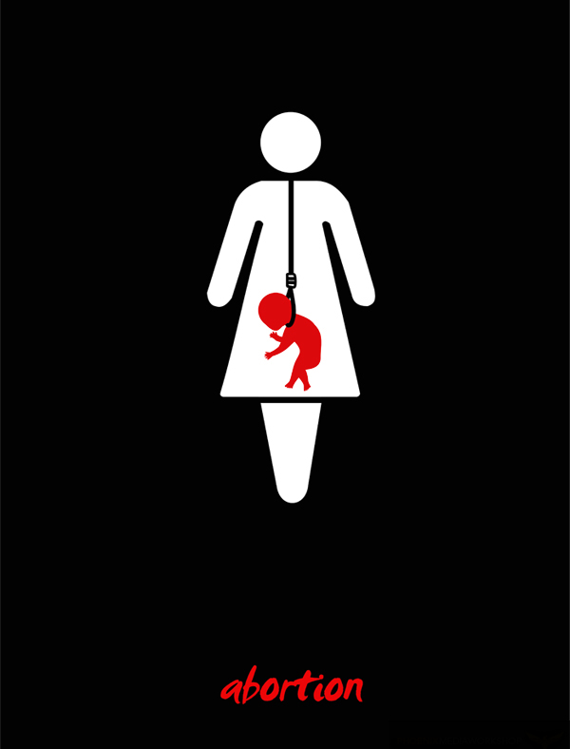
THE CONS OF ABORTION
ADOPTION, AN LTERNATIVE TO ABROTION
1.5 million American families wanting to adopt a child
An abortion can result in medical complications later in life
CONTROL SHOULD INCLUDE PREVENTING
the responsible use of contraception
No civilized society permits one human to intentionally harm or take the life of another
ABROTION IS NOT A CONTRACEPTION
Abortion frequently causes intense psychological pain and stress
Abortion punishes the unborn child who committed no crime

Slide 7

CONCLUSION

