Slide 1


Effect of thermal pre-treatment of proteins on the stability of air-filled emulsions
Mathieu Boujot-Matignon
22/03/2013
Supervisor : Dr Phil Cox

Slide 2
Introduction
What is an air-filled emulsion (AFE) ?
  Small air bubbles (1-20 μm) dispersed in a liquid phase
  Stabilised by protein coatings
  New and potentially important development in emulsion science
Application
  Low fat food
Liquid phase
Protein coating
Air cell
Air cell
Oil/Water emulsion
Air/Oil/Water emulsion

Slide 3
Introduction
Hydrophobins (Tchuenbou-Magaia et al., 2008)
  Stable AFE
  Surface elasticity provided by protein film
  Stable air-filled triphasic emulsions with similar rheological behaviour
  However, some disadvantages
BSA and EWP (Tchuenbou-Magaia et al., 2011)
  Optimisation of temperature, pH and concentration
  Air cells as stable as those with hydrophobins
  Requirement of thermal pre-treatment ?

Slide 4
Introduction
Aim of my project :
Study of the impact of a thermal pre-treatment in terms of freezing and thawing rates of the powder protein on the AFE stability

Slide 5
Materials
Methods
& Materials
Experiments
Results
Proteins (powder) :
  BSA
  Whey protein
  Soy protein (isolate + beans)
HCl (0.1M)/NaOH (1M) to adjust pH

Slide 6
Methods
& Materials
Experiments
Results
Freezing and thawing of the proteins
Freezing rate
Freezing
Protein (solid)
Thawing
Not insulated
Insulated
Well insulated
Thawing rate

Slide 7
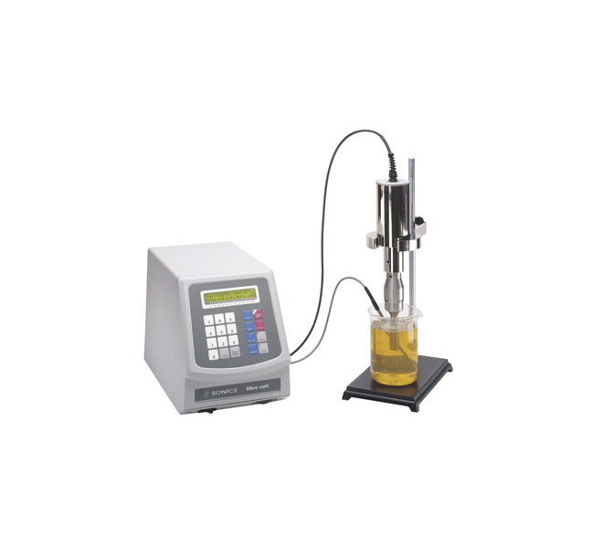
Methods
& Materials
Experiments
Results
AFE preparation
Protein
Stirring
Stage
(2h)
Foam
Water
pH adjustment
Centrifugation + filtration
Sonication
Protein solution
AFE

Slide 8
Methods of AFEs characterisation
Methods
& Materials
Experiments
Results
Microscopy
Turbidity
Mastersizer
Density

Slide 9
Methods
& Materials
Experiments
Results
3 freezing rates
3 thawing rates
Fast Freezing
(-3°C/min)
Fast Thawing
(6.6°C/min)
Average Freezing
(-1.5°C/min)
Average Thawing
(1.2°C/min)
Slow Freezing
(-1°C/min)
Slow Thawing
(1°C/min)
No pre-treatment
  10 different pre-treatments

Slide 10
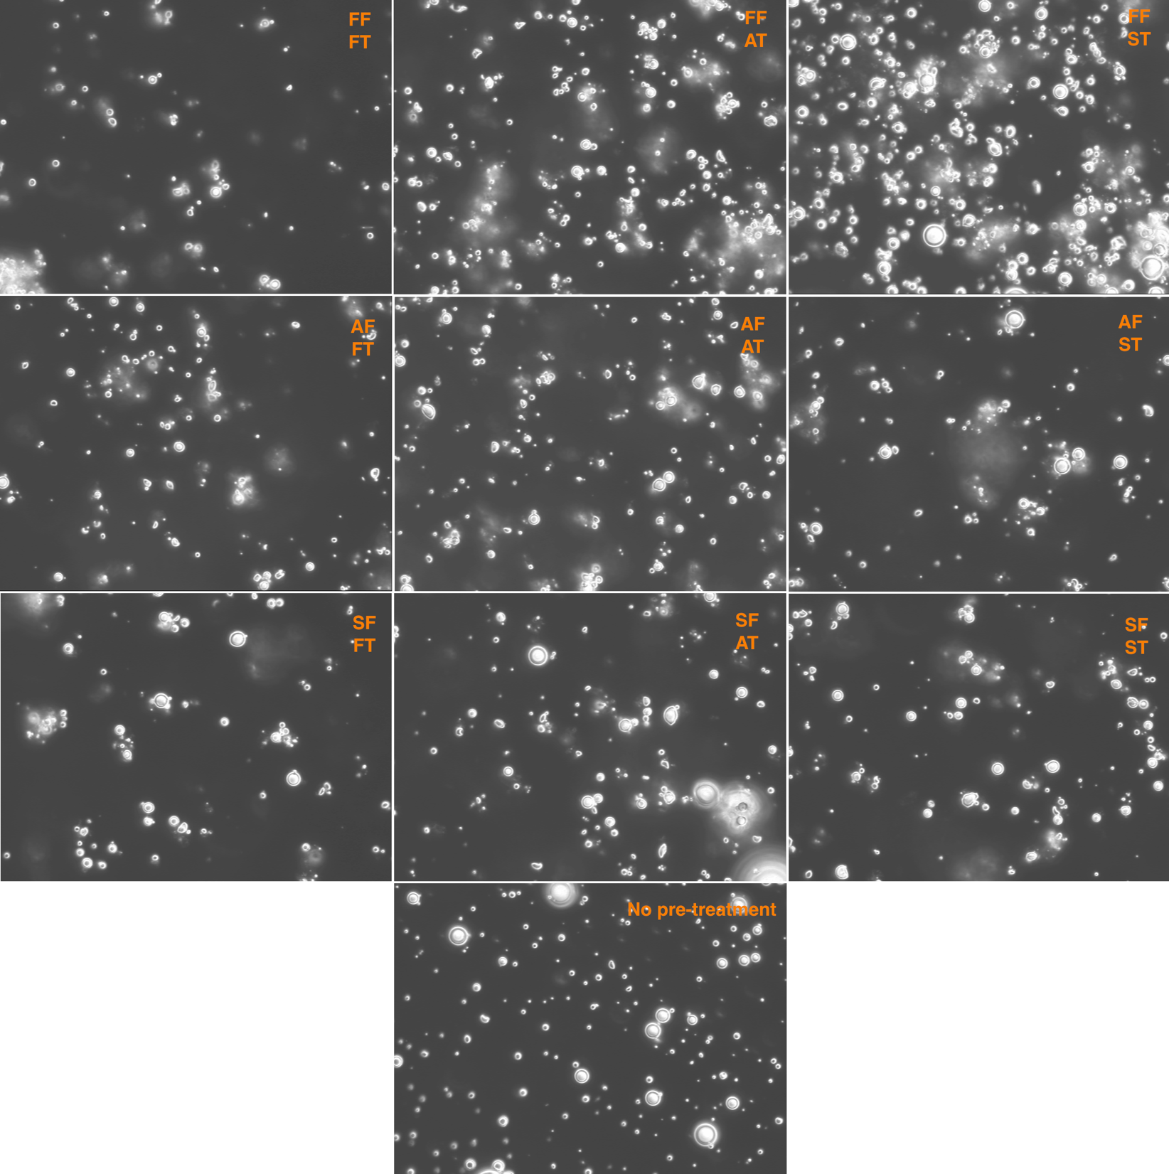
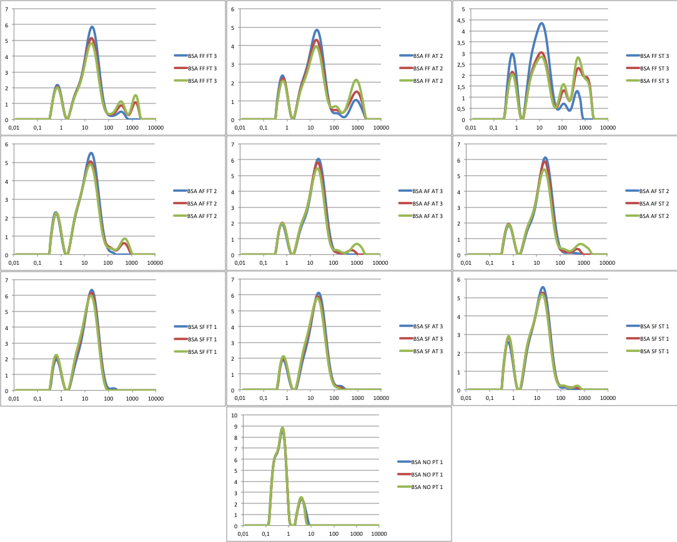
BSA
Methods
& Materials
Experiments
Results
Micrographs
Size distributions

Slide 11
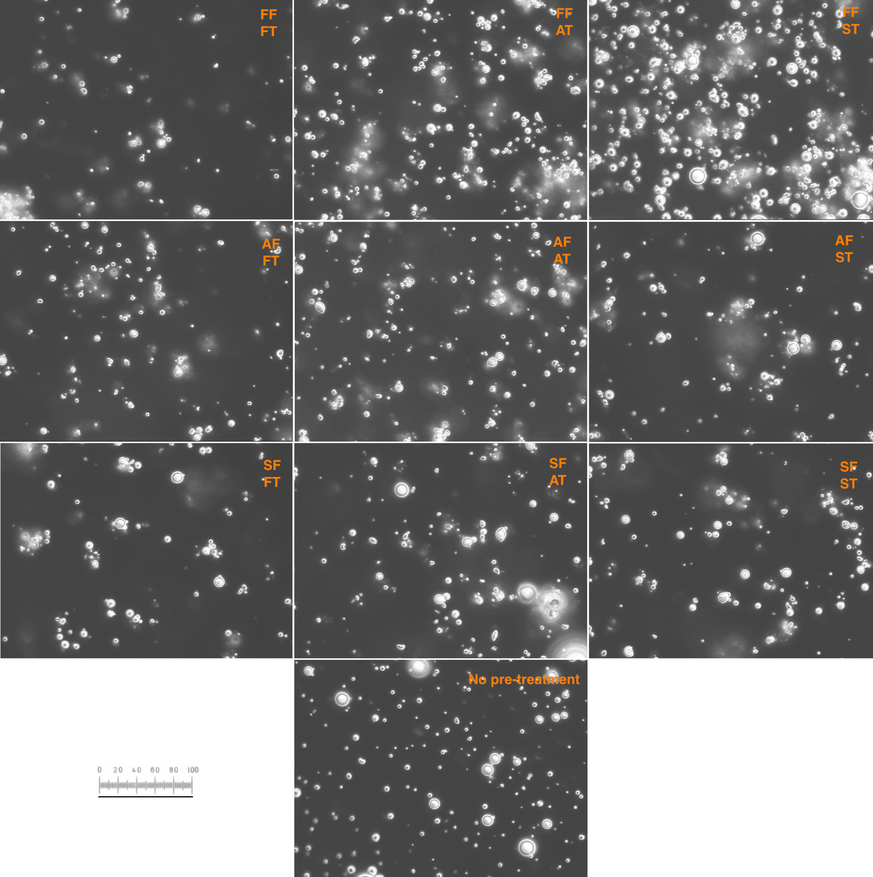
Thawing rate
Freezing rate
100 μm

Slide 12
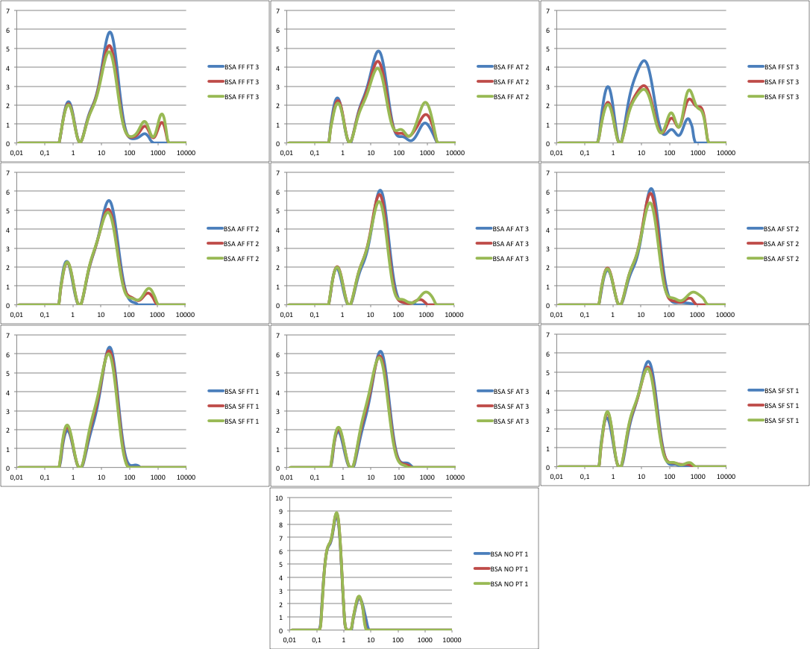
Thawing rate
Freezing rate
Volume (%)
Bubbles diameter (μm)

Slide 13
Other proteins
Methods
& Materials
Experiments
Results
Whey
  Much more flocculation
  Less obvious but same trend
Soy
  Air cells
  Not significant results

Slide 14
Conclusion
AFEs preparation and stability depends on the used protein
Their study requires simple material and different methods
Trend of the effect of thermal pre-treatment for BSA and whey protein
Further studies required

Slide 15
Thank you for your attention
Any questions?

