Slide 1


Slide 2
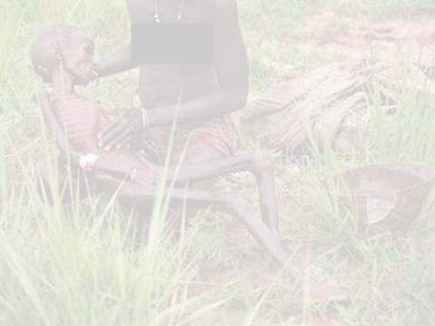
Food On Foot!

