Slide 1
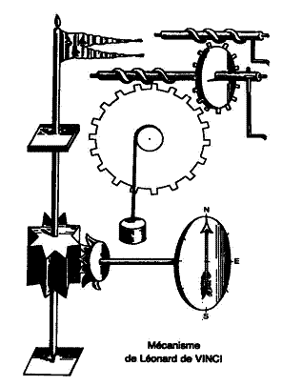

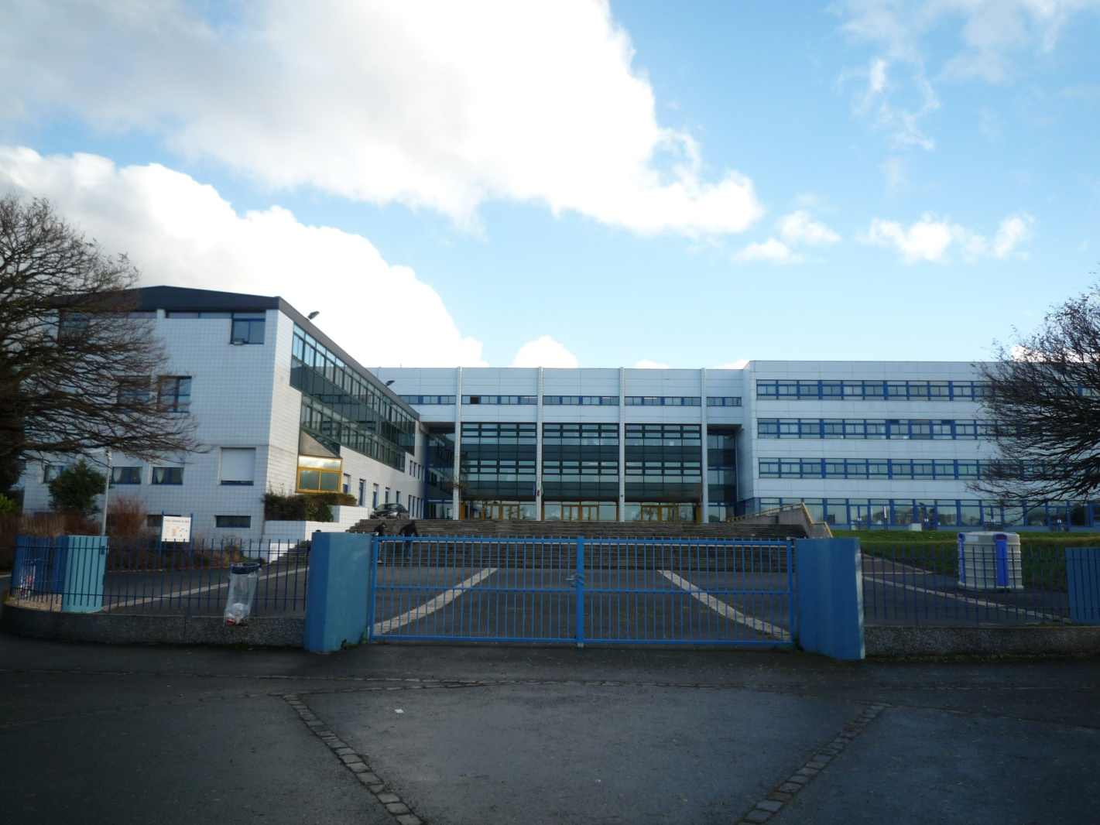


LYCEE LEONARD DE VINCI – SOISSONS - FRANCE
http://www.eurovinci.sitew.com
http://devinci.lyc.ac-amiens.fr/

Slide 2
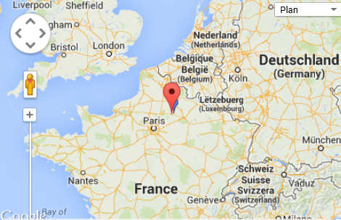
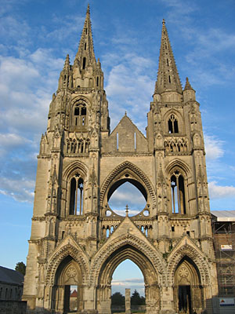
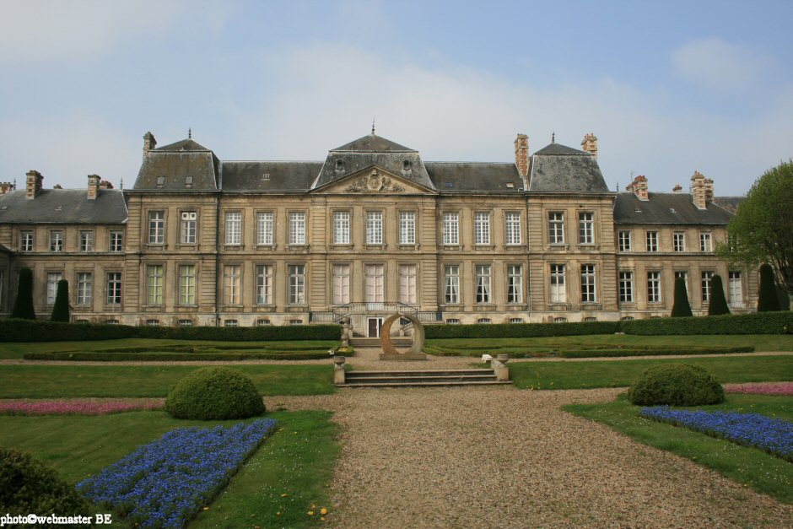
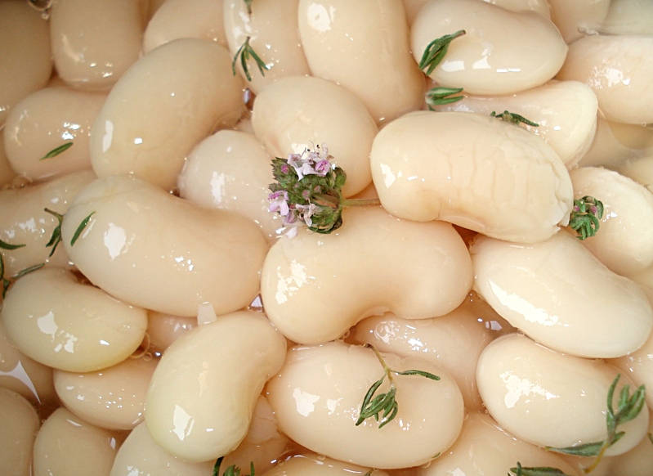
Soissons

Slide 3
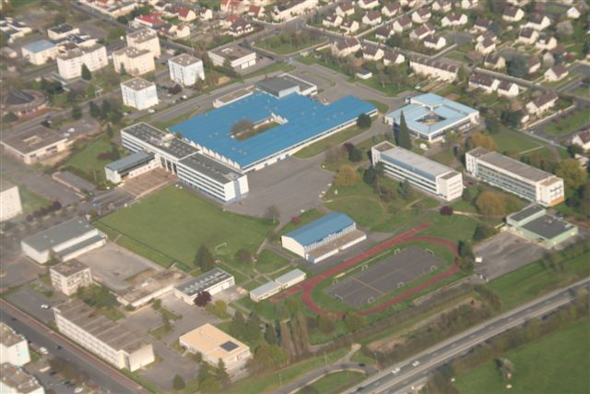
Lycée Léonard de Vinci

Slide 4

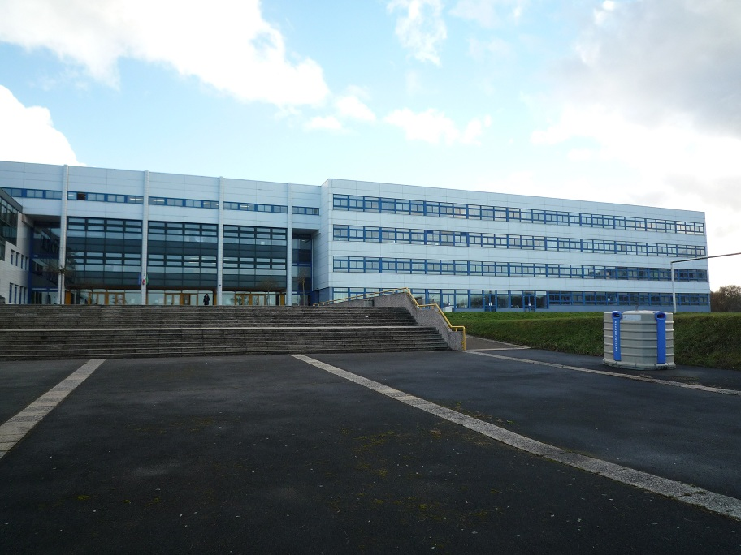
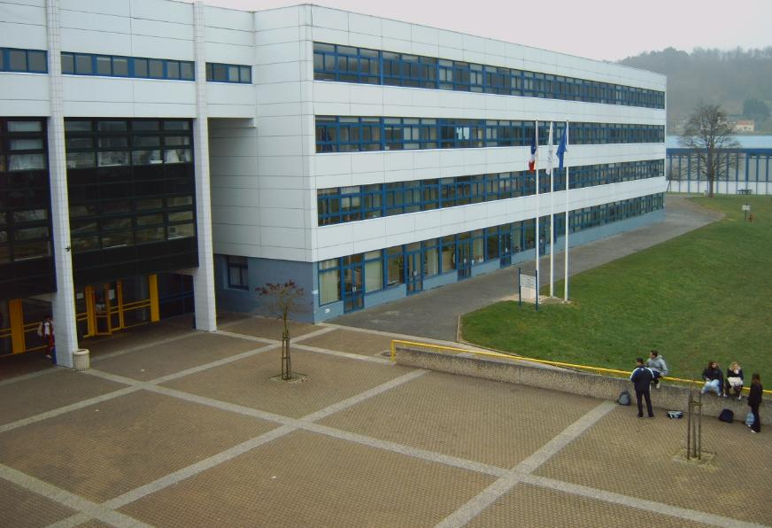
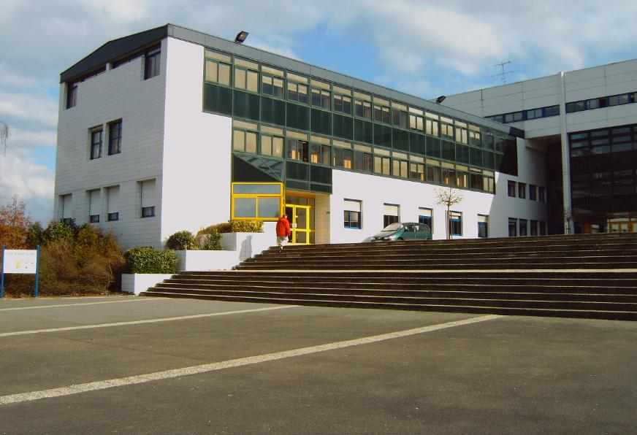

Slide 5
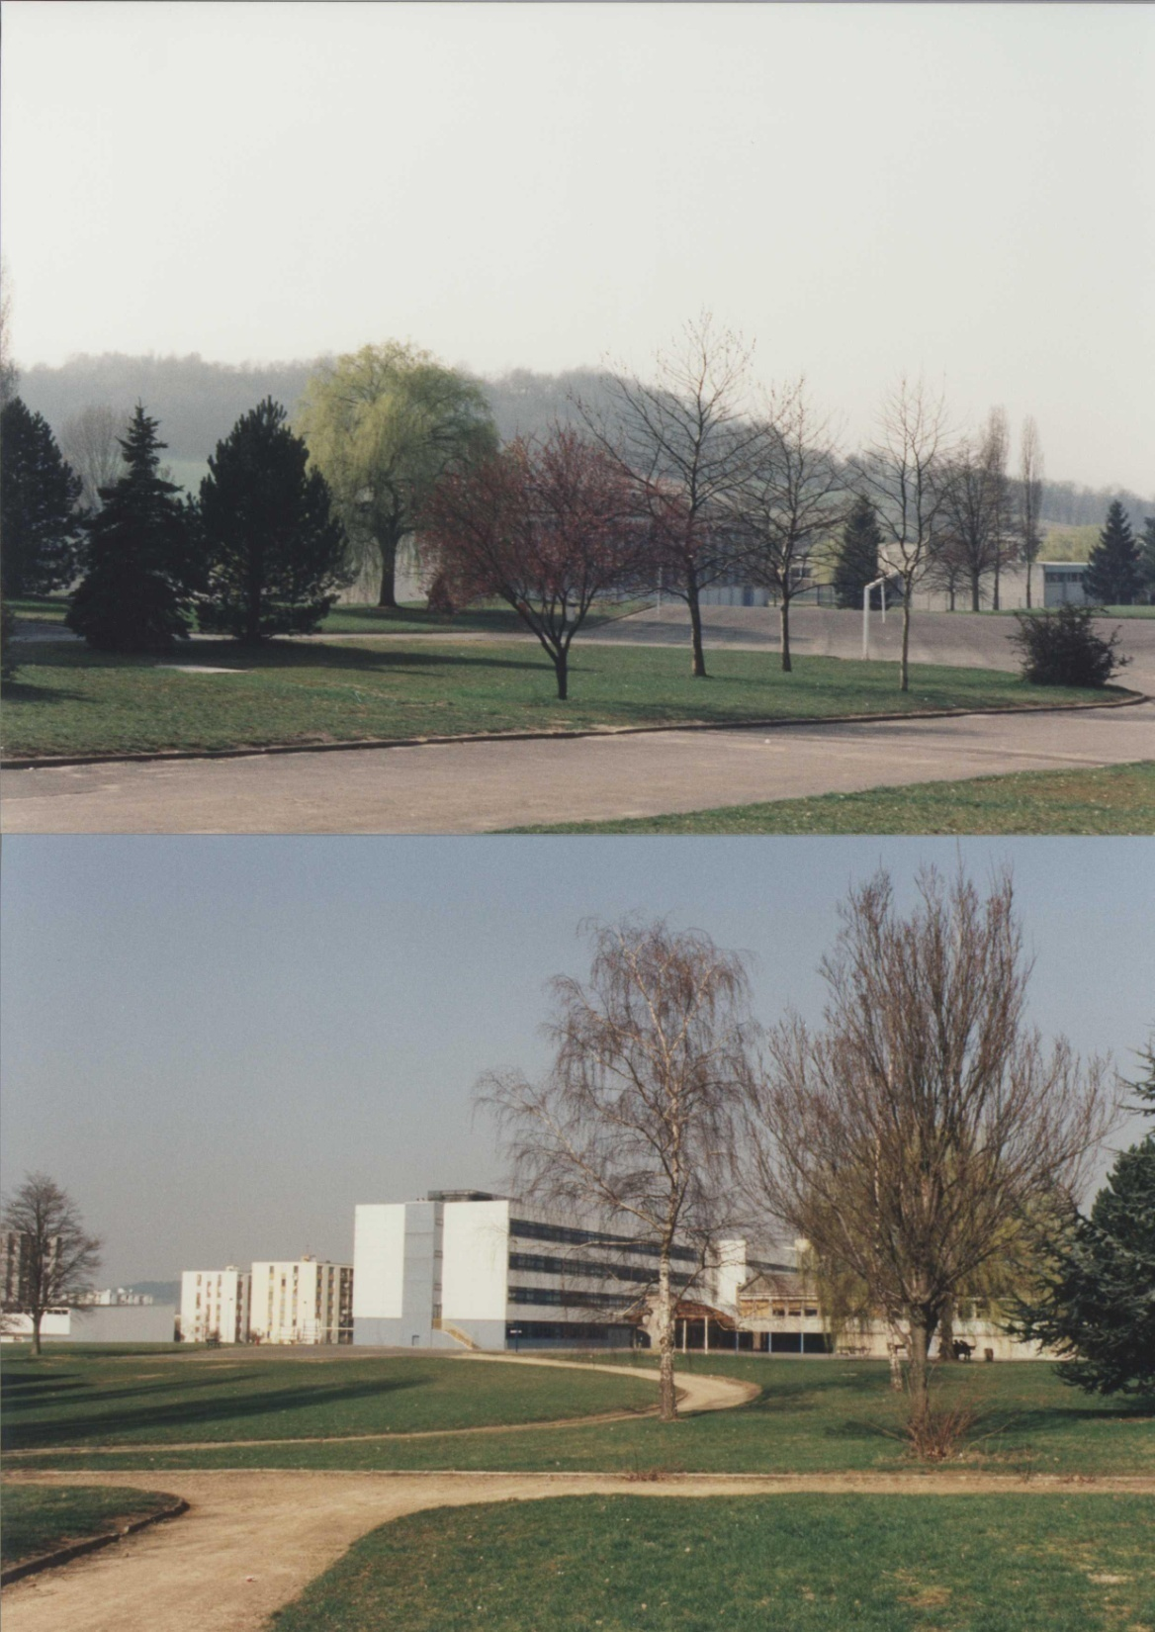
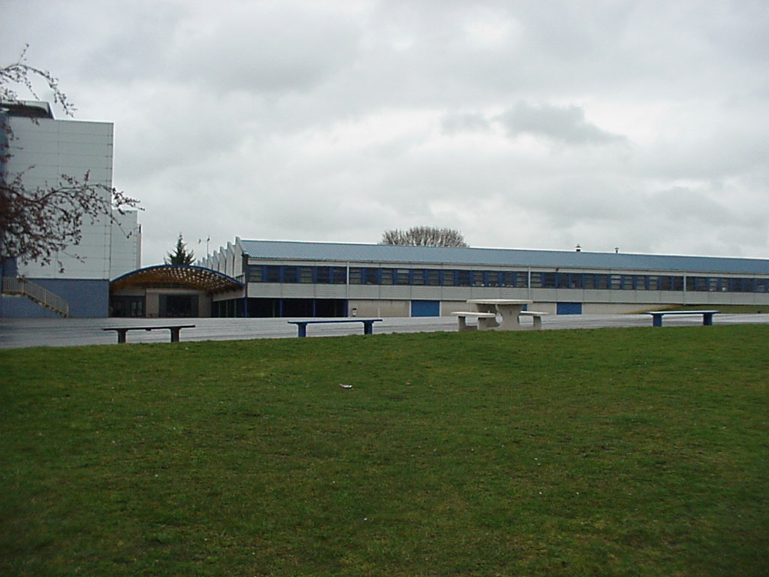
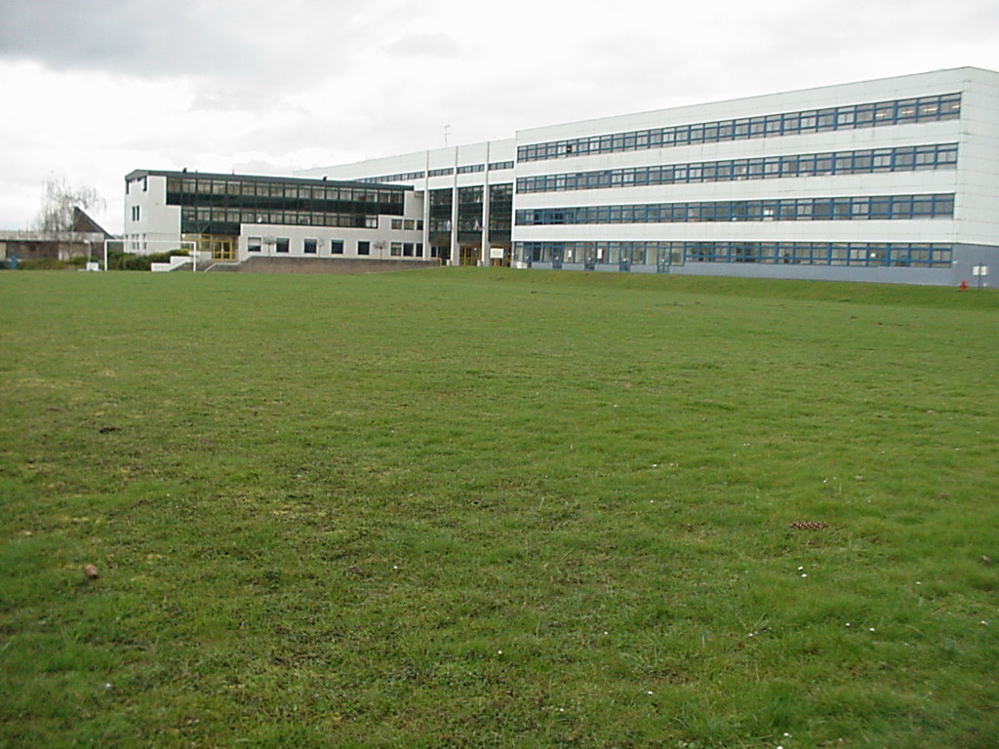
…a 10 ha wooded area…

Slide 6
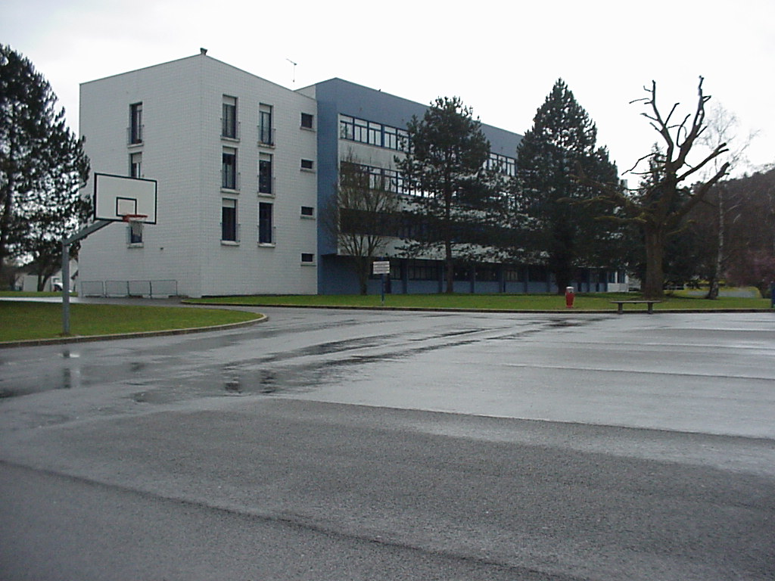
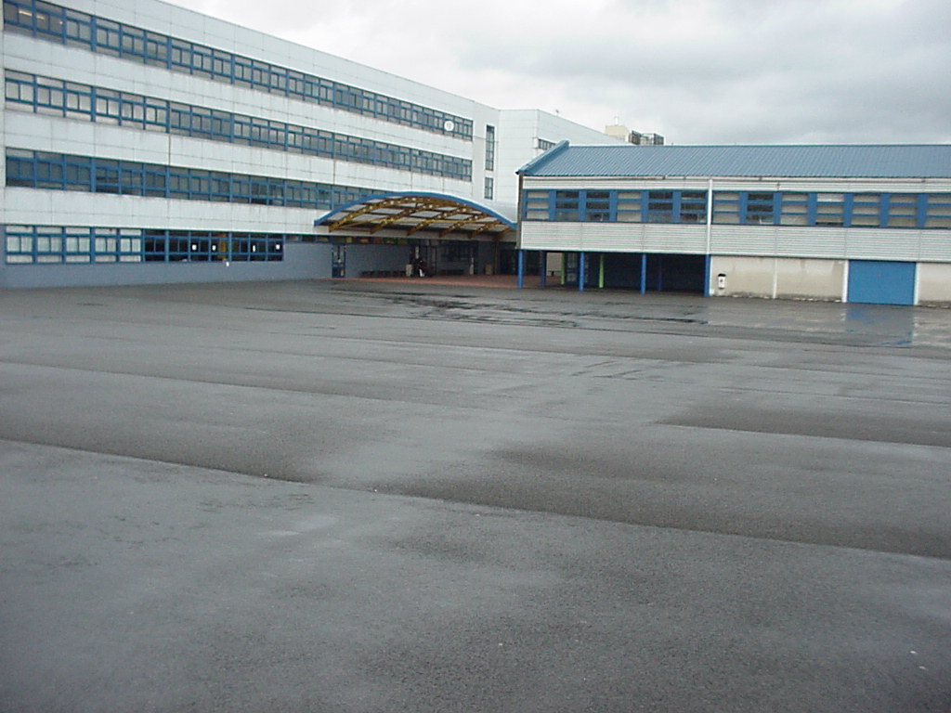
680 students
90 teachers
(full time and part-time)
A boarding school

Slide 7
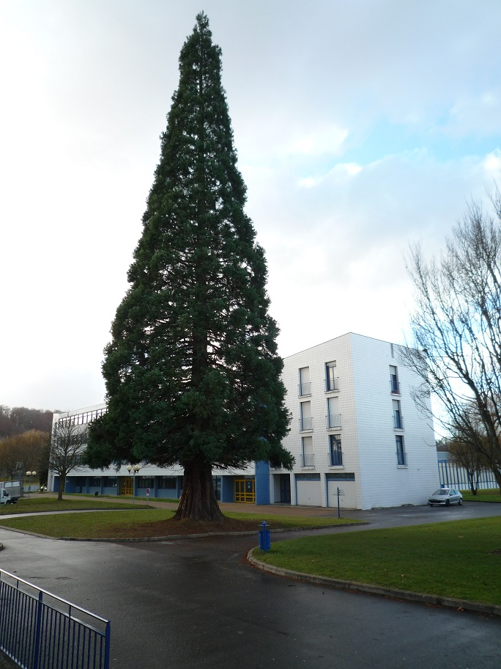
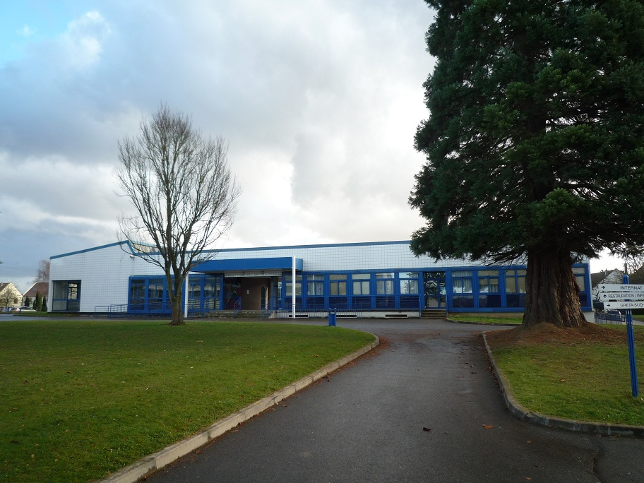
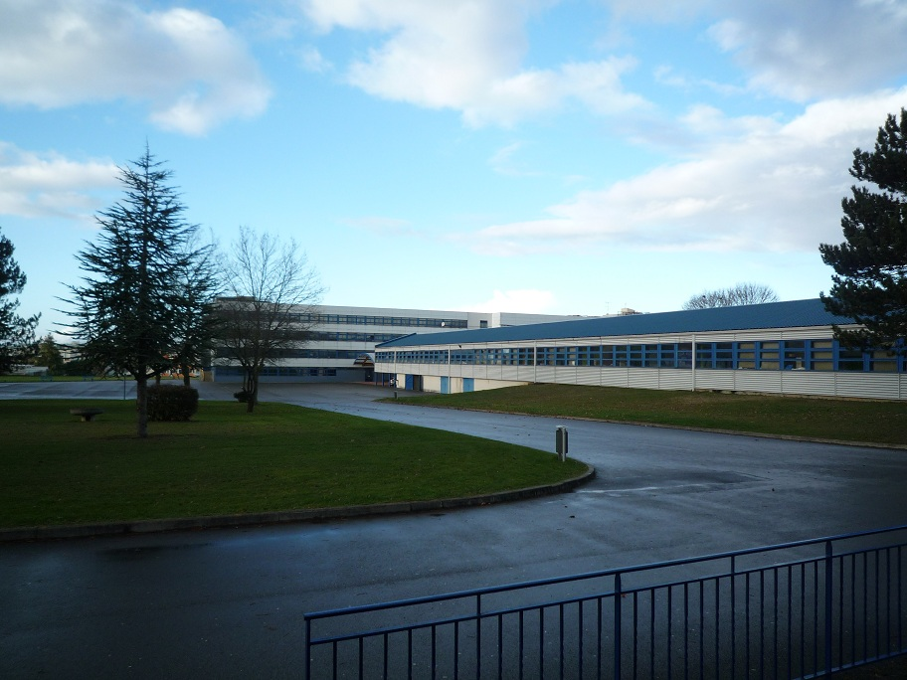
A beautiful Christmas tree…
Nursery
Workshops

Slide 8
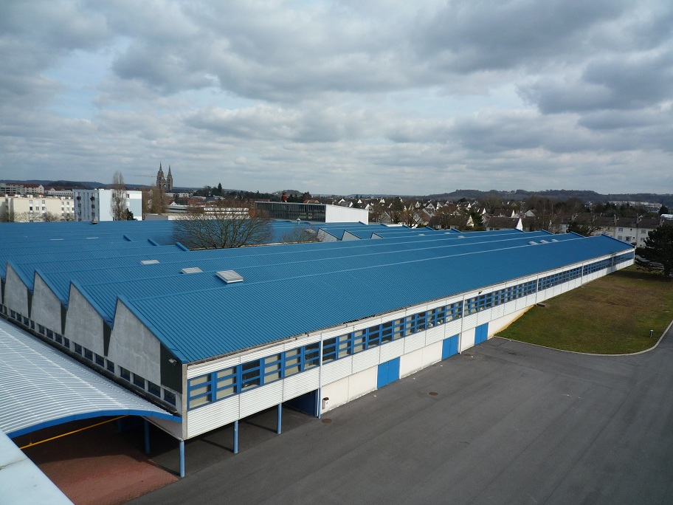
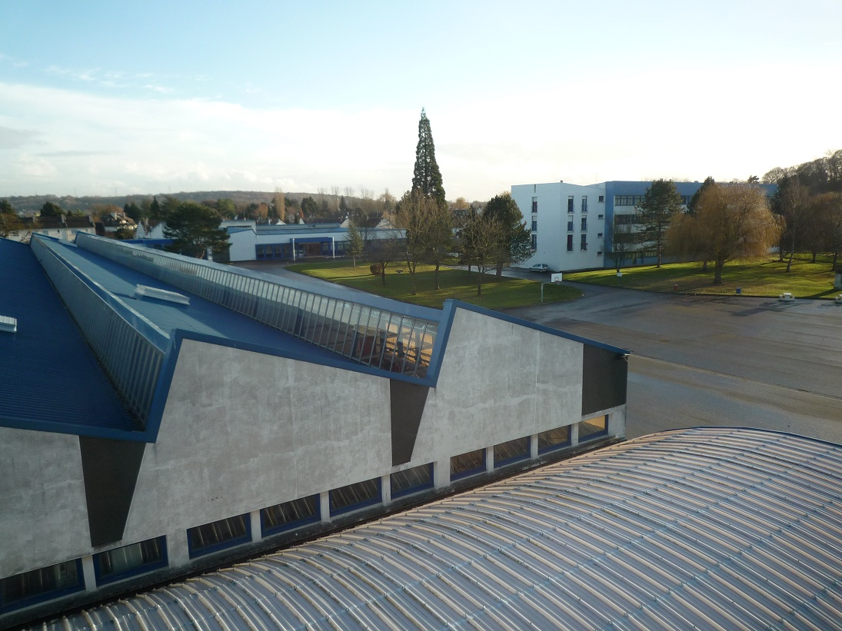
A place where life
(and work!!)
is enjoyable

Slide 9
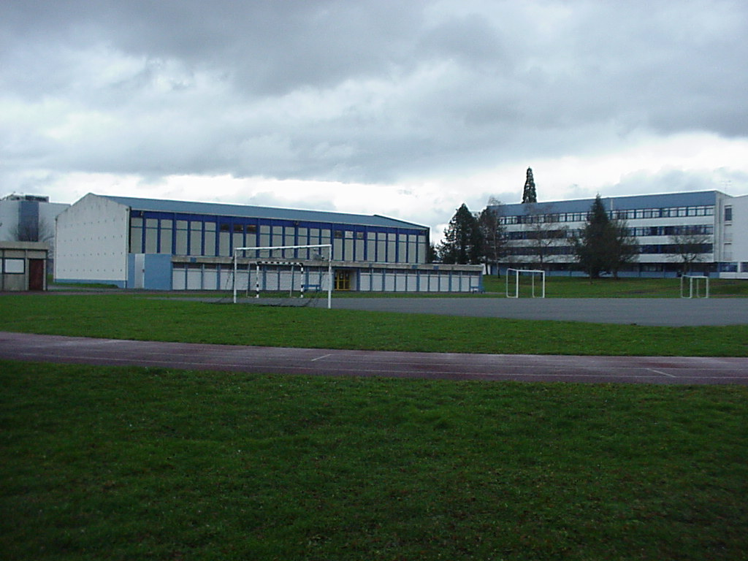
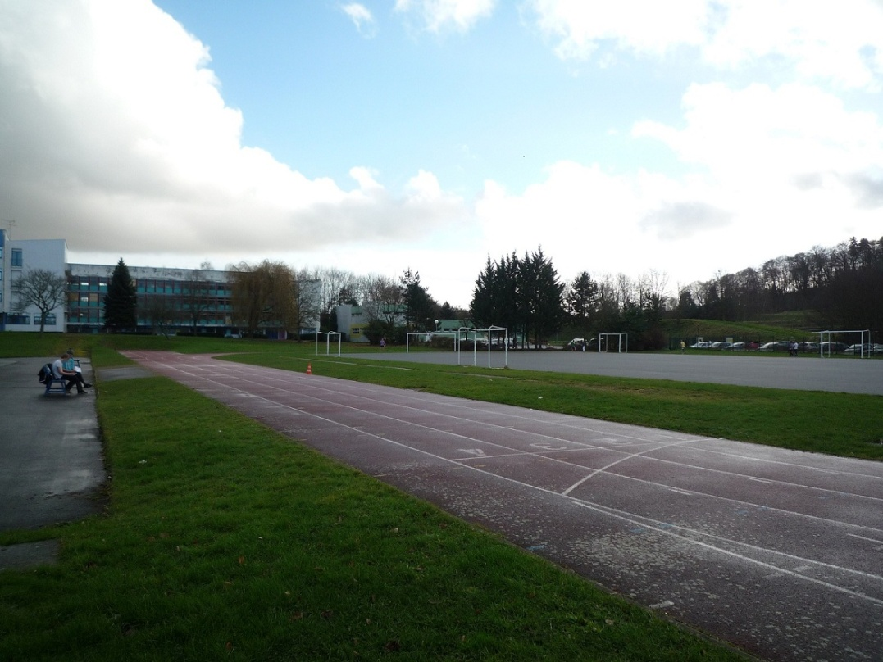
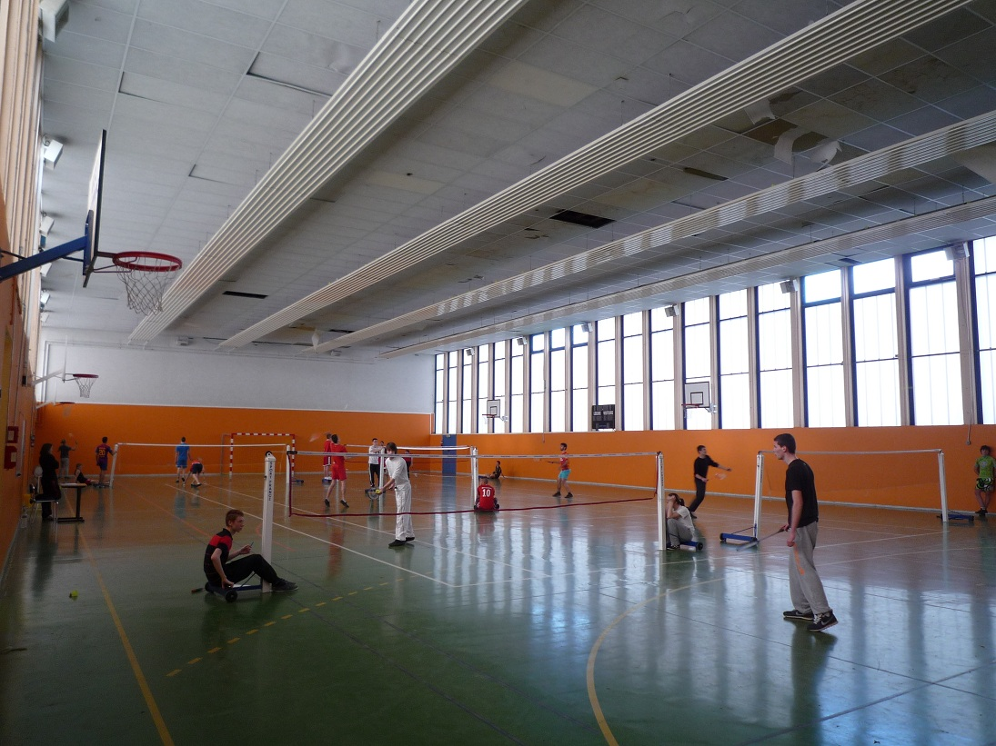
Sport facilities
(9-hole-golf course
inside the school!!)

Slide 10
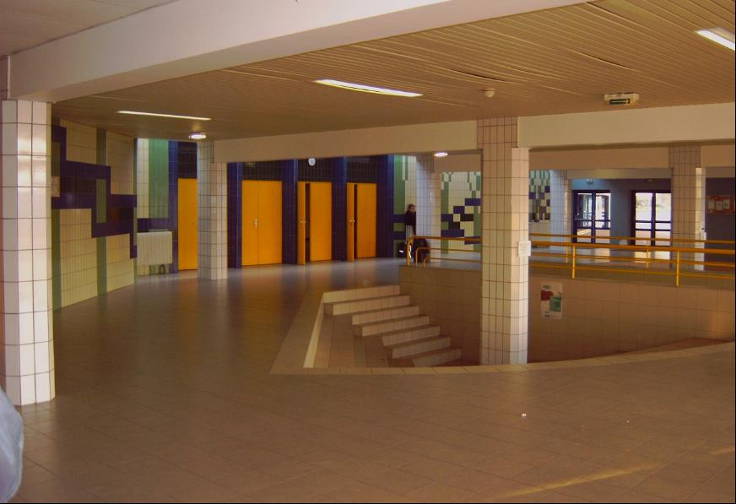
The entrance hall

Slide 11
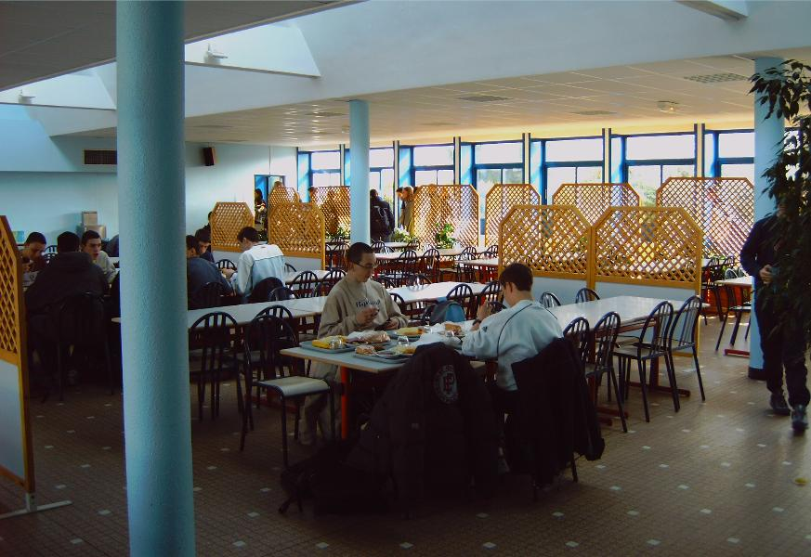
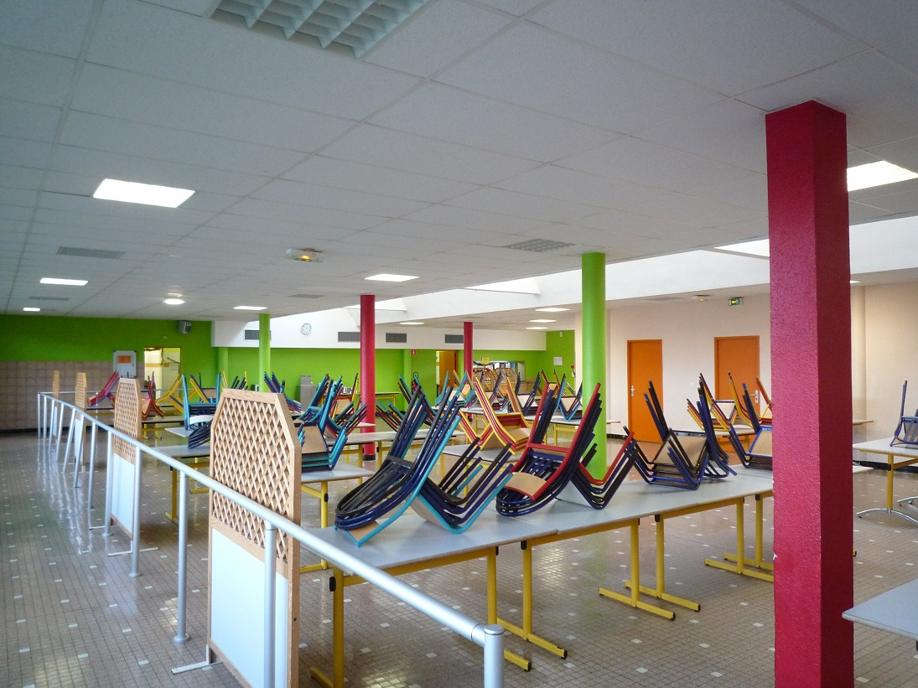
The canteen

Slide 12
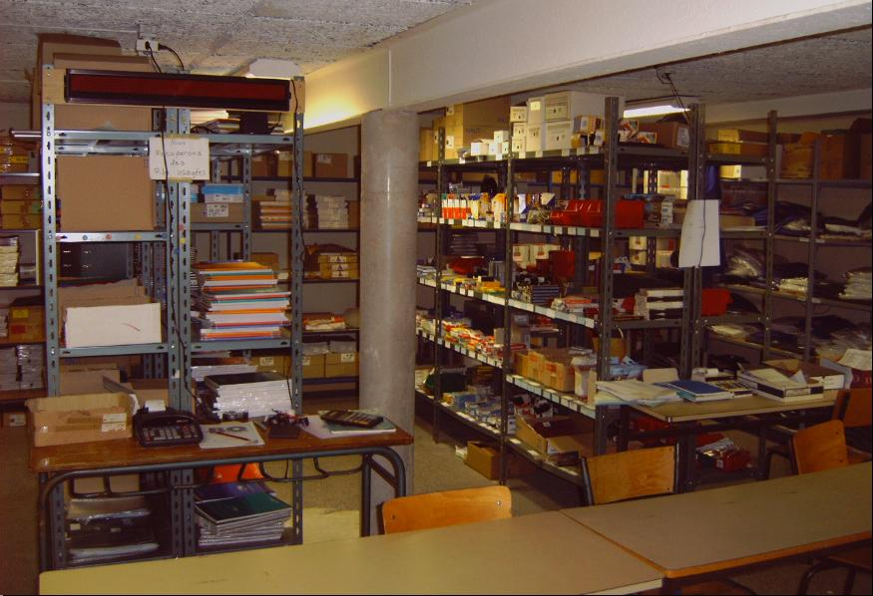
A place to buy cheap school stationeries

Slide 13
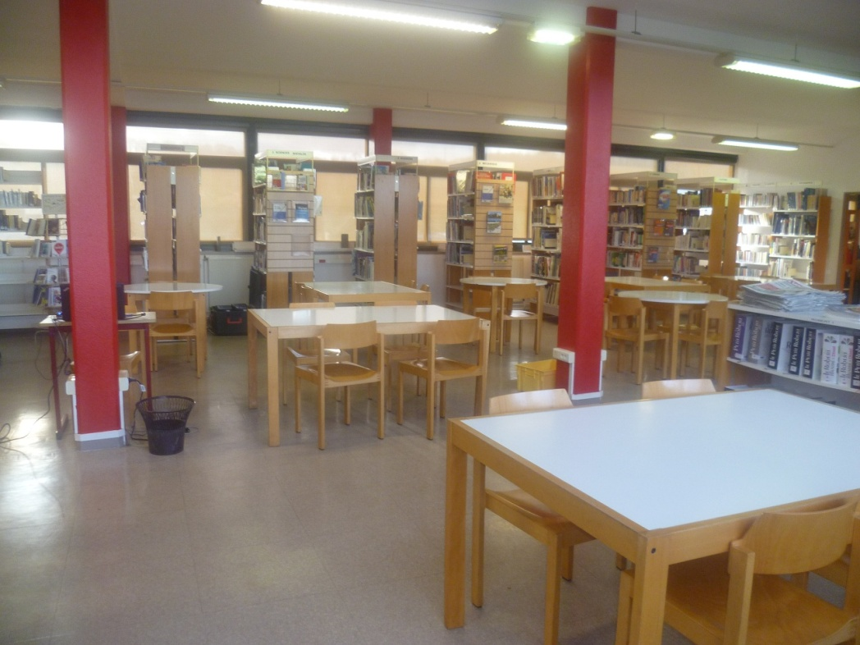
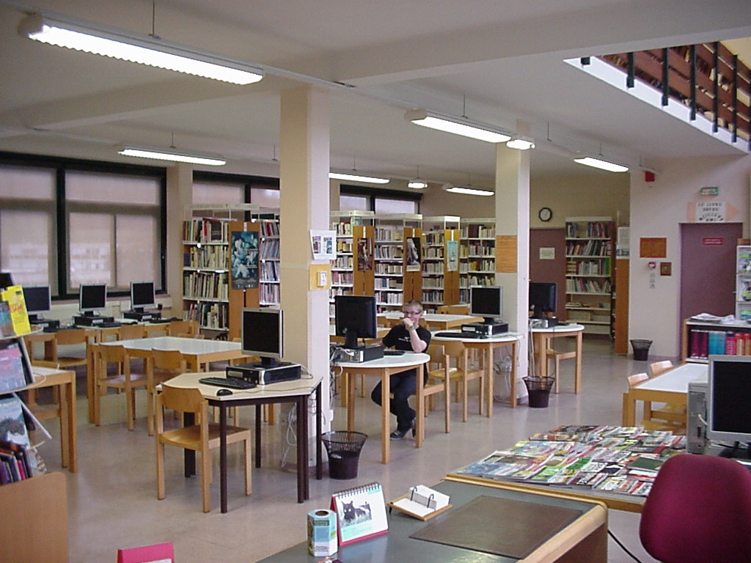
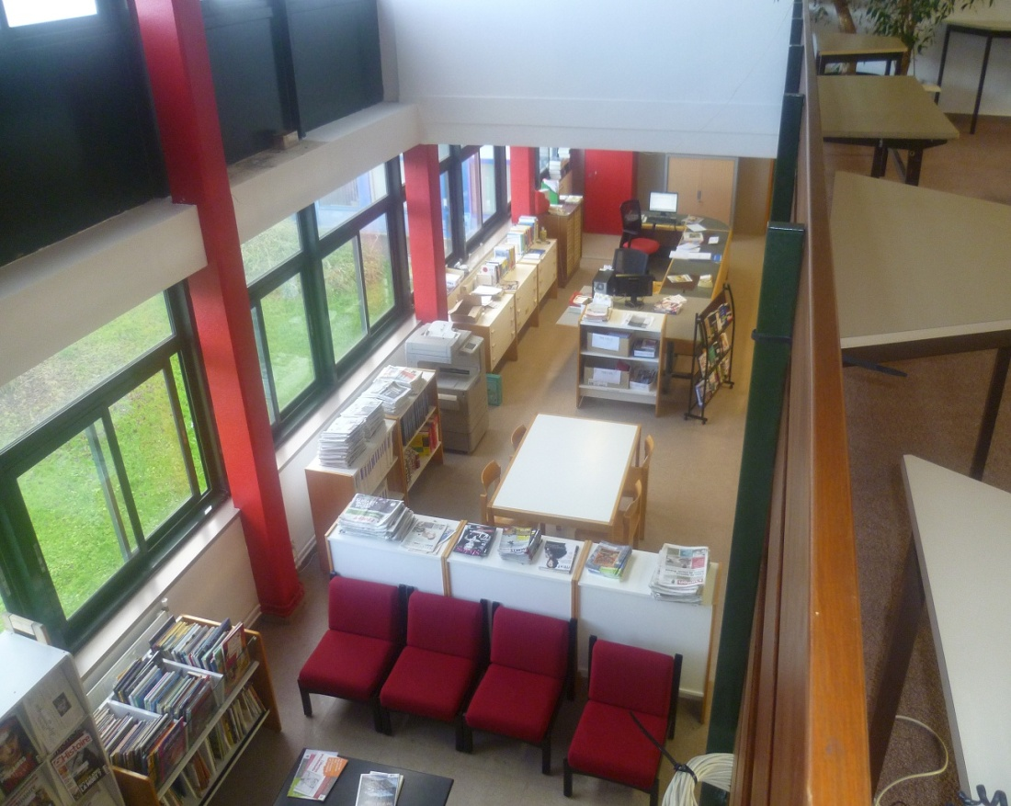
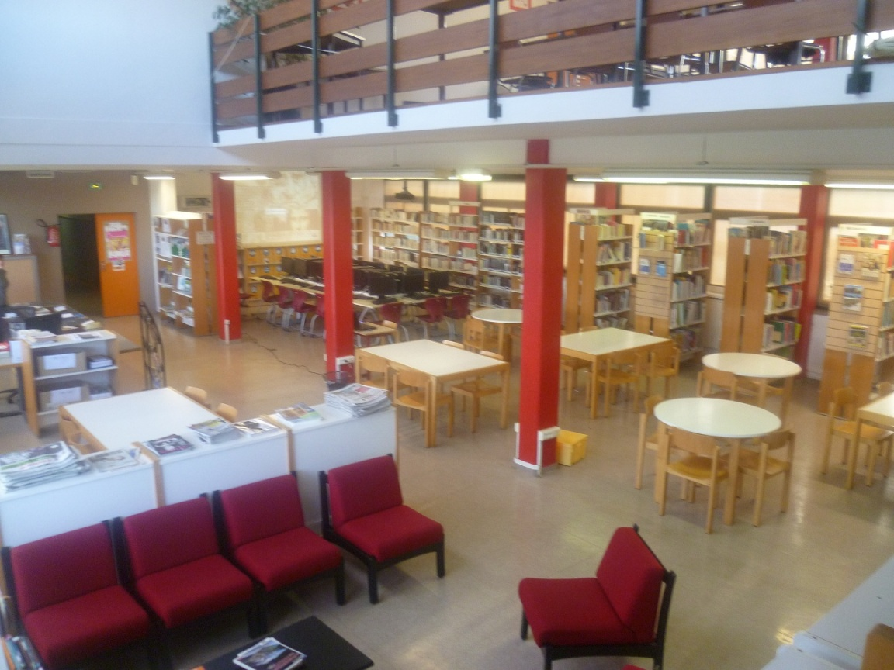
A library

Slide 14
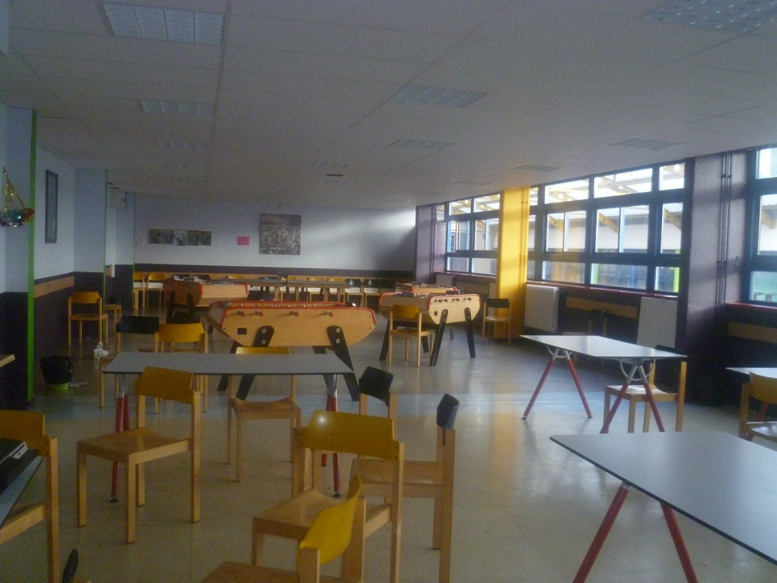
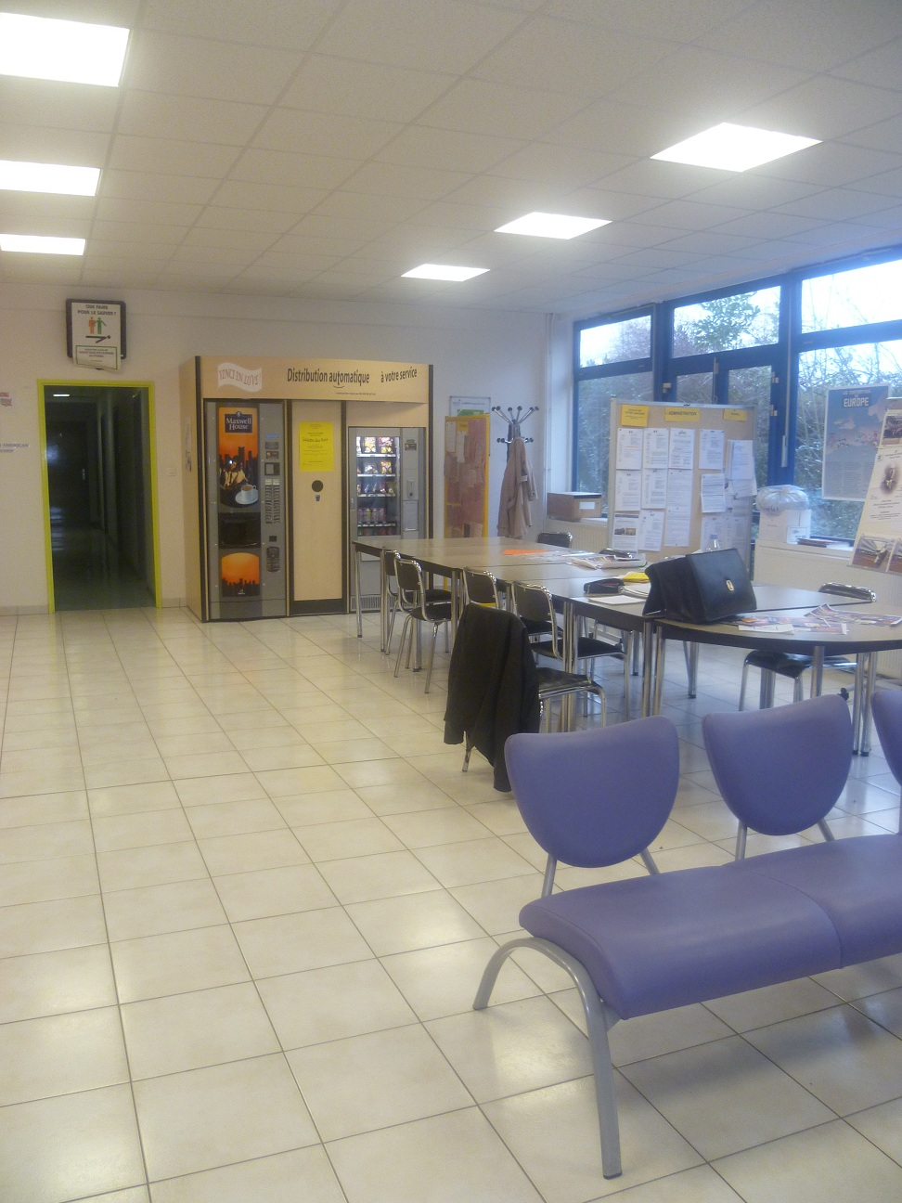
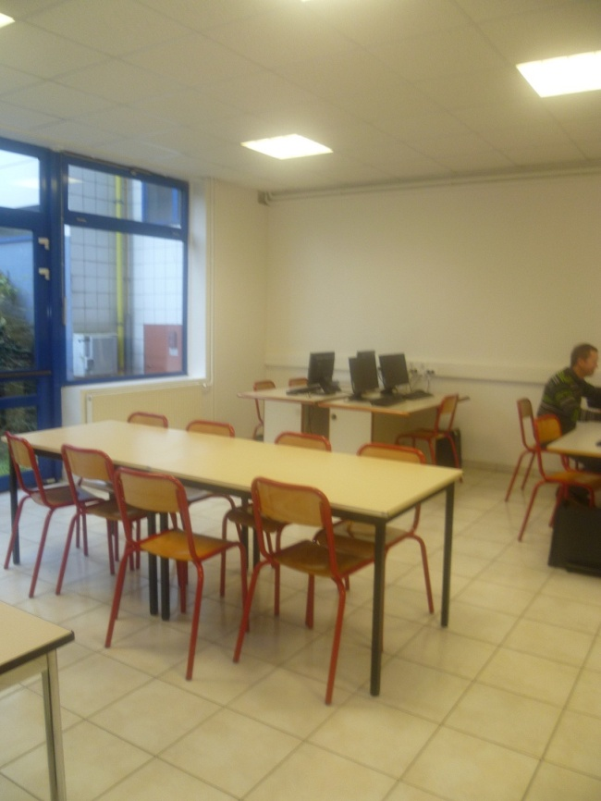
Entertainment room
Teachers room

Slide 15
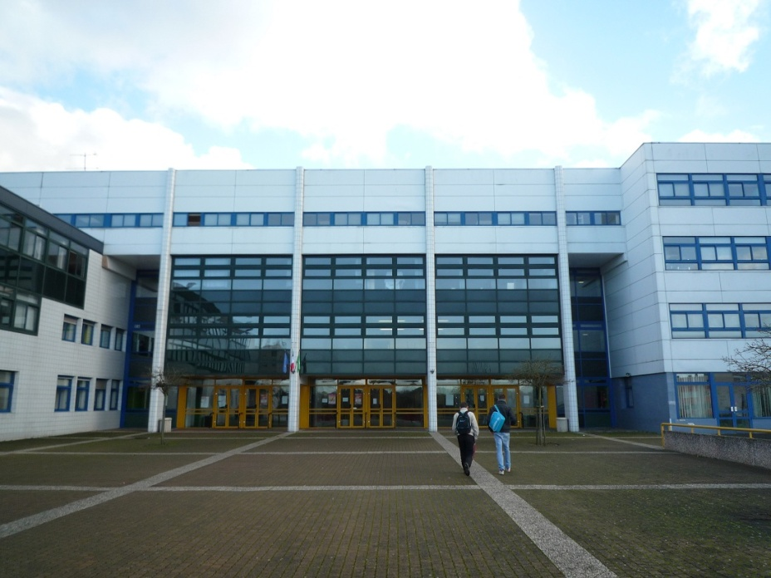
A general high school: scientific / economic and social sciences
A technical high school: sustainable development (with energy/3D design/materials engineering/electronics)
A vocational high school: electrotechnics/industrial maintenance/car mechanics (from sept. 2014)/productics/welding and boiling/metalwork/modeling-prototyps

Slide 16
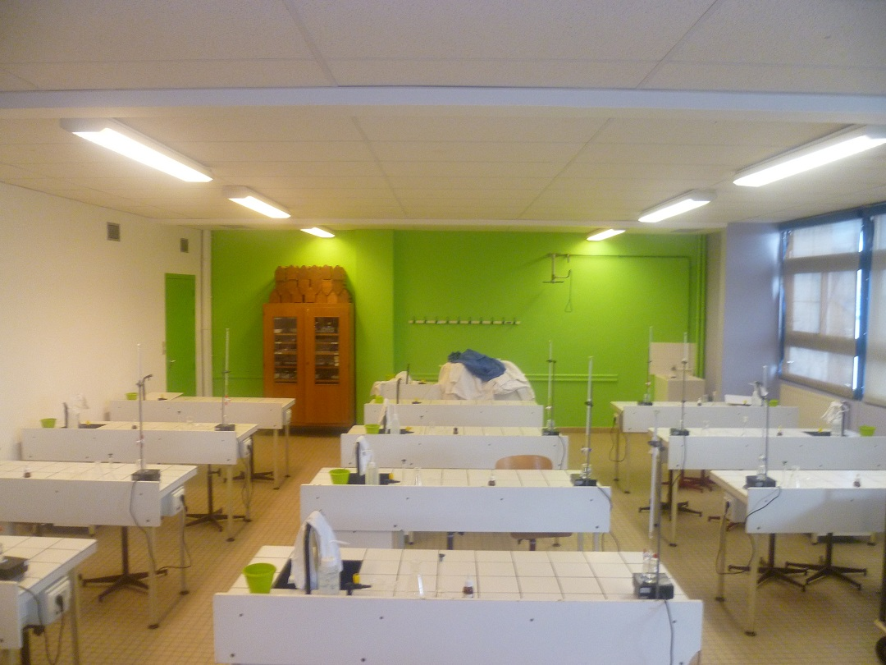
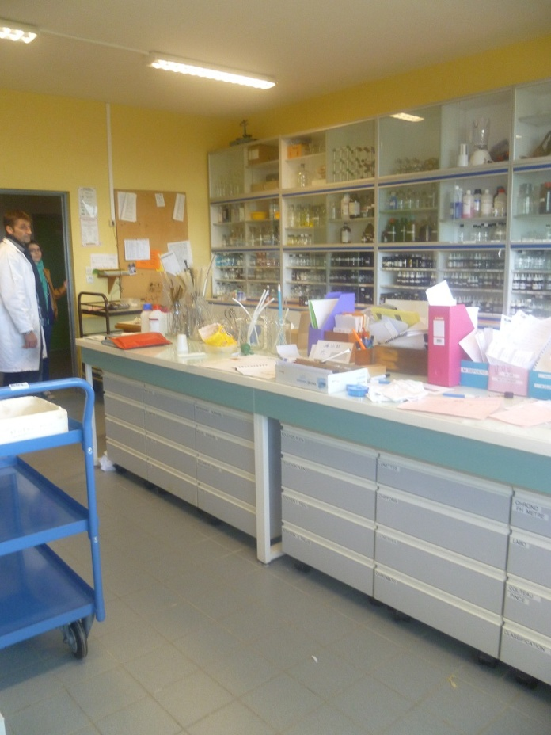
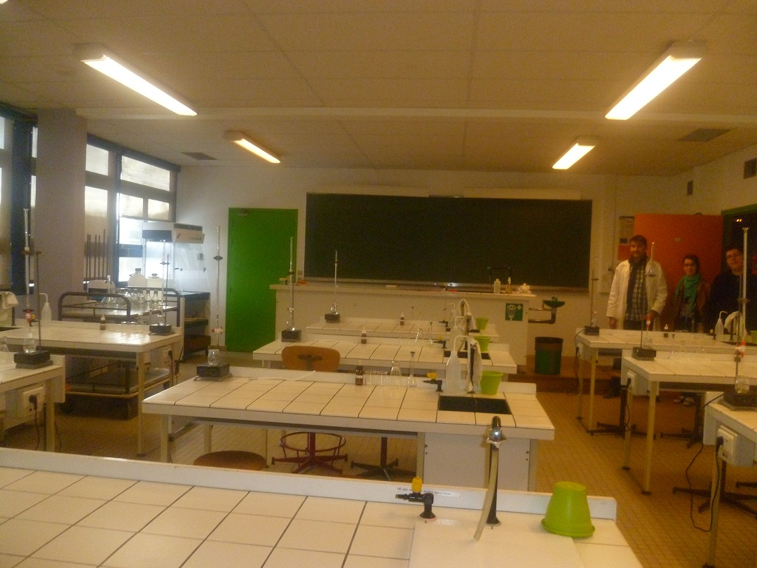
Chemistry
Physics

Slide 17
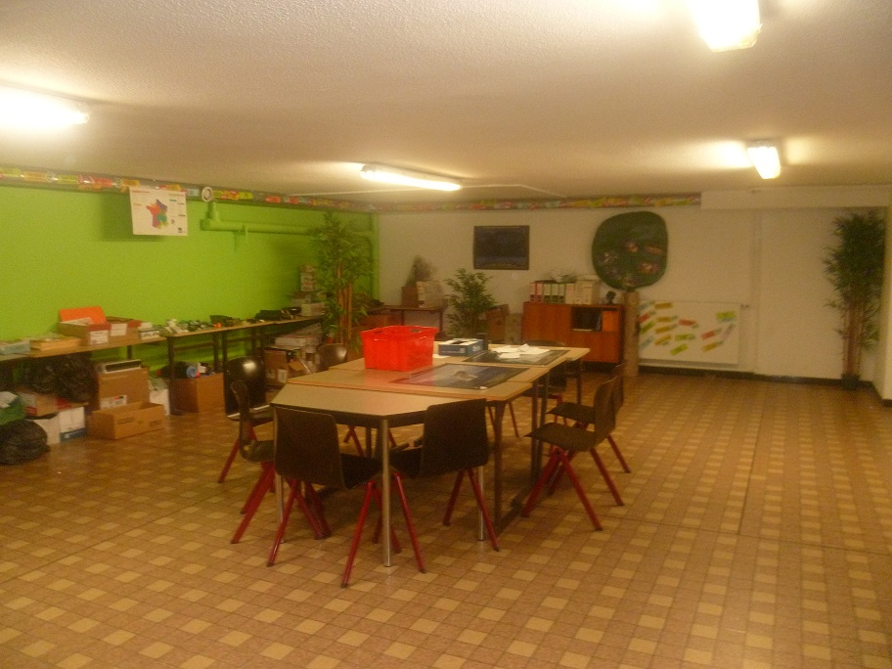
Environment club

Slide 18
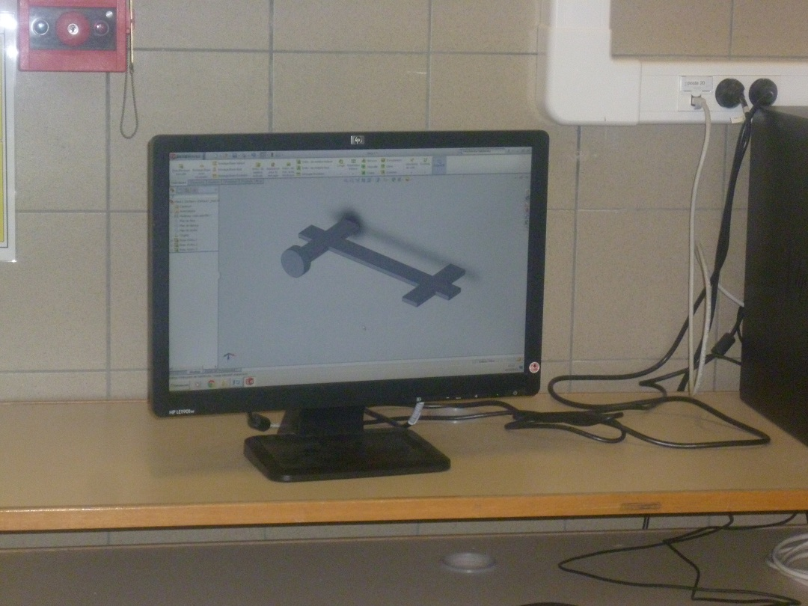
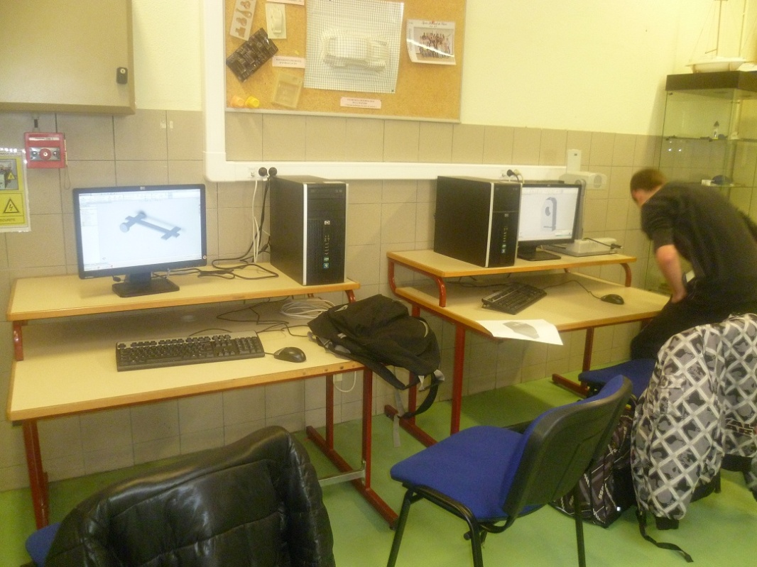
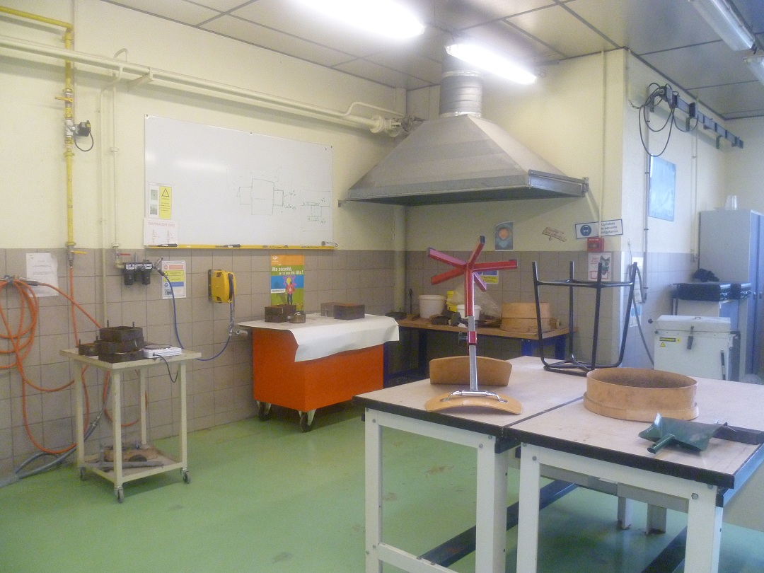
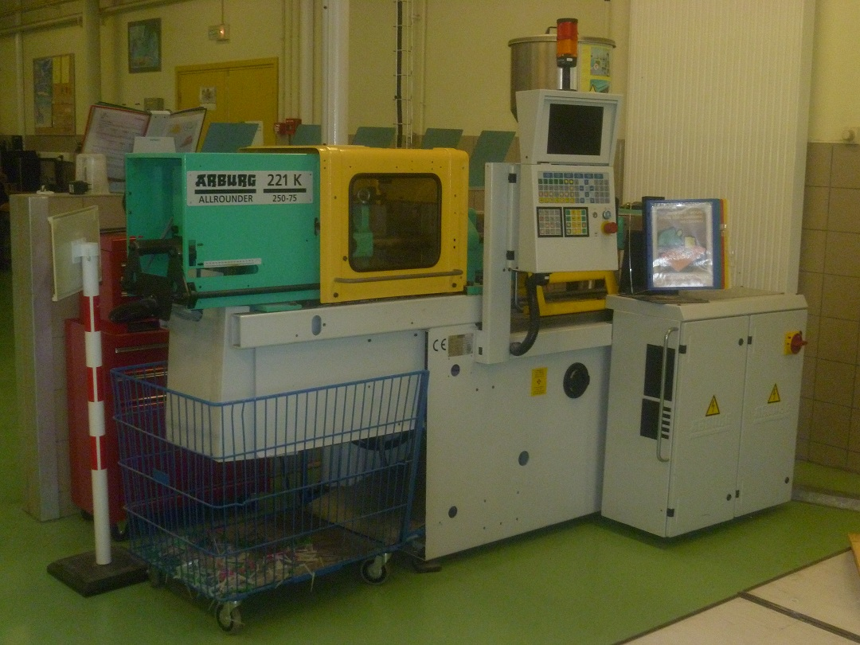
Computer aided design
Materials engineering

Slide 19
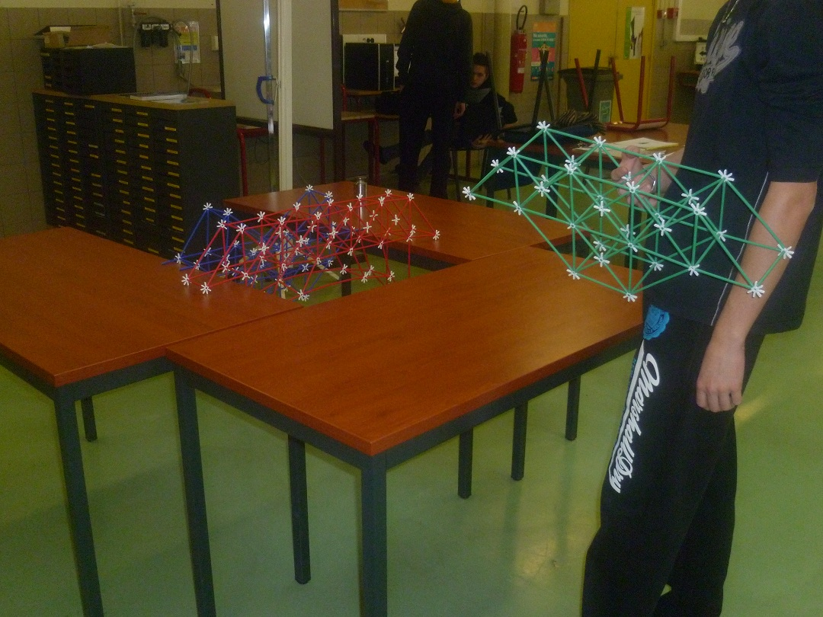
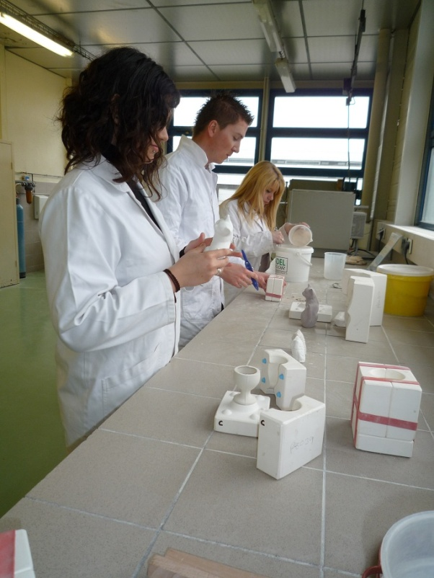
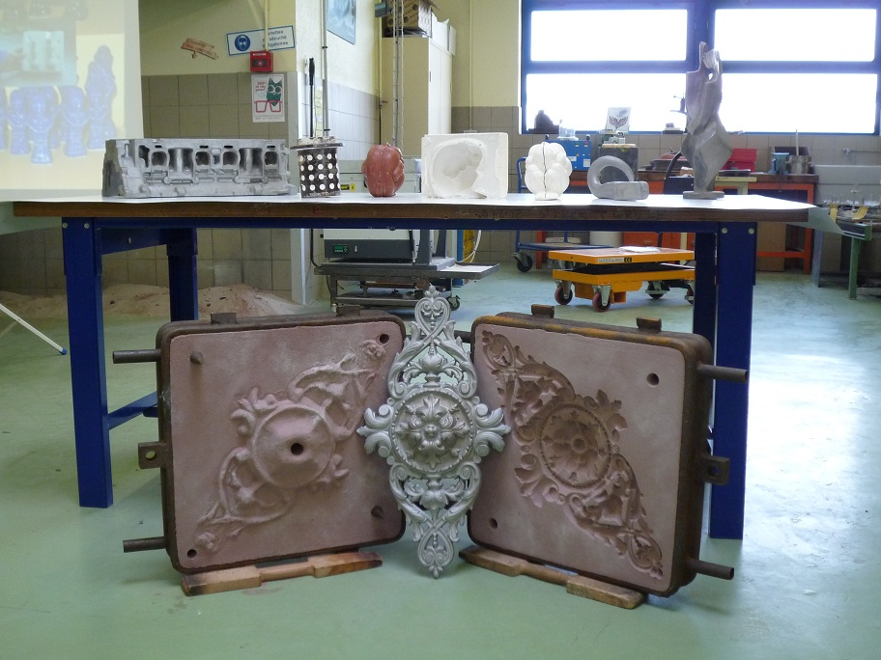
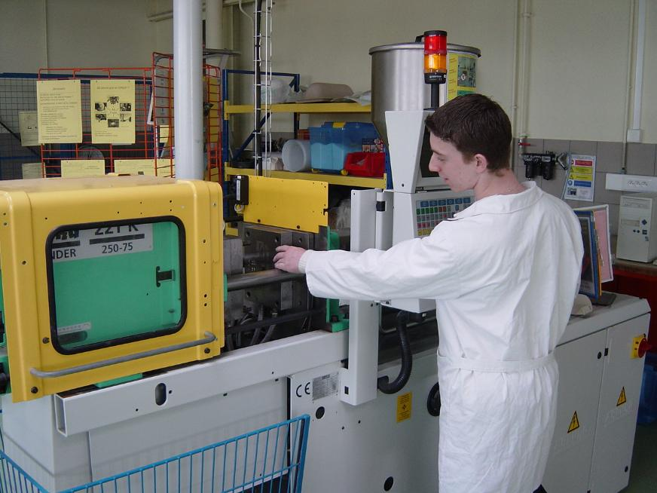
Materials engineering

Slide 20
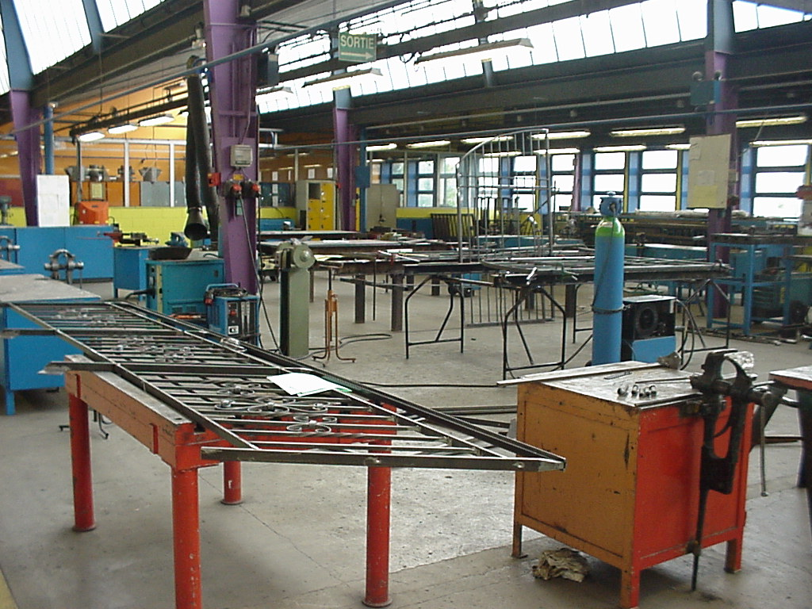
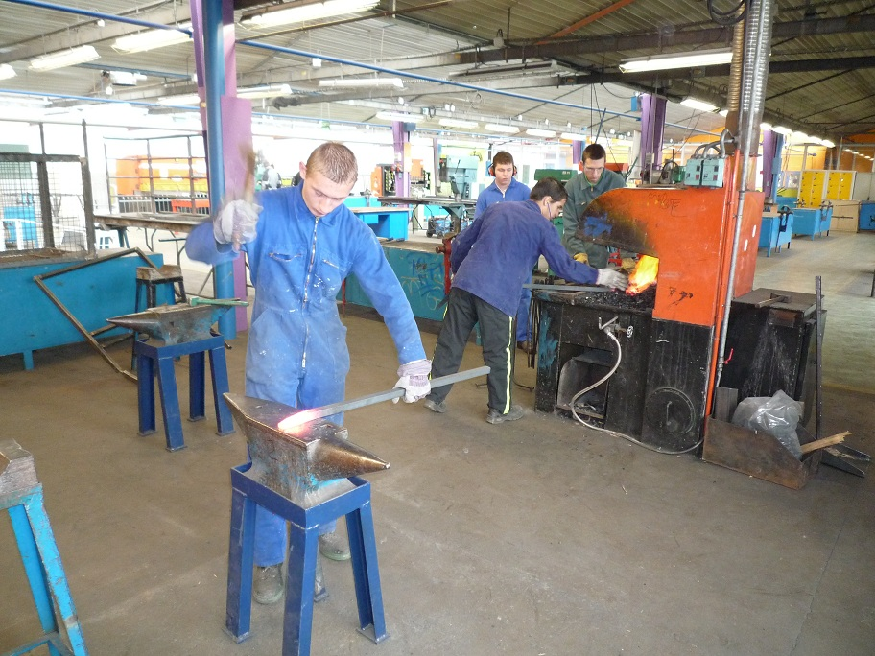
Metalwork

Slide 21
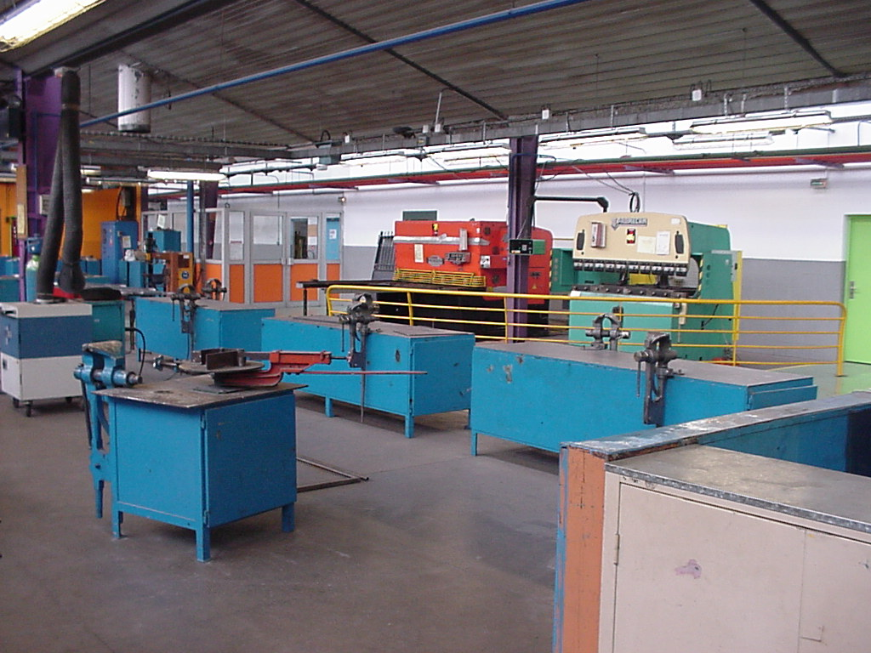

Metalwork

Slide 22


Welding and boiling

Slide 23




Welding and boiling

Slide 24

Productics

Slide 25





Slide 26

Industrial
maintenance

Slide 27


Slide 28


Modeling/prototyps

Slide 29



Electrotechnics

Slide 30


Energy and environment

Slide 31




Slide 32


Engineering

Slide 33


A red cab
Some crazy English teachers

Slide 34


Slide 35


Slide 36

A classroom to teach ‘Prevention of musculoskeletal disorders

Slide 37

Another one to teach ‘First aid’

Slide 38
That’s all… We’re looking forward to hosting you…

