Slide 1

GREEN FRUITS SA Tunisie packaging and transformation of fruits and vegetables
Société Green Fruits S.A au capital de 195.000 DT – M.F./C.D.:1192251Q – R.C.:B2353462011
B.P.70 Rte DE Tozeur –Kebili 4200 tél:+21675491884- Fax: +21675491885
E-mail: contact@green-fruits.com
Site web: www.green-fruits.com

Slide 2
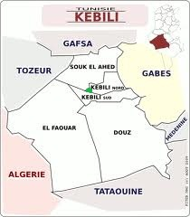
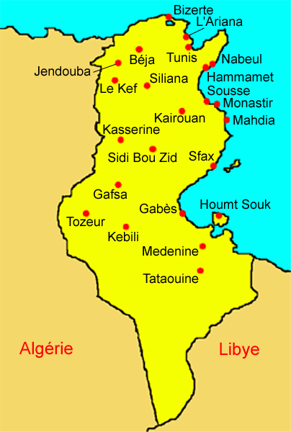
GREEN FRUITS
THE Green Fruits company set up in the industrial zone of kebili, is specialized in the packaging and transformation of fruits and vegetables, and mainly dates.

Slide 3
In order to develop this sector the enterprise in value of dates by developing the by products. The aim is to increase in value the Tunisian dates and to guide it towards an industry of transformation in order to increase its added value.
We collaborate with farmers in order to obtain high quality products while coming up to the expectations of our clients

Slide 4



concerning sanitary rules, the protection of the environment and the international norms, to achieve this purpose, local farmers are at the heart of our activity they benefit from training sessions about the methods of production and the selection of fruits
Our products are marketed under 3 trade marks: GREEN FRUITS, OROS et غلال الخضراء

Slide 5
Nutritional benefits of dates
The benefits of dates are not to demonstrate:
This fruit, full of water and sun kissed, rich in vitamins and minerals containing the essential that our body needs: calcium, magnesium, phosphor, iron and vitamins A and B.

Slide 6
The composition of the date “Deglet Nour” (for 100 grams)
Calories | 306 | Vitamins
Glucose | 73g | B1 | 0.09mg
Water | 20g | B2 | 0.05mg
Proteins | 2.2g | PP | 2.2mg
Lipids | 0.2g | carotene | 0.06mg
Fibers | 2.2g
Potassium | 650mg | Magnesium | 63mg
Calcium | 71mg | Sulphur | 60mg
Phosphorus | 50mg | Iron | 2.1mg
Sodium | 1mg | Manganese | 0.15mg
Chlorine | 250mg | Zinc | 0.35mg
 |  | Copper | 0.4mg

Slide 7
OUR PRODUCTS
Green Fruits condition natural dates in a large range of well-studied package in order to adapt itself to the development of the market and to the habits of the consumption.
Dates:
Dates in branches
Standard (unbranched)dates
Stoned dates
Carved (cut up) dates
Dates with a soft centre
Small box presents

Slide 8
Date by-products:
Green Fruits innovate in the field of date transformation, it always has new date-based products.
Date pastry
Date jam
Date syrup
Energetic date-bar (bar of date)

Slide 9
Date pleasure (pleasure of dates)
Dates with chocolate
Big mix of dates with a soft centre
The single of dates

Slide 10
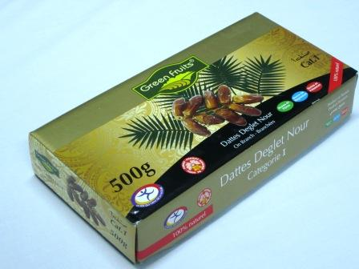
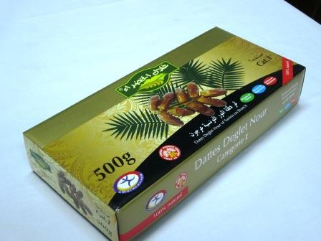
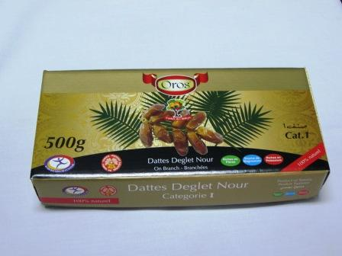
Branched dates
Packet 500g ‘green fruits’
Packet 500g ‘غلال الخضراء’
Packet 500g ‘Oros’

Slide 11
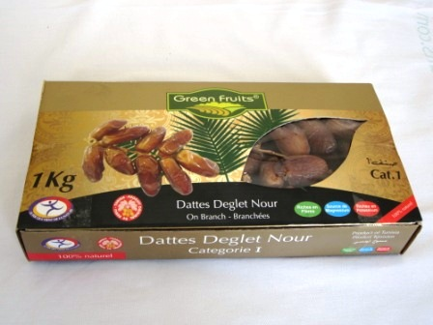
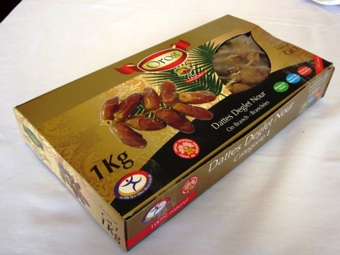
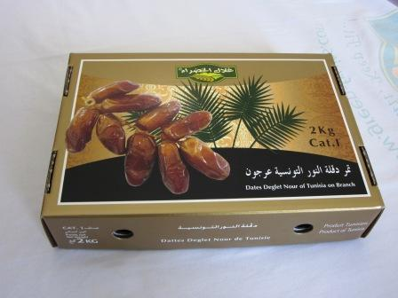
Packet 1 kg ‘Green Fruits’
Packet 1 kg ‘Oros’
Packet 2 kg ‘غلال الخضراء’

Slide 12
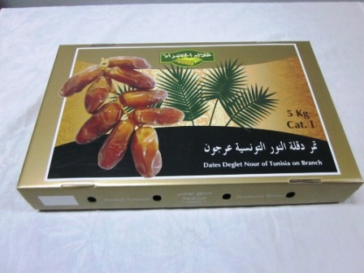
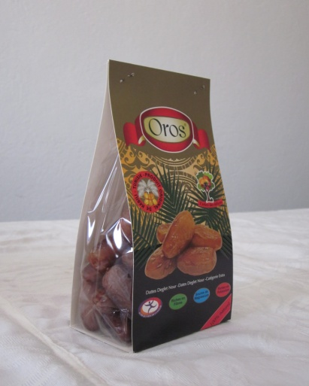
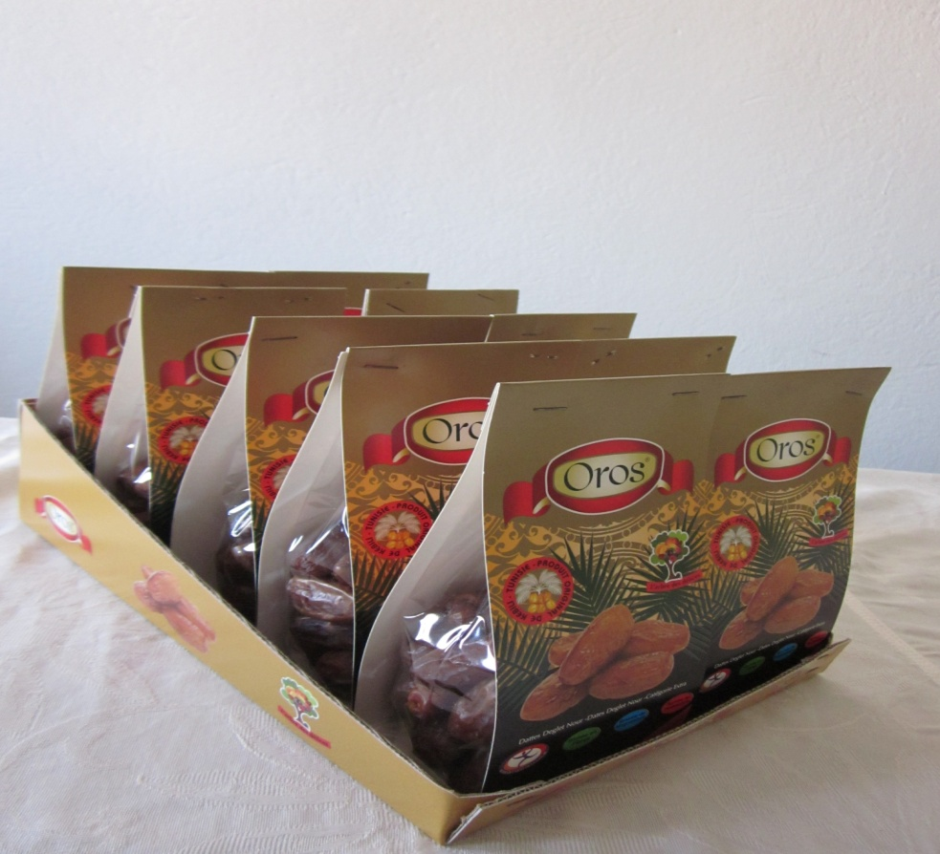
Packet 5 kg ‘غلال الخضراء’
Unbranched dates
dates in bag 250gr

Slide 13
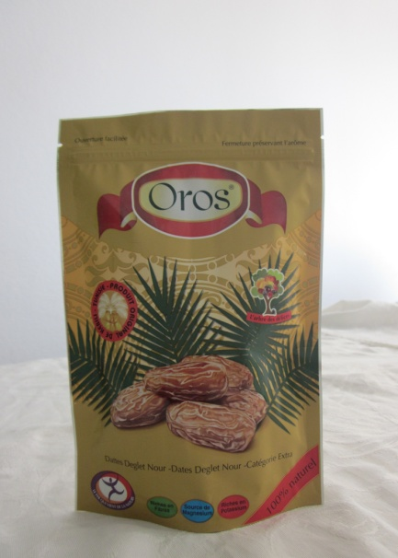
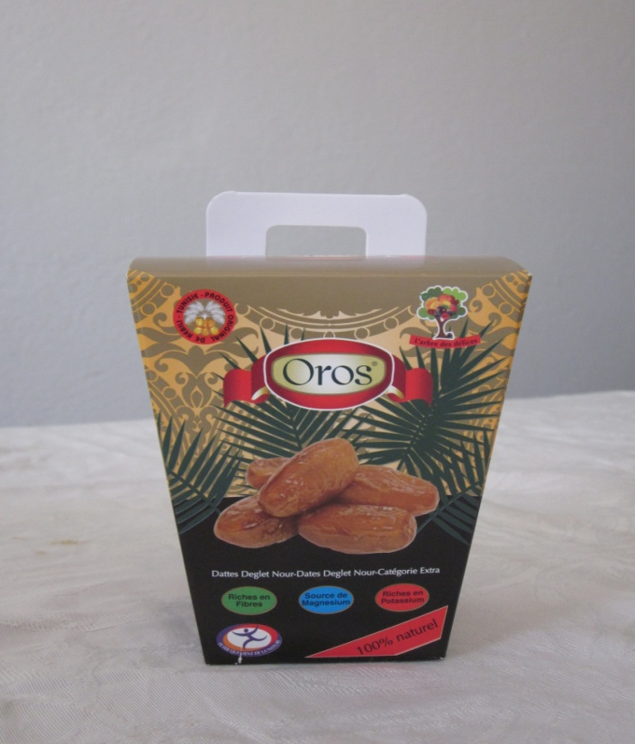
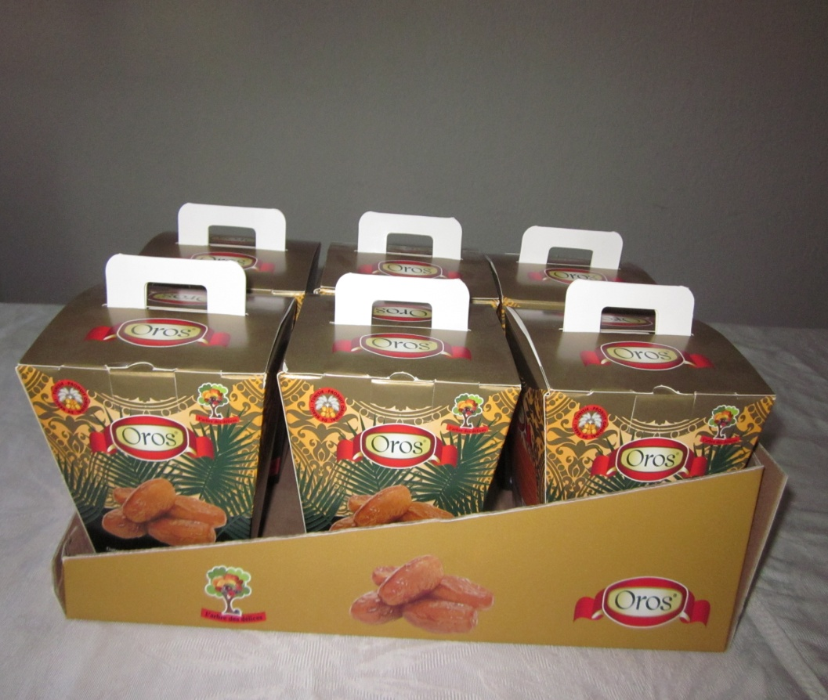
dates in bag 250gr ( doypack)
dates in box 250 gr

Slide 14
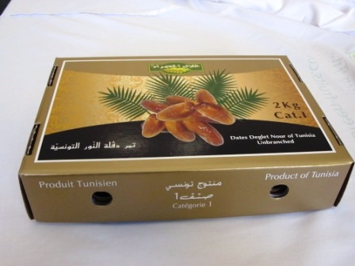
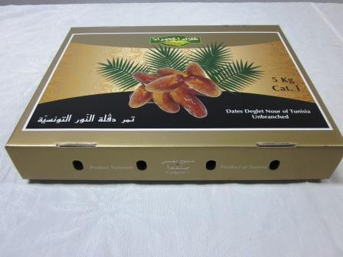
Packet 2 kg
Packet 5 kg

Slide 15
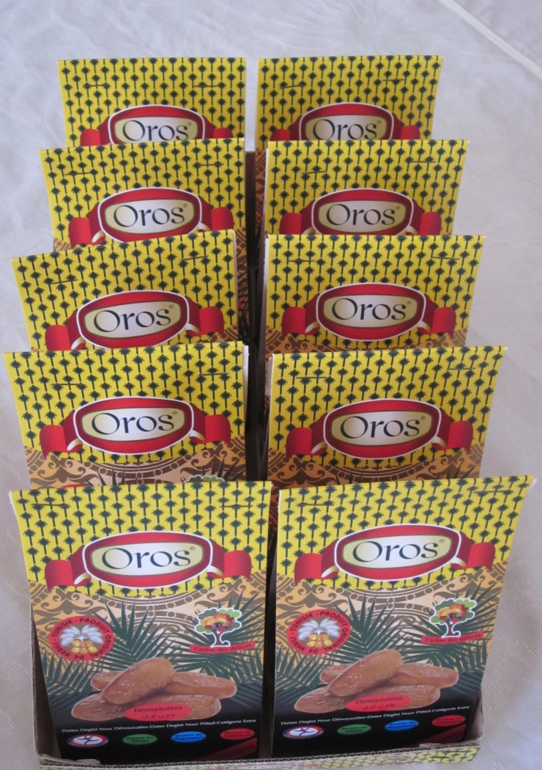
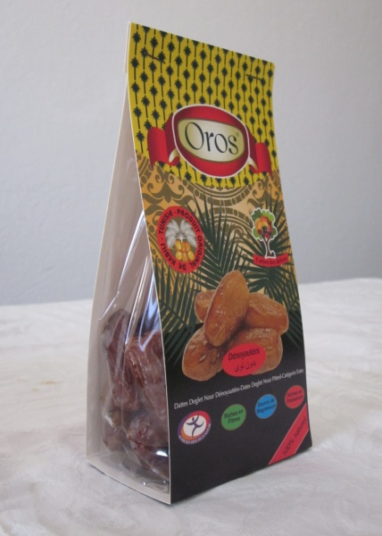
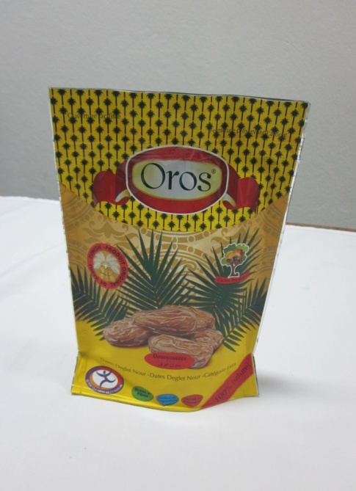
Stoned dates
dates in bag 200gr
dates in bag 200gr(doypack)

Slide 16
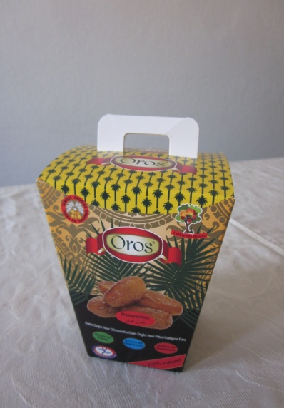
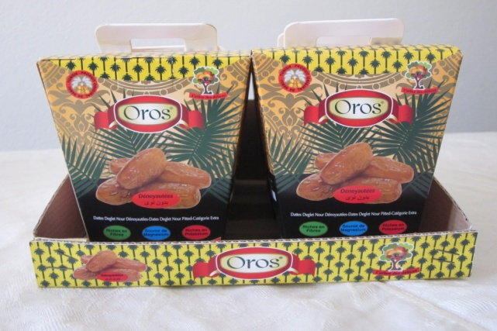
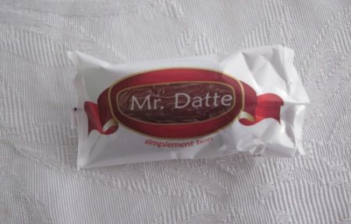
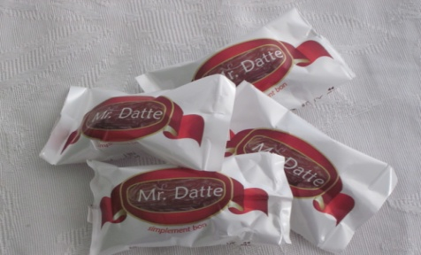
dates in box 200 gr
Stuffed dates
Single of dates

Slide 17
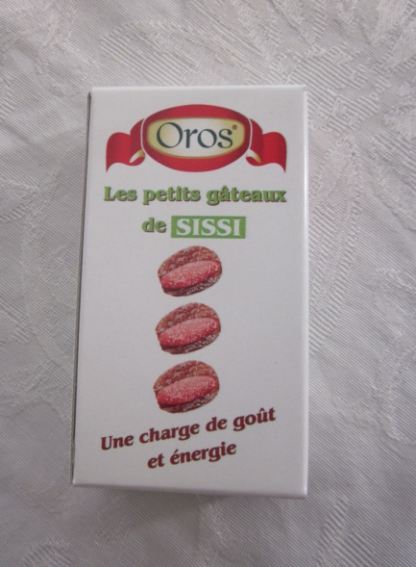
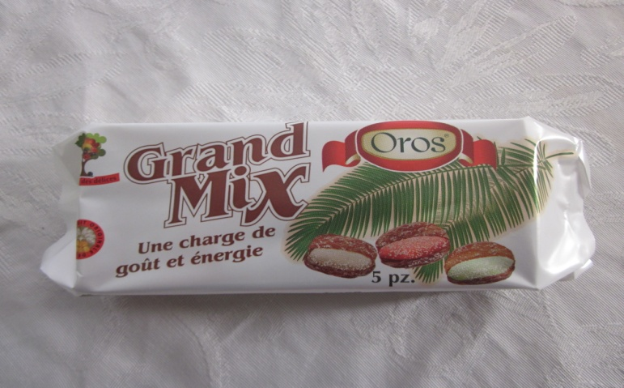
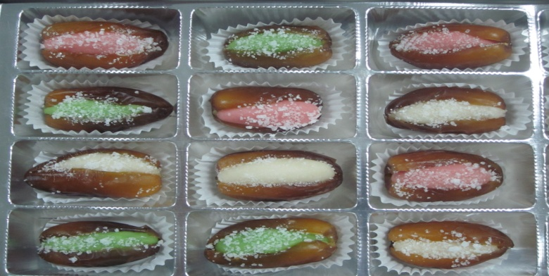
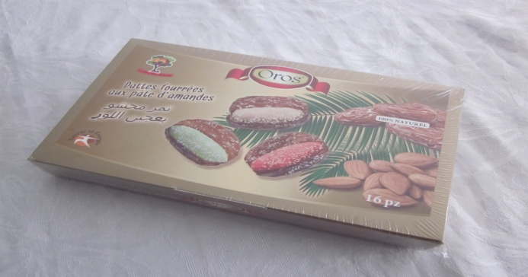
Grand mix stuffed dates
Stuffed dates with paste of almond 16 pcs

Slide 18
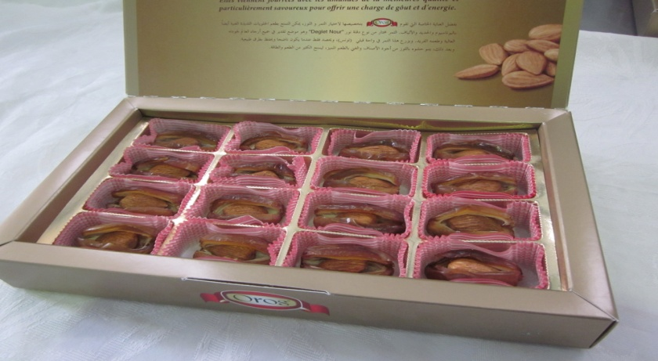
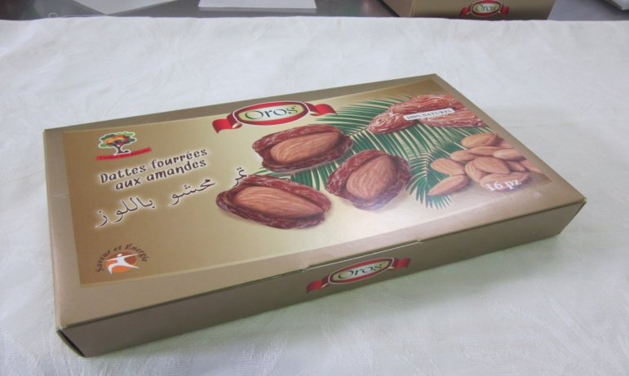
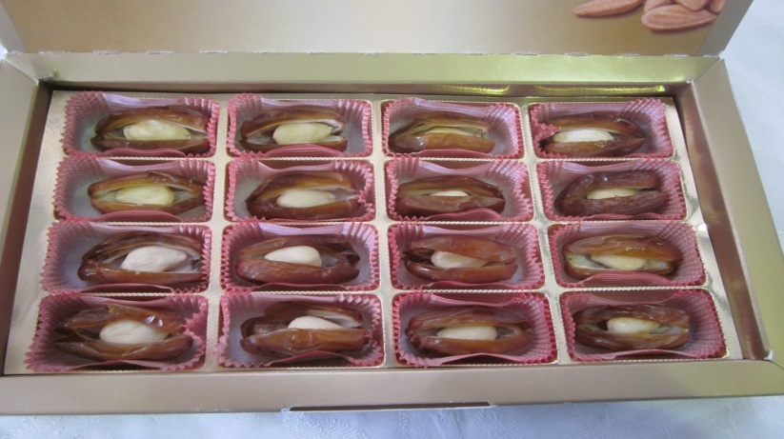
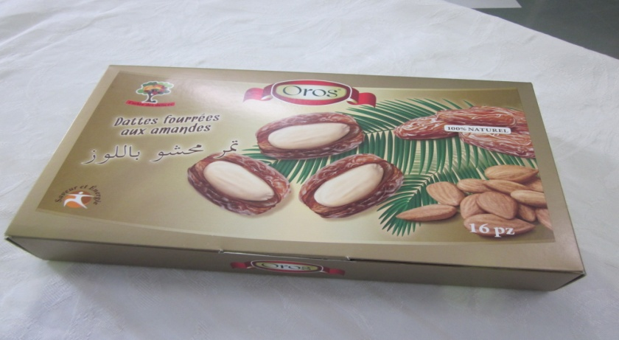
Stuffed dates with red almond 16 pcs
Stuffed dates with white almond 16 pcs

Slide 19
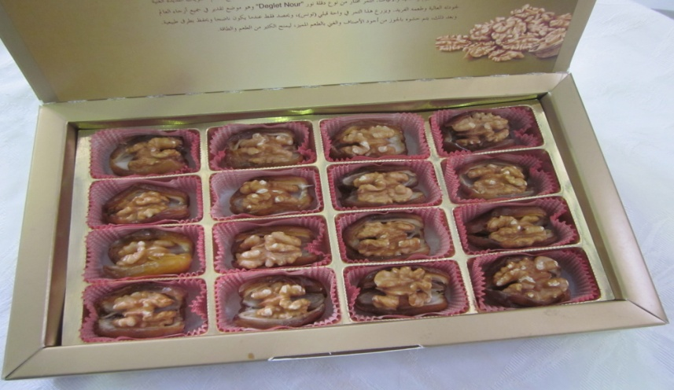
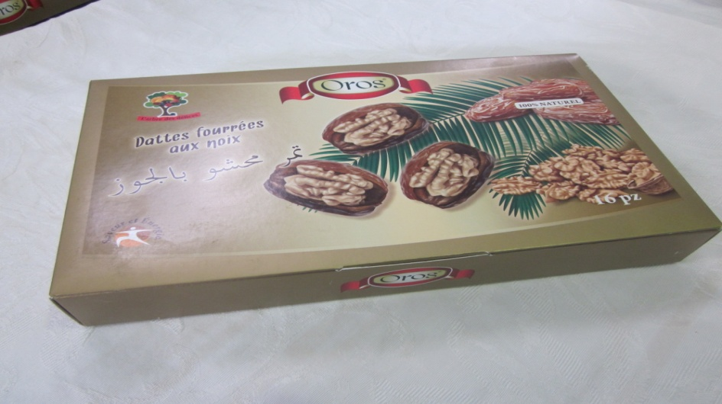
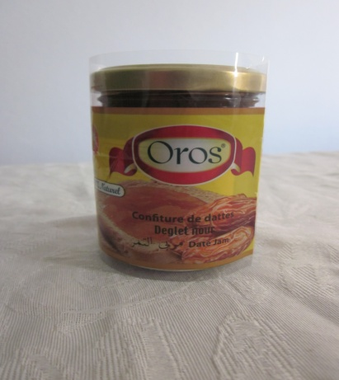
Stuffed dates with nuts 16 pcs
Date jam 250gr and date syrup 250gr

Slide 20
Process and quality policy
The factory:
Welcome the Green Fruits factory. It has two well equipped work rooms. While respecting the demands of the market and above all hygiene.
Green Fruits put very developed equipments at the disposal of its workers in order to well select and increase the value from the supply to the shipment.
Green Fruits owns a laboratory equipped with high technology materials in order to carry out physicochemical and microbiological analyses and in order to assure the conformity and the stability of our products and the security of our consumers.

Slide 21
Certification
Our company has invested since the start in the quality by setting up two quality systems HACCP (ISO 22000) and ISO 9001 that will be completed by the end of 2011.
So, Green Fruits has started the certification Bio with ECO CERT and this will be for the next date season.
Green Fruits collaborate with state and private organisms in order to develop date by products and create new products (arid areas institute, the agribusiness technical centre, the central laboratory of Tunisia…)

