Slide 1
Reversal of pathological pain
through specific spinal GABA_{A} receptor subtypes
Julia Knabl, Robert Witschi, Katharina Ho, Heiko Reinold, Ulrike B. Zeilhofer, Seifollah Ahmadi1,Johannes Brockhaus, Marina Sergejeva, Andreas Hess, Kay Brune, Jean-Marc Fritschy, Uwe Rudolph2,
Hanns Molher & Hanns Ulrich Zeilhofer
Marion Griton
Laurie Robin
Master 2 Neurosciences

Slide 2
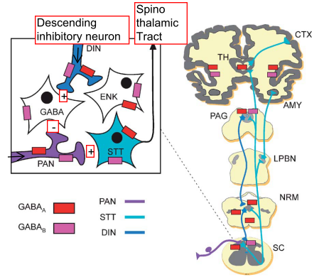
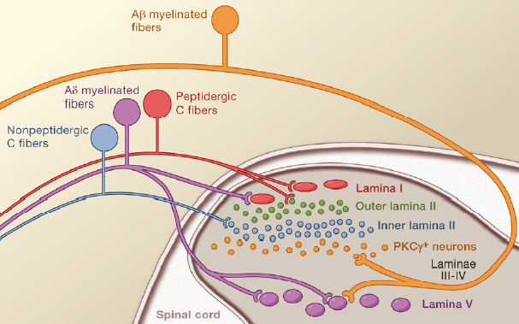

Neuropathic Pain Mechanisms
Pain pathway and GABA Receptor
GABA
+ -
Primary afferent
nociceptive neurons
Enna, adv pharmacol, 2006

Slide 3
Pain pathway and GABA Receptor
Pain pathway and GABA Receptor
Neuropathic Pain mechanism?
Reduction or elimination of spinal cord inhibition
    Ectopic activity in primary afferents
    Induction of central sensitisation in the dorsal horn :
        - Diminution of presynaptic inhibition at the central terminals of myelinated fibers (Wall & Devor 1981)
        - Loss of GABAergic inhibition in the sup dorsal horn (termination of small caliber primary afferents) (Moore, 2002)
    Degeneration of dorsal horn neurons, and especially GABAergic inhibitory neurons

Slide 4
GABA Receptors
2 types of GABA receptors:
GABA_{A}: ionotropic receptor
GABA_{B}: metabotropic receptor
GABA_{A/B} agonist:
hyperalgesia and allodynia
GABA_{A/B} antagonist :
neuropathic pain-like syndrome

Slide 5
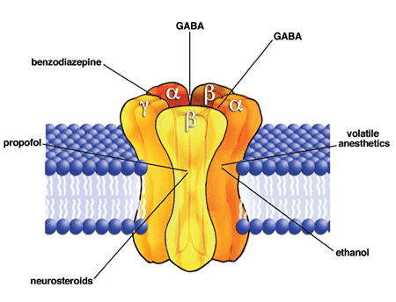
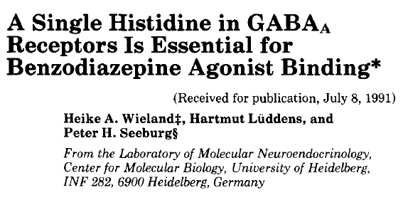
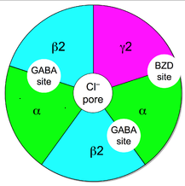
GABA_{A} receptor
α _{1,2,3,5} β γ₂
Sensitive to BZD
Cl- channel
Heteropentameric (5 subunits)
Isoforms of subunits: α β γ δ ε π θ
Notes:
Rajouter A lpha = BZD

Slide 6
Benzodiazepine: how does it work?
GABA_{A} R
Cl⁻
Cl⁻
Cl⁻
-
GABA_{A} R
+
+
-
-
+
GABA
-
+
-
-
-
-
Benzodiazepine
+
+
+
+
Notes:
Once bound to the benzodiazepine receptor, the benzodiazepine ligand locks the benzodiazepine receptor into a conformation in which it has a greater affinity for the GABA neurotransmitter. This increases the frequency of the opening of the associated chloride ion channel and hyperpolarizes the membrane of the associated neuron.

Slide 7
Limits of GABAergic drugs in pain management
Benzodiazepine:
Hypnotic, amnesic, anxiolytic and partly anticonvulsivant effects, are mediated by α1 GABA_{A} receptors subtypes
Rudolph, 1999
Low, 2000
Side effects associated, in particular sedation
Tolerance to GABAergic drugs
Developing subtypes selective agents that target
receptors involved in pain processes
Which α subunit mediate the analgesic effect of BZD?

Slide 8
Methods: Integrative approach
Genetically engineered Mice
Behavioral analysis
Pharmacological analysis
Electrophysiology
Immunofluorescence
Rats
Behavioral analysis
Pharmacological analysis
Functional imaging

Slide 9
What is the GABA_{A}R isoform responsible for the antinociception effect of Benzodiazepine?
Knock-in mice
behavioral study
Pharmacology

Slide 10
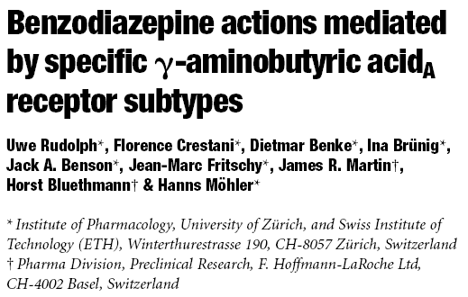
Genetically engineered Mice
GABAA-receptor point-mutated knock-in
mice (α1, α2, α3 and α5)
Insensitive to Benzodiazepine
Notes:
Recombinant diazepam-sensitive receptors can be rendered diazepam-
insensitive by replacing this histidine by arginine without
altering the GABA sensitivity

Slide 11

Genetically engineered Mice
H
WT allele
ELLA -CRE
H
CRE
H
Mutant allele 1
A
NEO
H
A
NEO
Embryonic Stem cells
H
Mutant allele 2
Neomycin
A
NEO
Notes:
Entre dans stem cell par electroporation

Slide 12
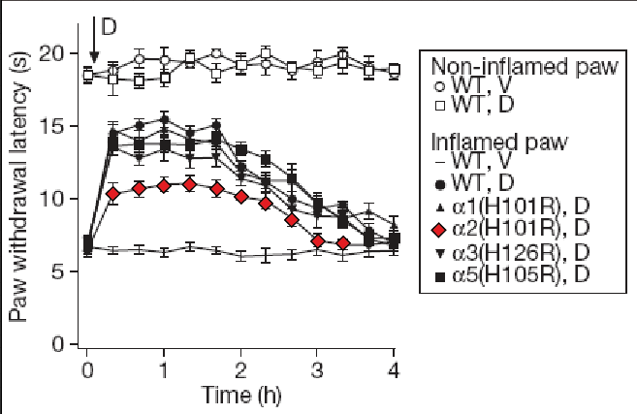
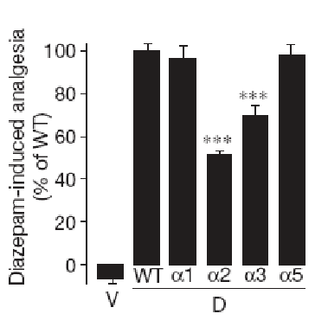

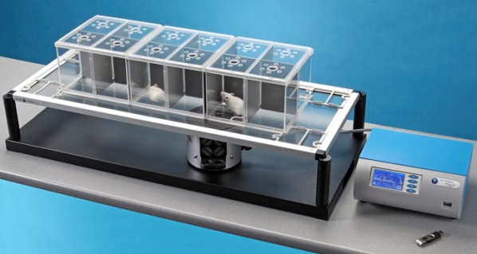


Which α subunits are responsible for the anti-nociception?
Inflammation pain
Zymozan A: induces inflammation pain
Diazepam: Benzodiazepine-binding site agonist
Zymozan A
BZD IT
48 hours
Heat Stimulus
α 2 and α3 subunits: site of action of BZP
Paw withdrawal latencies

Slide 13
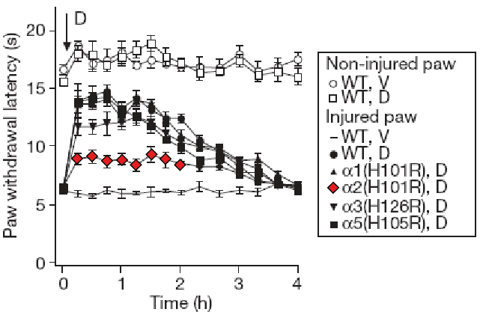
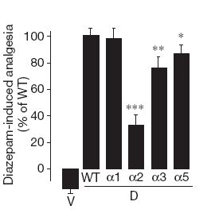
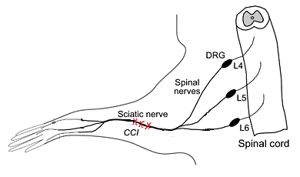
Which GABA_{A} receptor isoforms are responsible for this antinociception?
Chronic contriction injury
Diazepam: Benzodiazepine-binding site agonist
Surgery
BZP IT
7days
α 2, α3 (and α5 subunits): Mediate the effect of BZD
Paw withdrawal latencies

Slide 14
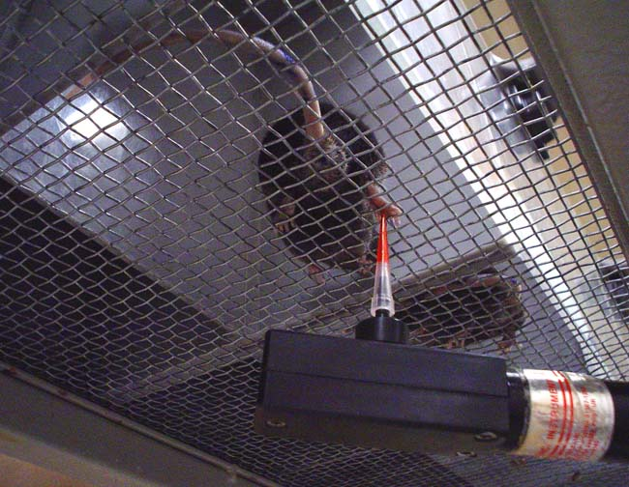

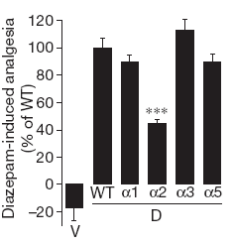
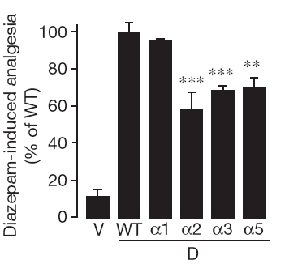
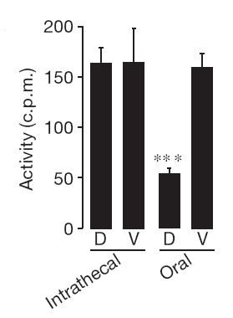
Which GABA_{A} receptor isoforms are responsible for this antinociception?
Chronic contriction injury
Cold Allodynia
Mechanical sensitivity
Acetone
α 2 subunit mediate the nociceptive effects of DZP
α 3 and α 5 subunits mediate the nociceptive effects of DZP (smaller effect)

Slide 15
Where are located the GABA_{A} receptors α subunits responsible for this antinociception?
Knock-in mice
Electrophysiological study

Slide 16
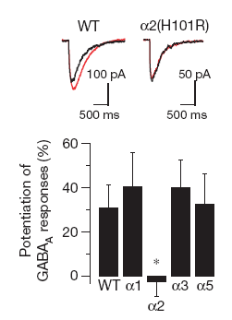
Localisation of GABA_{A} receptor α subunits
Sensitive to Capsaicin
Primary afferent Neurons (Dorsal Root Ganglia)
Whole cell patch clamp
DRG neurons
Dissociation and plated
GABA
BZD
Facilitation of BZP on GABA_{A} Current in DRG neurons are mediated through alpha2
GABA_{A} receptor α2 subunits are located on the presynaptic neurons

Slide 17
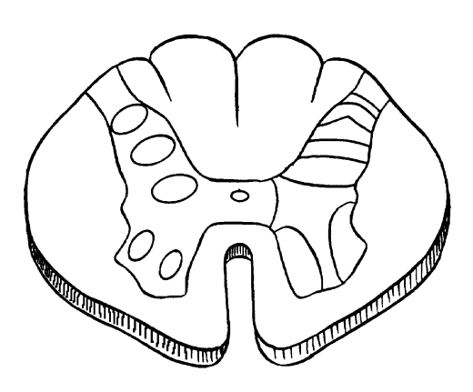
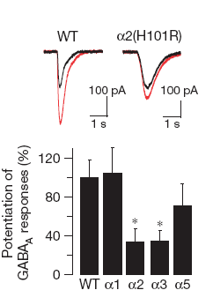
Localisation of GABA_{A} receptor α subunits
Electrophysiological studies
Whole cell patch clamp
Recording Pipette
GABA_{A} receptor α2 and α3subunits are located on the post-synaptic neuron
Notes:
Facilitation of DZP on GABA_{A} Current in superficial dorsal horn Neurons are mediated through alpha2 and alpha 3

Slide 18
Where are located the GABA_{A} receptors α subunits responsible for this antinociception?
Confocal microscopy study

Slide 19
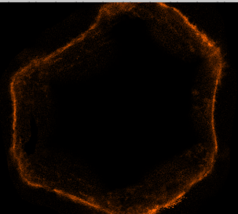
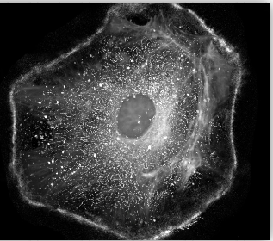
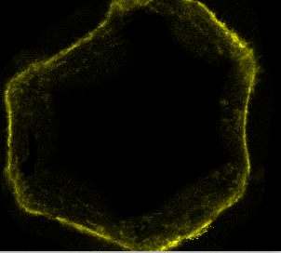
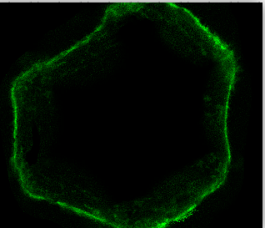
Immunofluorescence
Immunofluorescence
Ab subunit specific antiserum
Y
Y
Y
Y
Doubled labeled objects
Y
Y
Y
Y
Y
Y
Y
Y
Marker for primary peptidergic nociceptors
Y
Ab anti substance P
Y
Y
Y
Marker for intrinsic nociceptive dorsal horn neurons in lamina I
Ab anti NK1 Rec
Notes:
A variety of specimens exhibit autofluorescence when they are irradiated, i.e. when you shine on some molecule you may see light of different colour emitted from those molecules. The molecule absorb high-energy light (exciting light) and then emits a photon with less energy.
To study animal tissue, we can add fluorochromes which fix to specific part of the tissue.
Immunofluorescence involve the use of antibodies to which a fluorescent marker has been attached. Antibodies recognise and bind selectively to specific target molecules in the cell.
The fluorescent signal can be amplified by using an unlabelled primary antibody and detecting it with labelled secondary antibodies.

Slide 20
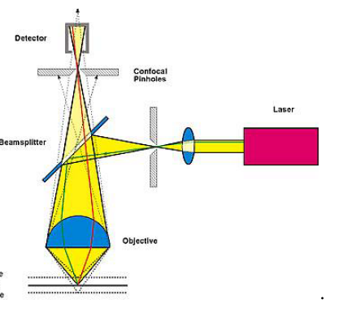
Confocal
Microscopy
Vs regular?
  Pinhole
  AND
  Laser
  Photomultiplier detector
  Computer
Advantages
  Better resolution
  3D images
  Thicker samples
Photomultiplier detector
Computer
Confocal pinhole
Laser
Sample to study

Slide 21
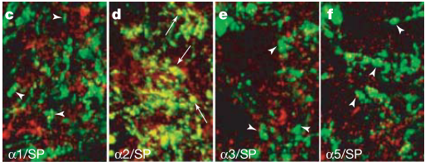
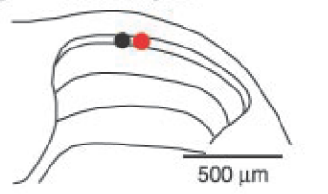
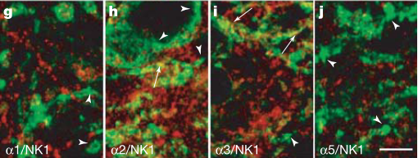
Localisation of GABA_{A} receptor α subunits
Localisation of GABA_{A} receptor α subunits
Colocalisation Subst P/ α2 subunit in lamina 2
GABA_{A} receptor α2 and α3 subunits are located on the post-synaptic terminals
α2 are located on the presynaptic terminal
SP = presynaptic
Colocalisation NK1R /α3subunit in lamina 1
NK1R = postsynaptic
Specific subunits Ab
SP/ NK1R Ab
Colocalisation

Slide 22
Is this antinociception effect achieved by systemic treatment with subtype-selective benzodiazepine-site agonist?
Pharmalogical/behavioral study
Subtype-selective BZD-site agonist??
L-838.417: antagonist α1
partial agonist at α2, α3 and α5

Slide 23
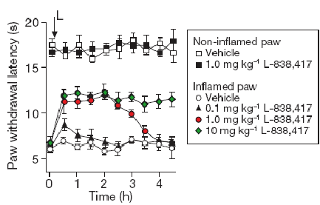
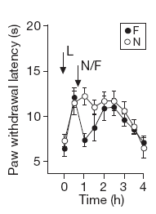
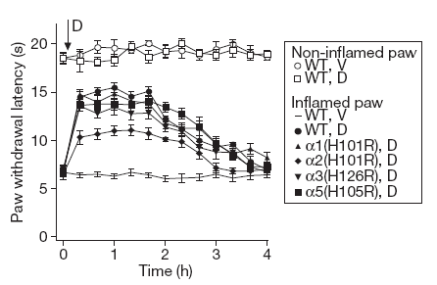
Treatment with a subtype-selective BZD-binding site agonist
L-838.417: antagonist α1
partial agonist at α2, α3 and α5
T1/2 to short in mice
Rats
Injection of L-838,417
+
Heat stimulus
Zymozan A
Dose-dependant
effect
6 hours
BZD site
Opiodergic pathway not involved
Partial agonist
Paw withdrawal latencies
Flumazenil = BZD binding site antagonist
Naloxone = Opiod Receptor Antagonist

Slide 24
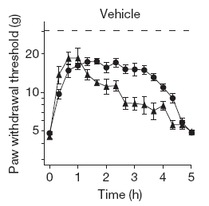

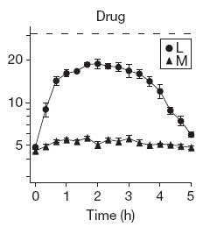
Effect of a chronic treatment with a subtype-selective BZD-binding site agonist
Effect of a chronic treatment with a subtype selective drug
L-838.417: antagonist α1
partial agonist at α2, α3 and α5
Same analgesic effect
Surgery
Treatment
Heat stimulus
0
16 days
10
injection of vehicle
injection of Morphine
or L-838
L838
No loss of efficacy
Morphine
or
L838
Notes:
Morphine ttt référence for major pain

Slide 25
Does it modify the representation of pain in the central nervous system?
Functional MRI study

Slide 26
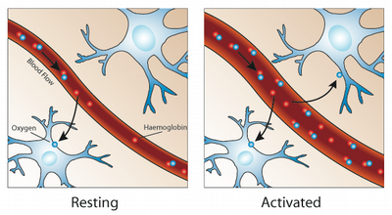
Functionnal MRI
Technique:
  Mesure blood flow related to neural activity (Blood oxygenation level dependant: BOLD)
  Map brain with changes in paramagnetic desoxyhemoglobin content
Bruce, Neuroimage, 2011

Slide 27
Functionnal MRI
Advantages
  Correlated to oxygen consumption in healthy subject : Brain function map
  Used since years to assess neuronal activity
Drawbacks
  Moderate spatial/temporal resolution: 1 voxel = 1 to 4 mm²
  Indirect measure of neural activity:
    Implies a stable CBF/CMRO² ratio
    Difficulties to analyse in pathologic state: changes with age, disease, pharmacological manipulation
  Needs anaesthesia ( & pain evaluation?)

Slide 28
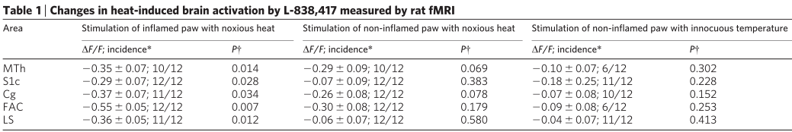
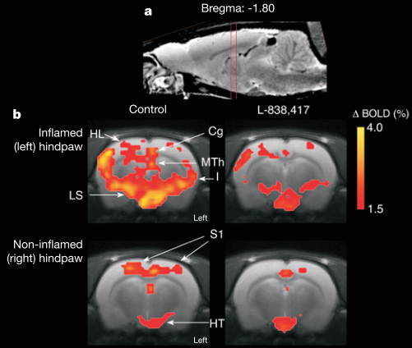
Is the representation of pain also reduced with subtype-selective BZD-binding site agonist?
Hyperalgesia
Emotional component
Limbic system
Frontal association cortex
Emotional, sensory and discriminative component are reduced with α1 sparing BZP ligand in neuropathic pain
Zymosan
Sensory & discriminative
component:
Medial thalamus Controlateral
Primary sensory cortex
Notes:
HT hypothalamus
HL representation of hindlimb in S1
FAC frontal association cortex
LS: Hippocampus, amygdala, entorhinal cortex)
Imaging with noxious heat

Slide 29
Conclusion
Points of interest
Integrative approach with complementary techniques
Several models of pain:
  Inflammatory pain
  Neuropathic pain
Major potential clinical interest

Slide 30
Take home message
Neuropathic pain is mediated by:
α2 and α3 GABA_{A} subtypes receptors
in pre and post synaptic GABA_{A} receptor
α1 sparing BZP ligand (partial agonist at α2 and α3)
in neuropathic pain:
Can reduced pain behavior to thermal nociception
Reduced pain representation (discriminative and emotional components)
Avoid benzodiazepine side effects (hypnotic, addictives properties)

Slide 31
Thank you for your attention

