Slide 1

Calcium Triggers Exocytosis from Two Types of Organelles in a Single Astrocyte
Tao Liu & al J.Neuroscience 2011
Julie JEZEQUEL
Lila KHENNOUF
UE NBCM
22 Nov. 2011
Notes:
Today Julie and I are gonna talk about a paper called « calcium triggers exocytosos from two types of organelles in a single astrocytes ». It has been published a few month ago in Journal of Neurosciences

Slide 2
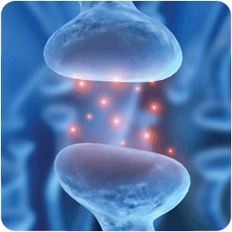
Exocytosis in neurons
Small clear vesicles for neurotransmission
Large dense core vesicles for neuropeptides and hormones
Notes:
In neurons, exocytosis has been well defined. It’s regulated by calcium and allows the release of neurotransmitters and hormones. About vesicles, in nerve terminals synaptic vesicles are used for neurotransmission, and in neuroendocrine cells large dense-core vesicles are used to release neuropeptides and hormones. In many types of neurons we can find both types of vesicles.

Slide 3
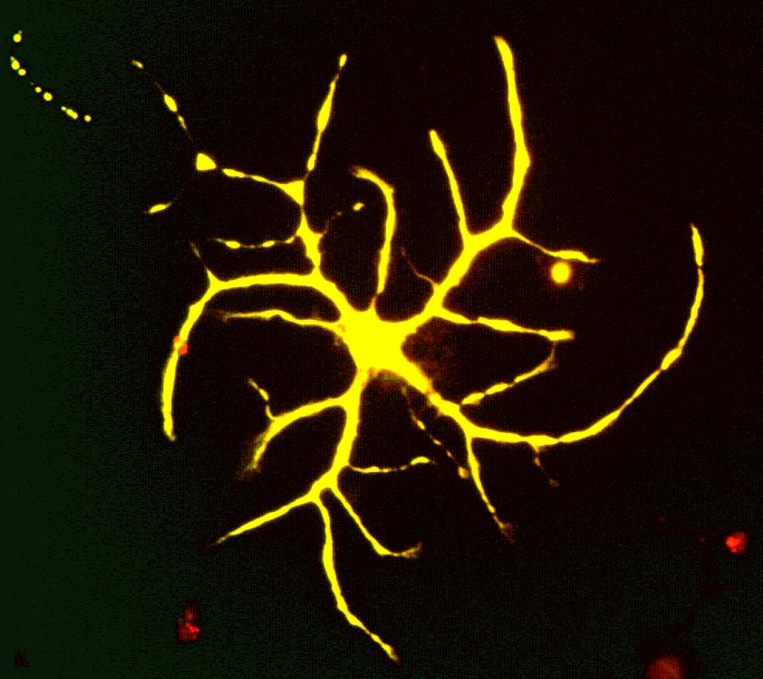
What about astrocytes ?
Activity-dependent regulation of synaptic functions
Gliotransmitters
ATP
D-Serine
Aspartate
GLUTAMATE
Notes:
What about astrocytes?
They represent 90% of brain cells and perform many functions, including provision of nutrients to the nervous tissue, maintenance of extracellular ion balance, and a role in the repair and scarring process of the brain and spinal cord after an injury. Research since the mid-1990s has shown that astrocytes propagate intercellular Ca²⁺ waves over long distances in response to stimulation, and, similar to neurons, they release gliotransmitters in a Ca²⁺-dependent manner. They’re able to release ATP, D-serine, Aspartate and more importantly in this publication, glutamate.

Slide 4
An exocytosis still under debate
Different papers:
Small vesicles with VGLUT and Syb2. Ca²⁺ dependent exocytosis.
Lysosome (FM1-43). Ca²⁺ dependent exocytosis.
Investigation of vesicles with Ca²⁺ dependent exocytosis in the same astrocyte
Notes:
But how are these gliotransmitters released? The mechanisms are still under debate and some data have already been published. We already know that VGLUT1 and Syb2 are localized on small vesicles and that their exocytosis is Ca2+ dependent. Another group found by means of FM1 43 labeling and TIRM technic that lysosome are also found in astrocytes and their exocytosis is also calcium dependent. In this article they want to investigate this type of vesicles and their release properties in the same experiment.

Slide 5
PART 1
Coexistence of small vesicles and lysosomes in astrocytes ?
Notes:
The first question the authors wondered is : does small vesicles and lysosomes coexist in astrocytes ? In fact, this is not a real question because, as Lila just said before, it is already known that small vesicles and astrocytes coexist in atsrocytes. But, to go on, the authors have to prove it in their experimental conditions.

Slide 6
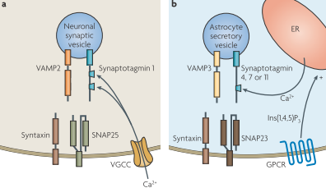
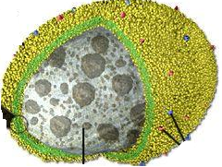
How to distinguish small vesicles and lysosomes ?
Hamilton et Attwell 2010
Synaptobrevin 2 = VAMP2
Cellubrevin = VAMP3
LAMP1
Notes:
To prove the coexistence of the two organelles, they need to be able to distinguish them.
How ? They relied on the resident proteins that are present in the membranes to label lysosomes or vesicles. In the case of vesicles, they choosed to target 2 VAMP proteins : synaptobrevin and cellubrevin. In the case of lysosome, they labeled LAMP1, a Lysosome Associated Membrane Protein.

Slide 7
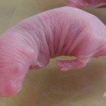



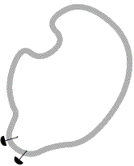

General protocol
Immunofluorescence detection
Culture of
HPC astrocytes
0-1d old
Small vesicles detection
Lysosomes
detection
Alexa Fluor
+ Ab II
Alexa Fluor
+ Ab II
Alexa Fluor
+ Ab II
Ab I
vs Syb2
Ab I vs cellubrevin
Ab I
vs LAMP1
Notes:
How it works ?
They did a culture of astrocytes extracted from the hippocampus of new born mice. Then, they try do detect small vesicles and lysosomes in those astrocytes thanks to immunofluorescence detection. For that, they coupled the resident proteins I’ve just shown you before with a first Ab. And, this Ab is in turn detected with a secondary Ab coupled to a fluorophore : Alexa Fluor. It’s the same construct for the lysosome detection.

Slide 8
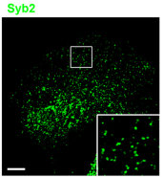
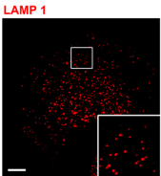
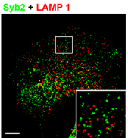
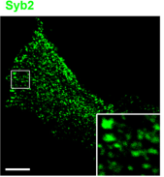
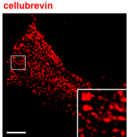
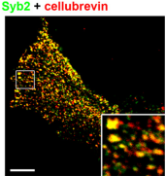
1 – Do small vesicles and lysosomes coexist
in hippocampal astrocytes ?
Both small vesicles and lysosomes present
in cultured astrocytes
Notes:
This is what they obtained.
First, they detected the fluorescence of Syb2, the SV protein and the fluorescence of LAMP1, the lysosomal protein. And when they superimposed the two signals, they found no colocalisation.
They did the same between Syb2 and cellubrevin, two small vesicle proteins → and hopefully, they found a colocalisation.
So, they were able to conclude that small vesicles and lysosomes are both present in the cultured astrocytes. And they seem to form distinct compartments

Slide 9
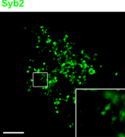
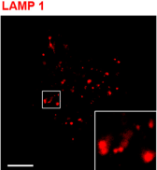
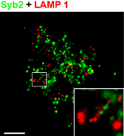
2 – What about freshly isolated astrocytes ?
→ Both small vesicles and lysosomes present
in freshly isolated astrocytes
Notes:
Since astrocytes may have a different protein expression in culture conditions , they reproduced the experiment in freshly isolated astrocytes. As previously, they found no colocalisation between LAMP1 and Syb2.
So, SV and lysosomes are also present in freshly isolated astrocytes.

Slide 10

An other way to label organelles membranes
FM1-43 = lipophilic marker
Used to monitor vesicle fusion in neurons
FM1-43 seems to only label lysosomes in astrocytes
(Zhang et al 2007, Li et al 2008)
→ Does FM1-43 only label lysosomes in cultured hippocampal astrocytes ?
Notes:
The precedent results were obtained by labelling the resident proteins of the organelles. But, it exists an other way to label membranes : FM dyes and in particular, FM1-43. It is a lipophilic marker which penetrates in lipidic environments. So, it is classically used to monitor vesicles fusion in neurons. The problem is that, in astrocytes, FM1-43 seems to only label lysosomes.
So the authors wondered if FM1-43 could also label SV in cultured astrocytes.

Slide 11
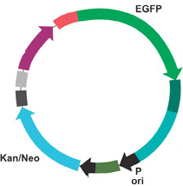
Protocol
24h
24h
Transfection
Fluorescence detection
Culture of
HPC astrocytes
48h
EGFP-Syb2
- Lysotracker → lysosomal marker ?
- FM1-43 ?
Colocalisation with
EGFP-LAMP1
Notes:
Used an other way to label organelles → fusion protein transfected in astrocytes
Avantages détection protéines de fusion par rapport aux complexes fluorochromes ?

Slide 12
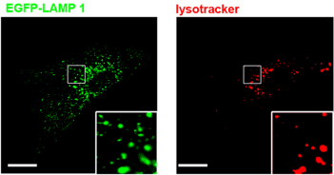
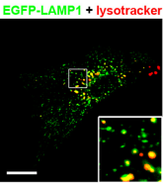
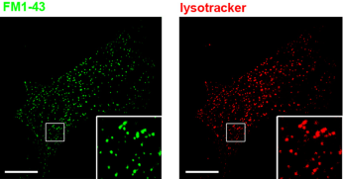
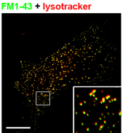
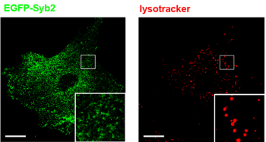
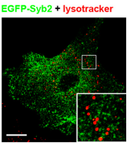
3 – Does FM1-43 label small vesicles ?
→ Lysotracker labels lysosomes but not small vesicles
FM1-43 labels lysosomes
FM1-43 + EGFP-Syb2 ?
No direct evidence that FM1-43 does not label small vesicles !
Notes:
To detect the proteins, they don’t use Ab anymore but fusion (recombinant?) proteins.
So, the lysosomes are labeled with EGFP-LAMP1 and the small vesicles with EGFP-Syb2.
First, they superimposed the fluorescence signal of EGFP-LAMP1 and lysotracker, awhich is known to label lysosome. They found a colocalisation. They did the same between EGFP-Syb2 and lysotracker : no colocalisation. So, we can say that lysotracker only labels lysosomes.
Then, they did the same between FM1-43 and lysotracker →colocalisation.
What about SV and FM1-43 ??? This was their initial question and they didn’t compare FM1-43 and EFGP-Syb2 signals… So there is no direct evidence that FM1-43 doesn’t label SV.
We tried to understand this problem : our first hypothesis is that FM1-43 and EGFP-Syb2 both emit green fluorescence, so they cannot distinguish them but this would be quite ridiculous… So, our second hypothesis is a technical limitation. All the plasmids they used are gifts. So we think that they may not have the technical equipment to do transfections …

Slide 13
PART 2
Are both types of organelles responsible for exocytosis in astrocytes ?
Notes:
Now they are sure that SV and lysosomes are both present in astrocytes, they can investigate if those two organelles are responsible for exocytosis.

Slide 14
How to investigate exocytosis in astrocytes ?
Small vesicles
Mechanical stimulation
Lysosome
Ca²⁺
RE
Ca²⁺
?
Notes:
So first point to discuss is : how to investigate exocytosis in astrocytes ? You know that astrocyte, although not electricaly active, can be activated by intracellular calcium elevations. There is different manners to increase the intracellular level of Ca and the authors used a mechanical stimulation. This induces the release of Ca from the endoplasmic reticulum stocks. And they observed if this Ca triggered exocytosis from both organelles. The second point to consider is : How to track live exocytosis ?

Slide 15
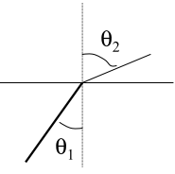
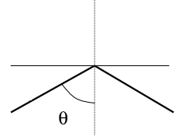
How to track live fusion events ?
→ TIRFM = Total Internal Reflection Fluorescence Microscopy
Classical fluorescence
TIRF
TOTAL
REFLECTION
Cell
≠
Air
REFRACTION
→ Excites all the fluorophores present in the cell
→ Excites the fluorophores close to the membrane
Notes:
The idea is that you need a technique that allows you to detect one organelle fusion, which is a fast event, and to detect it where it happens. For that, they used TIRFM. This technique has been developed to observe single particule fluorescence at surfaces or interfaces.
So how does it fonction ? In classical fluorescence microscopy, the incident light is in part refracted and in part reflected. In TIRFM, the light beam is totally reflected. It is the name of the technique !
The interest of this is that, in classical fluorescence, all the fluorophores present in the cell are excited. In TIRFM, the light only excits the fluorophores present close to the membrane. So it is much more precise.

Slide 16
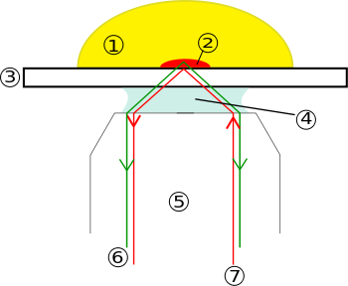
Global TIRF concept
Astrocyte
Non excited fluorophores
Excited fluorophores
Evanescent wave
100^{n} nm
Incident light beam
OBJECTIVE
Notes:
To illustrate it in practice, a little scheme. You have your astrocyte on your cover slip. The objective of the microscope is here. The incident light beam is going to be totally reflected when it reaches the interface between the cell membrane and the cover slip. It generates an evanescent wave in the specimen. You can imagine this as a wave of excitation penetrates only on few hundred nanometers in the cell. So, it only excits the fluorophores present in this field and not all the fluorophores of the cell, as in classical fluorescence.

Slide 17
TIRFM | CLASSICAL FLUORESCENCE
Restricted excitation | Global excitation
Single fusion detection | Global fusion detection
Fusion kinetics | -
Photobleaching and noise -- | Photobleaching and noise +++

Slide 18
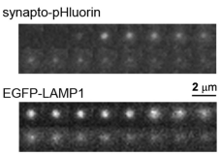


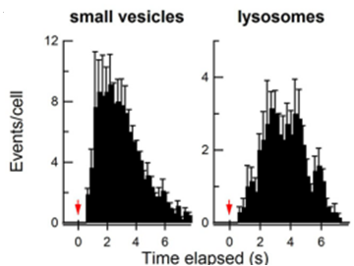
Live imaging of small vesicle & lysosome fusion
Synapto-pHluorin
Syb2
pH sensitive-GFP
Ca ²⁺
signal
pH 5,5
pH 7
EGFP-LAMP1
Small vesicles exocytosis > lysosomes exocytosis
Notes:
The authors labeled the SV with synaptopHluorin, a pH sensitive form of GFP coupled with syb2. As you know, it emits fluorescence at a neutral pH. The lysosomes were labeled with EGFP-LAMP1. And they observed exocytocis of both organelles after a mechanical stimulation.
The frames that you can see here represent the fluorescence along the time of a fusion event. What is important in fact is the quantification. There is around 3 times more fusion events of SV than lysosomes.
(We can notice a little problem here : SV are labeled with a pH sensitive fluorophore but lysosomes are not. So, in theory, these two signals aren’t comparable. But, we think that if they took the risk to compare them, it’s because they mesure the 2 phenomenons in differents cells and they normalize their results …)
Threshold of detection : sudden increase of fluorescence = fusion event

Slide 19
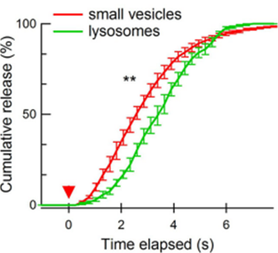
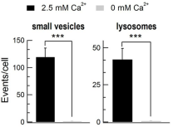
Properties of small vesicle & lysosome fusion
→ Faster exocytosis for small vesicles than for lysosomes
→ Both types of exocytosis are Ca²⁺- dependent
Notes:
Next, they looked at the kinetics : they saw that small vesicles fuse more rapidly with the membrane than lysosomes.
At last, they investigated if both types of exocytosis are Ca-dependent. They compared the number of fusion events with and without Ca and they found that Ca is necessary for the exocytosis of both organelles.
But, in this experiment, they worked on a population of astrocytes. So, they cannot directly compare the kinetics of both types of exocytosis.

Slide 20
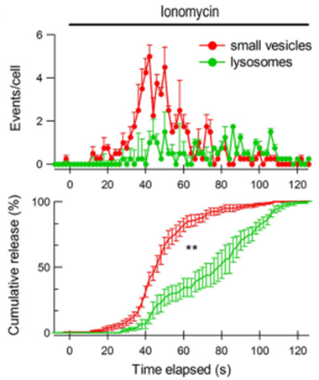
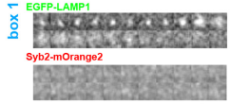
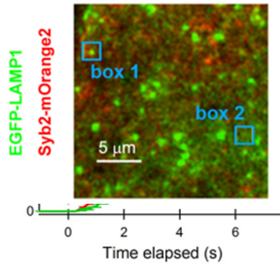
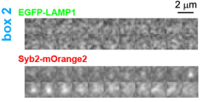
Live imaging of both organelles fusion in the same astrocyte
Small vesicule fusion > lysosome
Faster exocytosis for small vesicle
EGFP-LAMP1
Syb2-mOrange2
Notes:
To make direct comparison between small vesicles and lysosomes, they visualized Syb2 and LAMP1 simultaneously in the same astrocyte.
This is THE experiment of the paper. The novelty is really that they observe both types of exocytosis, in the same cell, at the same time and under the same stimulus.
They labeled SV with mOrange2 and lysosome, still with EGFP. As before, they quantified the fusion events after calcium stimulation. Again, the number of fusion events is around three times higher for small vesicles. And again, they fused more rapidly than lysosomes
These results established that both small vesicles and lysosomes are Ca regulated releasable vesicles and they possess distinct exocytosis kinetics.

Slide 21
Brief data summary
PART 1
Small vesicles and lysosomes present in cultured and fresh astrocytes
PART 2
2 types of release : small vesicles and lysosomes
Distinct exocytosis kinetics
Both types of exocytosis are Ca²⁺- regulated

Slide 22
PART 3
Functional role ?

Slide 23
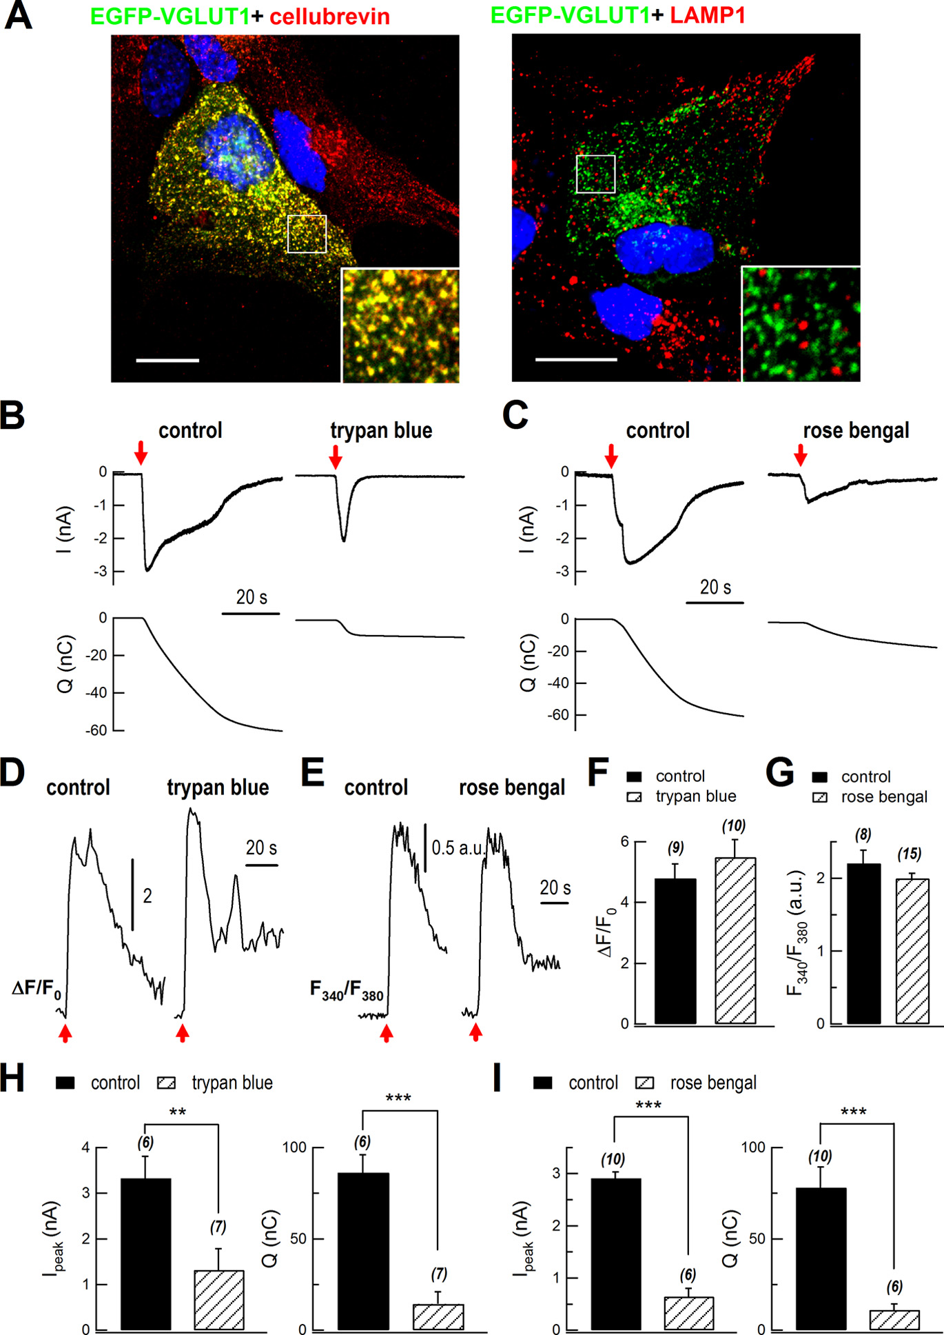
Blockade of VGLUT1 inhibited glutamate release
VGLUT1 is already known to be expressed on small vesicles, but what about lysosomes ?
VGLUT1 only found on small vesicles
Notes:
First, they want to show on which vesicle VGLUT is expressed. To do so, they look at the localization of VGLUT1 regarding to the localization of cellubrevin, and the localisation of VGLUT1 regarding to the localization of LAMP1. We can clearly see that VGLUT1 is co localized with cellubrevin but not LAMP1, so they conclude that this molecule is only found on small vesicles.

Slide 24
Role of VGLUT1 on glutamate release
The sniffer patch technic
Astrocyte
HEK cell
GluR-L497Y
glutamate
Calcium
Notes:
Then, they want to assess the release of glutamate. To do so they use a recent technic called sniffer patch. To realize this sniffer patch, they first transfected a glutamate receptor on HEK cells. They used this kind of cells because they don’t present any receptor on their surface, so after experiment you can conclude that your response is due to the transfected receptor and not another type of receptor. After transfection, they can see which cell are transfected because they combined the receptor plasmid with a dye during the transfection. These cells are brought next to the astrocytes and a whole cell patch clamp is realized. If glutamate is released from astrocytes, they will activate the receptor, calcium will enter the cell and the potential response will be recorded by the electrode.

Slide 25
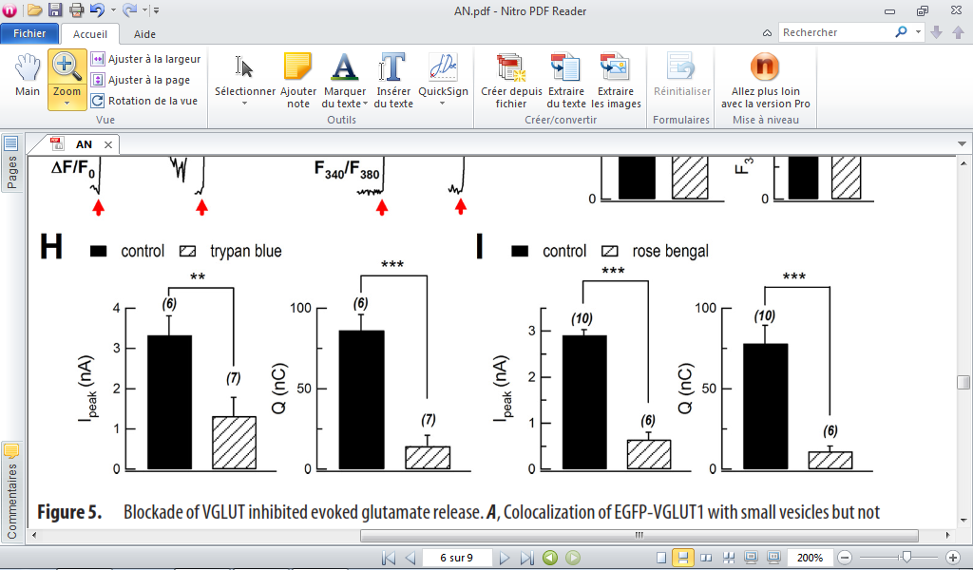
Blockade of VGLUT1
Glutamate release is decreased when VGLUT1 is blocked
VGLUT1
Notes:
Here you can see that after a mechanical stimulation, glutamate is released from astrocytes. To assess the functional role of VGLUT, they blocked it with trypan blue or rose bengal. Then they stimulate the astrocyte again and they found a decrease release of glutamate, in term of current and in charges. With these experiment they proved that blocking a small vesicle glutamate transporter decrease the release of glutamate, but the remain release still can be from the lysosome. Indeed, they know that VGLUT1 is not present, but maybe glutamate enter the lysosome whit another transporter.

Slide 26
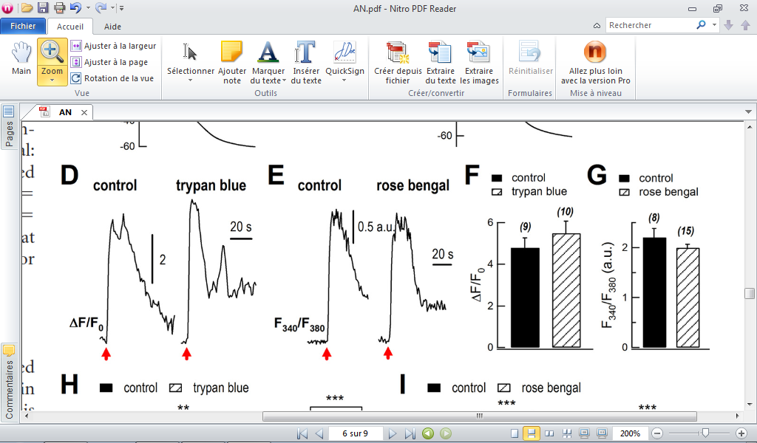
Rose began and trypan blue on calcium
Importance of a control
No modification of calcium by typan blue or rose bengan
Notes:
Another question is, are we sure that the effect of rose bengal and trypan blue are on VGLUT1 and not on the calcium metabolism? Indeed if these molecules acts on calcium, it would decrease the liberation of glutamate and a conclusion about the functional role of VGLUT won’t be possible. So what they did is they assessed the amount of calcium via the fluorescence, in control conditions, with trypan blue and with rose bengal. They found no modification of calcium by typan blue or rose bengan, so the decrease in glutamate release is due to their effect on VGLUT1

Slide 27
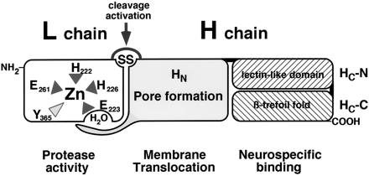

TeNT effects on lysosome fusion
Clostridium tetani (TeNT)
Syb2 (VAMP2) and Cellubrevin
→blocks small vesicles exocytosis
Notes:
Then, to assess the liberation of glutamate after the blockade of exocytosis and not only a transporter, thy use the tetanic proteaseClostridium tetani (TeNT). It’s a zinc protease that blocks neurotransmission by cleaving synaptic proteins. Among the molecules that it can cleave there are the small vesicle proteins Syb2 an cellubrevin. So it’s already known that they block small vesicle exocytosis. Their first experience would be to compare this effect to the effect on lysosome

Slide 28
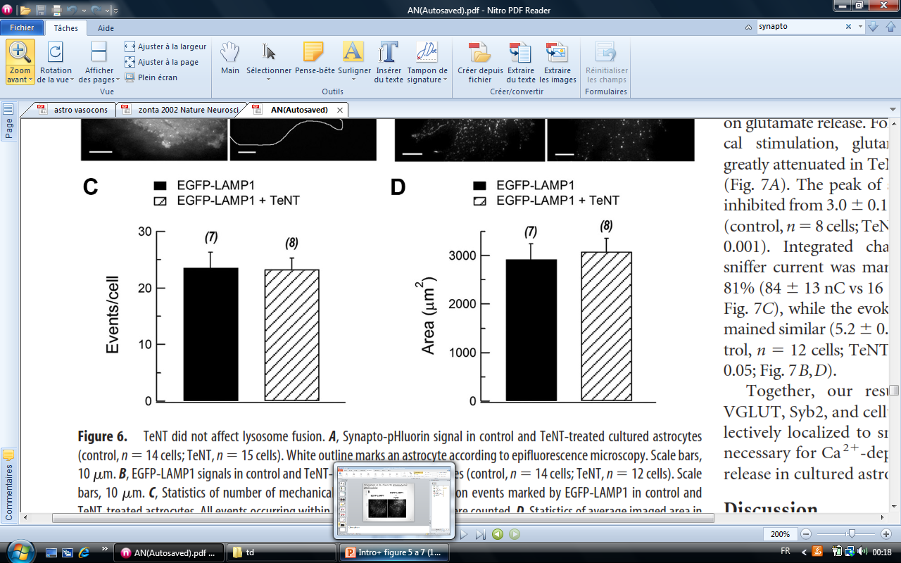
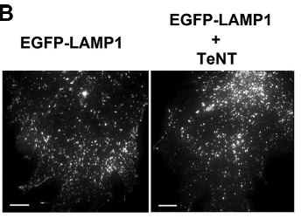

Assessment of the effects on lysosomes and small vesicles
TeNT has no effects on LAMP1
= syb2-pHluorin
TeNT affects syb2
Notes:
What we can see here via TIRMF is that TeNT as a clear effect on the small vesicle proteins, because when it’s cleaved the fluorescence disappear. In another hand, we can’t see any effect on LAMP1, a lysosome protein. This effect has been quantified and no difference has been found

Slide 29

Quantification for LAMP1
TeNT affects Syb2
TeNT does not affect LAMP1
No quantification for Syb2
→ Is TeNT really a tool to block small vesicle exocytosis?
→ Does it mean that TeNT affects small vesicles and not lysosomes?
Notes:
About what they conclude from this experiment we would like to point out a couple of things. First they target one molecule of the small vesicle or lysosome, so is that enough to conclude about the entire element?
Then we noticed that we don’t have a quantification for the remaining exocytosis of small vesicles after the action of TeNT, so maybe it’s not inhibited but highly decreased

Slide 30
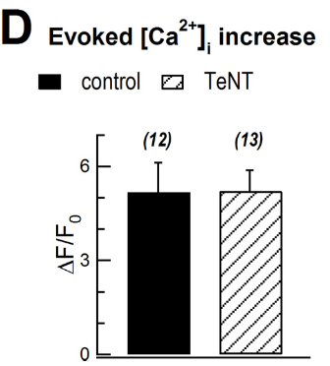
Will TeNT affect the glutamate release?
First control of the TeNT effects on calcium metabolism
TeNT has no effects on astrocyte calcium release
Notes:
Let’s go back to their experiment and see the effects of the toxin on the release of glutamate. First, like for trypan blue and rose began they need to make sure this toxin doesn’t affect the calcium metabolism, and it didn’t.

Slide 31
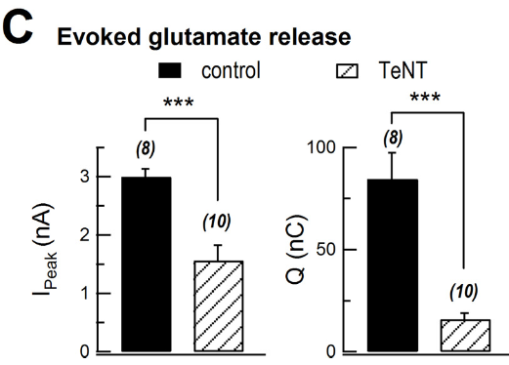
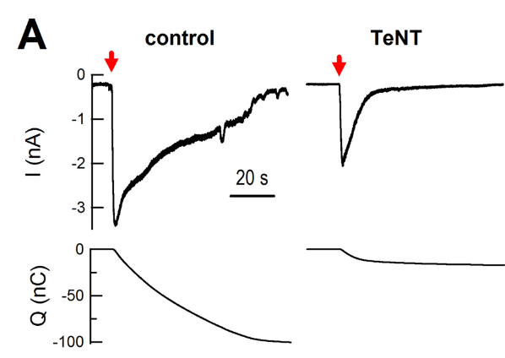
Will TeNT affect the glutamate release?
TeNT inhibits evoked glutamate release
Notes:
Then they look at the current and charges after a stimulation, with or without the toxin. Has you can see there is a significant decrease in the release. The elements that they bring is not enough to draw conclusion about the remaining charges released.

Slide 32
Conclusion
& Perspectives
PART 4

Slide 33
Lysosomes
Ca²⁺
Ca²⁺
Small vesicles
Notes:
Before the conclusion, we would like to resume the observation they made in this paper. First we know that we can find two types of organelles in astrocytes, lysosomes and small vesicles. After a mechanical stimulation, calcium rises in the astrocyte. This rise wild trigger calcium dependent exocytosis of the two kind of vesicles found in the cell.

Slide 34

Glutamate
?
TeNT
VGLUT1
How do the remain glutamate is released?
Notes:
We also know that VGLUT is localized only on small vesicles, and glutamate is released from astrocytes after a stimulation. When you block a glutamate transporter on small vesicles, or use a toxin that prevent from its exocytosis, the glutamate released is highly decrease. We are still wondering how do the remain glutamate is release.

