Slide 1
Casein Kinase 2 Regulates the NR2 Subunit Composition of Synaptic NMDA Receptor
Antonio Sanz-Clemente, Jose A.Matta, John T.R. Isaac and Katherine W. Roche.
National Institute of Neurological Disorders and Stroke, National Institutes of Health, Bethesda, MD 20892, USA
Bertille LORGEOUX
Emilie DESFOSSES
M2 Neuropsychopharmacologie

Slide 2
Introduction
NR1
NMDAR
Casein kinase 2 (CK2) :
Serine/threonine kinase
NR2B
CK2
S1480
P
α
α
β
β
Notes:
Rappel sur NMDA +schéma
Préciser role dans mémoire et apprentissage, important dans le développement du cerveau
Composition et densité des récepteurs au niveau synaptique est régulé par de nombreux mécanismes tel que des P° au niveau du domaine de liaison aux prot PDZ grace a CK2
What is the impact of CK2 phosphorylation on synaptic NMDARs ?
Description CK2 et localisation, role dans mémoire.→ Schéma
Composition des NMDA au cours du développement→ activité dépendant→ molecular mechanisms?

Slide 3
What is the main molecular mecanism for the switch between NR2A and NR2B, comprising synaptic NMDARs?

Slide 4
Material & Method
Immunoprecipitation
Elution + Centrifugation
Centrifugation
Notes:
Lysis of cells
Putting of the beast with sepharose and antibodie specific for the receptor
Centrifugation
Recuperation of the beast which are attached to the R
(of the beast from the reeptor)

Slide 5
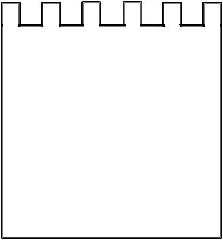

Material & Method
Immunoblotting
Samples
Big proteins
Small proteins
SDS-PAGE
Protein blot on nitrocellulose
Label with specific antibody and secondary antibody
Protein of interest
Notes:
What we know : CK2 differentialy regulates NR2A and NR2B
What we research : the role ok CK in the trafficking and synaptic localization of these subunits
- effect of inhibiting CK2 activity on the surface expression of the NR2A and NR2B
We use cortical cultures (treated overnight with TBB (inhibit P incorporation) or vehicle), then surface protein were biotinylated and isolated wtith streptavidinagarose. (semblable à la biotine), and then we use SDS-PAGE (séparation des protéines selon leurs poids moléculaire

Slide 6

Test in vitro (1/2)
WT (ESDV)
S/A (EADV)
NR2A
+ CK2 and radioactive ATP
+/- TBB for WT
GST
NR2 C-term
WT (ESDV)
S/A (EADV)
NR2B
Notes:
Production of GST fusion protein containing the last 175 aa of NR2 A and B. (4 groups : 2 Wild Type for each subunit and 2 mutants for each one called : S1462A→ NR2A and S1480A → NR2B)
Incubation with CK2 and radioactive ATP
Addition of TBB for some WT sample.
western blot

Slide 7
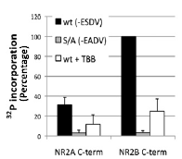
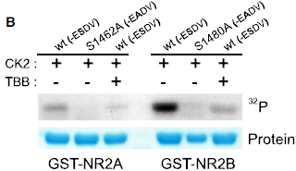
Test in vitro (2/2)
The C-terminal serine is necessary for the NR2 subunit phosphorylation by CK2
NR2A is less sensitive than NR2B for the CK2 phosphorylation

Slide 8

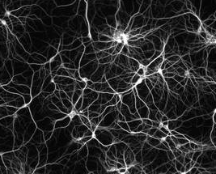
Test in vivo (1/2)
+/- TBB
Lysis and Immunoprecipitation with Antibodies for NR2A and NR2 B
Phosphorylation Assay with CK2
Cortical neuron culture
Notes:
Cortical neuron culture from a rats
Add of TBB or not→ pre-traitement
Lysis and immunoprecipitation
Phosphorylation assay as dercriveb before
Western blot

Slide 9
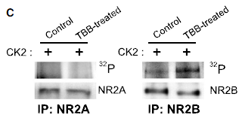
Test In vivo (2/2)
Endogenous NR2B is also phosphorylated by CK2
Endogenous NR2A is not efficiently phosphorylated by CK2

Slide 10
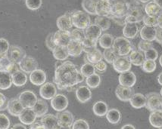
PSD-95 and NR2 subunit interaction (1/2)
Cotransfection
+/- TBB
Lysis and coimmunoprecipitation with NR2A and NR2B antibodies
HEK293 : NR1 + PSD95 + GFP-NR2B
+/- TBB
Immunoblot → figure 1D
HEK293 : NR1 + PSD95 + GFP-NR2A
Notes:
Transfection of HEK293 cells with :
- NR1, PSD95 and GFP-NR2A
- NR1, PSD95 and GFP-NR2B

Slide 11
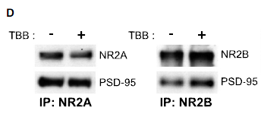
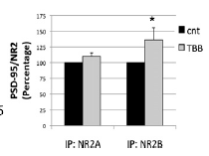
PSD-95 and NR2 subunit interaction (2/2)
The TBB treatement increases the asssociation between PSD95 and NR2B
It is not the case of NR2A which is not affected by the TBB treatement
Notes:
Taken together, these data show that despite the high homology between the C terminal part of NR2A and B SU, NR2A is not really affected by the CK2 activity.
CK2 regulates NR2B binding to PDZ domain containing protéin like PSD95→ MaguK protein

Slide 12
Effect of inhibiting CK2 activity on the surface expression of the NR2A and NR2B
+/- TBB
Immunoblot with NR2A, NR2B, NR1, GluR1 and synaptophysin antibodies
Biotinylation and SDS-PAGE
Cortical neuron culture

Slide 13
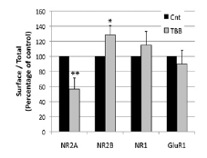
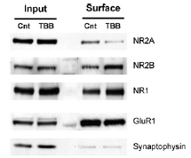
Effect of inhibiting CK2 activity on the surface expression of the NR2A and NR2B
→ Inhibition of CK2 activity increase the surface expression of NR2B but not the surface expression of NR2A.

Slide 14
Visualization of the receptor surface expression
Immunofluorescence assay protocol :
GFP-NR2A
GFP-NR2B
±TBB
Anti GFP antibody
Surface receptors labeled in white
permeabilization
Internal pool receptors labeled in green
Notes:
To complete these information, a fluorescence-based assay and a confocal microscopy were used to visualise receptor surface expression. Here hippocampal neurons were transfected with GFP-NR2A or GFP-NR2B, (GFP for Green Fluorescent Protein) and anti-GFP antibody was used to label the surface –expressed receptor

Slide 15
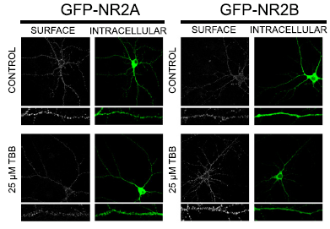
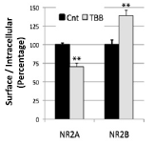
Visualization of the receptor surface expression
Notes:
We can see that with TBB there is less surface expression that in control case for the NR2A subunit wheras NR2B are more expressed in the surface in the presence of TBB
So we can say that CK2 decrease the NR2B surface localization and increase the NR2A surface localization

Slide 16
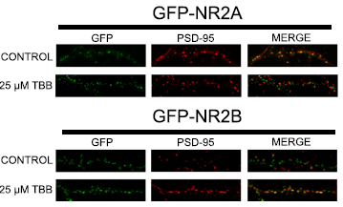
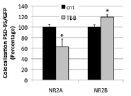
Does CK2 regulates the synaptic expression of NR2 subunits?
→ CK2 regulates the surface expression and the synaptic localization of NR2 subunits in an inverse manner
Notes:
Next we want to study if CK2 also regulates the synpatic expression of NR2 subunits, so we analyzed the synaptic localization of GFP-NR2A and GFP-NR2B (aftar TBB treatment) using immunofluorescence microscopy to mesure the colocalization with PSD-95 (postsynaptic marker).
We can see that for the NR2A in the control case there is more colocalization between GFP and PDS-95 than in presence of TBB.
For NR2B there is more colocalization in presence of TBB.
So in TBB treated hippocampal neurons, there is a decrease in the colocalization of NR2A and PSD-95 ,and an increase in the colocalization of NR2B and PSD-95
We concluded that CK2 differentially regulates the surface expression and synaptic localization of NR2 subunits in an inverse manner, increasing the level of NR2A-containing and decreasing NR2B-containing NMDARs.

Slide 17

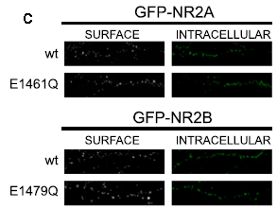
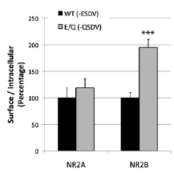
Effect of the mutation of E1479 on the synaptic NR2 subunit expresion
→ The inhibition of NR2B phosphhorylation on S1480 stabilizes the NR2B expression to the surface

Slide 18
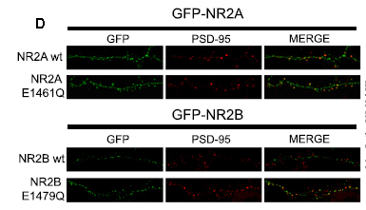
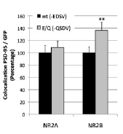
Effect of the E mutation on the interaction between NR2 subunits and PSD95
→ The non phosphorylation of NR2B on S1480 increase the NR2B interaction with PSD-95 that suggesting the phosphorylation of S1480 regulates the synaptic expression of NR2B
Notes:
Figure 3D

Slide 19
Effect of CK2 on NMDAR endocytosis
Hippocampal neurons tranfected with GFP-NR2B (WT or E1479) :
Immunofluorescence assay protocol :
E1479 mutation
GFP-NR2B
(Wt or E1479)
Anti GFP antibody
Surface receptors labeled in green
permeabilization
Internal pool receptors labeled in white
±TBB
internalization
Notes:
Regulation of NR2B trafficking by CK2
We next investigate the mechanims of the regulation of NR2B tafficking cy CK2. Some resarches have demonstrated that CK2 activity disrupts the binding of NR2B with MAGUK proteins (like PSD-95), and that PSD-95 stabilizes the NMDARs at the surface and inhibits endocytosis. So we hypothesized that the observed decrease in surface and synaptic expresssion is due to increased NMDAR endocytosis.
We analyzed the effect of CK2 on NMDAR endocytosis using fluorescence-based assay in GFP-NR2B or GFP-NR2B E1479Q tranfected neurons. For this, surface receptors were labaled with anti GFP antibody and the cellls returned to 37°C to allow internalisation. Then surface proteins were labeled with Alexa 568 conjuged secondary antibody (green) and cells were permeabilized and the internalization of pool receptors was visualized with Alexa-633

Slide 20
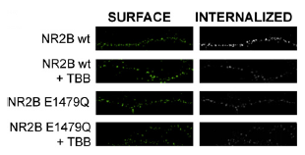
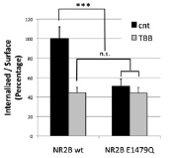
Effect of CK2 on NMDAR endocytosis
→NR2B endocytosis is reduce by CK2 inhibition
→ CK2 increase endocytosis via S1480 phosphorylation
Notes:
Here we can see a decrease in the endocytosis of the wt in presence of TBB, and a decrease in the endocytosis of the mutant that was no;more decrease by the presence of TBB.
So the inhibition of CK2 decrease the endocytosis so we can say that CK2 increase NR2B internalization via S1480 phosphorylation.

Slide 21
Does phosphorylation in the PDZ-domain of NR2B regulates its surface expression and endocytosis via phosphorylation of Y1472?
Hippocampal neurons tranfected with GFP-NR2B with mutations in the YEKL and/or PDZ-domain :
Y1472 mutation
S1480 mutation
E1479 mutation
Immunofluorescence assay protocol :
GFP-NR2B
(Wt ,E1479Q, S1480E,Y1472A)
Anti GFP antibody
internalization
Surface receptors labeled in green
permeabilization
Internal pool receptors labeled in white

Slide 22
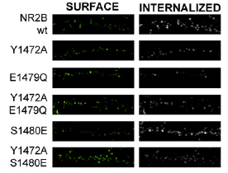
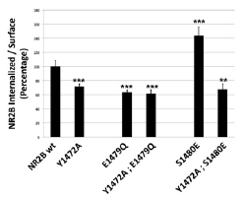
Does phosphorylation in the PDZ-domain of NR2B regulates its surface expression and endocytosis via phosphorylation of Y1472?
→The phosphorylation in the PDZ-domain and in the YEKL endocytic motif, share a common molecular mechanism to regulate NR2B endocytosis.
Notes:
For the YEKL mutant there is less internalization that for the WT. For E and Y mutation there is the same decrease of internalization, and we can notice that for the double mutant there is no additional decrease of endocytosis, so we can say that the YEKL motif and in the PDZ domain share a common molecular mechanisms to reduce endocytosis.
For the S mutation there is an increase of internalization but for the bouble mutant S and Y we can see that these internalizatnio was reduce
So the Phosphorylation in PDZ-domain of NR2B affects the phosphorylation of the Yekl endocytic motif and induces internalization

Slide 23
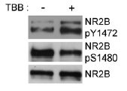
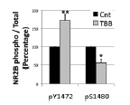
Effect of CK2 inhibition on Y1472 phosphorylation
→ The reduction of S1480 phosphorylation in presence of TBB is concomittant to the increase in Y1472 phosphorylation.
Notes:
To analyse this hypothesis, we investigated the effects of CK2 inhibition on Y1472 phosphorylation, fir that we analyzed the levels of NR2B pS1480 and pY1472 in HEK293 transfected with PSD-95 NR1 and NR2B with or without TBB
We can see that with TBB there is more pY1472 than with TBB unlike there is less pS1480 with TBB.
So we conclued that the reduction of pS1480 in presence of TBB is concomittant to the increase of pY1472.

Slide 24
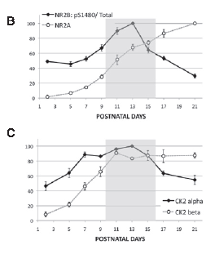
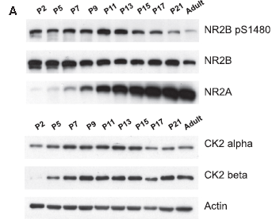
Mecanism during the development : NR2B pS1480 phosphorylation and CK2 activity
→ The switch NR2B/NR2A thanks to the CK2 occurs during the critical period : P9-P15
Notes:
when there is the most elevated ratio pS1480/Total and the higher quantity of each SU of CK2

Slide 25
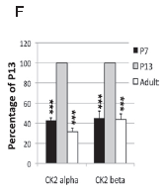
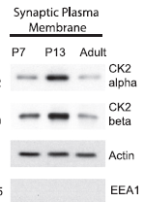
CK2 activity in synaptic development
→ The association of CK2 on SPM at P13 proves that this kinase is important in synaptic development
Notes:
But it is the case for the synaptic plamatic membrane → CK2 is ncssary for the switch during the developpement

Slide 26
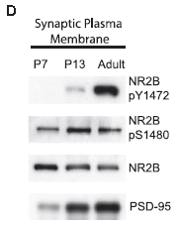
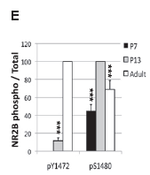
Phosphorylation of S1480 and Y1472 in synaptic development
→ The phosphorylation « transfert » betwenn S1480 and Y1472 occurs also during the critical period : important for the synaptic development
Notes:
Prouve que le mecanisme de P° de la figure 4 de Y sur S se fait durant le développe
The level of NR2B pS1480 is elevated in P13 and pY1472 is reduced in comparison with the adult level

Slide 27
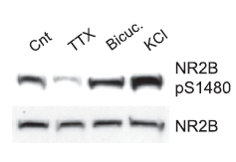
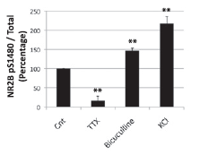
Effect of drugs on NR2B S1480 phosphorylation
TTX, bicuculline or KCl
Isolation of cellular membrane
Immunoblot with NR2B or phopho-specific NR2B S1480 antibodies
Cortical neuron culture
→Phosphorylation on NR2B S1480 is induce by synaptic activity.
Notes:
Phosphorylation of NR2B and synaptic activity
We know that incorcopartion of NR2A needs synaptic actvity and can be blocked by NMDAR inhibotors, so here we want to know if NR2B phosphorylation is synaptic activity dependant.
For this we used TTX who block neuronal activity and bicuculline who stimule neuronal activity and we analyzed the level of pS1480 after immunoblotting. The KCl was also used to induce neuronal depolarization. We can see that in presence of TTX there is no P on S1480 whereas in presence of activator of neuronal activity (bicu and KCL) there is P.
phosphorylation on NR2B S1480 is induce by synaptic activity .
Then authors want to know if the pS1480 is dependant of synaptic NMDAR activation so they do the sameexperiment with NMDAR antagonists( MK-801 and APV) and we can see that in the presence of antagonists there is no P on S1480.
So we can say that phosphorylation on NR2B S1480 is induce by activity that is dependant on synaptic NMDAR activation.

Slide 28
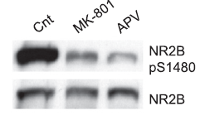
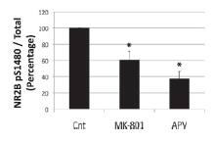
Effect of drugs on NR2B S1480 phosphorylation
MK-801 or APV
Isolation of cellular membrane
Immunoblot with NR2B or phopho-specific NR2B S1480 antibodies
Cortical neuron culture
→ Phosphorylation on NR2B S1480 is induce by activity that is dependant of synaptic NMDAR activation.

Slide 29
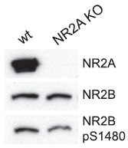
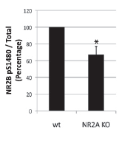
NR2A expression and NR2B S1480 phosphorylation
Isolation of cortical synaptosomes
Immunoblot with, NR2A, NR2B or phopho-specific NR2B S1480 antibodies
Cortical synaptosomes from mice (WT or NR2A KO
→The stimuli required for NMDAR switch is implicated in NR2B S1480 phosphorylation
Notes:
Then authors if the level of NR2A is important for the P S1480, for this they use NR2A knockout mouse or WT and they analysed the P S1480 by immnublotting.
We can see that in NR2AKO mouse there is less phosphorylation than in WT mouse, so NMDAR switch and NR2B S1480 phosphorylation need the same stimuli

Slide 30
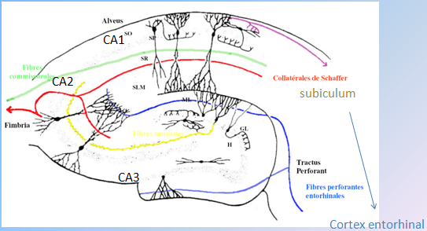
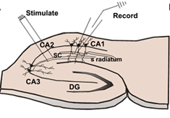
Role of CK2 in the swich of NR2 subunit after induction of LTP
+ NBQX + Picrotoxin
Notes:
Electrodes de stimulation placées dans le stratum radiatum du CA1 recevant des afférences des collatérales de schaffer et des axones commisuraux. Les electrodes placées de chaque côté de la cellule enregistrée

Slide 31
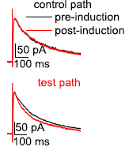
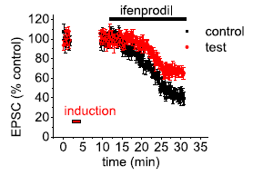
Role of CK2 in the switch of NR2 subunits after an induction of LTP
→ Reduction of sensitivity to infenprodil and speeding of NMDA EPSC kinetics.
Notes:
We know that LTP induction induces a switch in NMDAR in hippocampal neurons, so authors want to study the role of CK2 in this swith. For this, they used whole cells patch clamp and an inhibitor of NMDAR (ifenprodil). The ifenprodil is selective of the NR2B. Authors induce LTP (with a LTP induction protocol) with or without TBB.
We can see that without TBB there is an increase of EPSP, ant that with TBB there is no speeding of the EPSP and no reduction of the ifenprodil sensitivity. So this imply that during LTP, CK2 is involved in the switch in NR2 subuints.

Slide 32
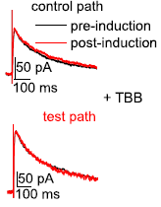
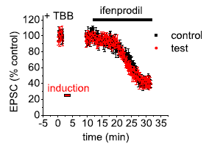
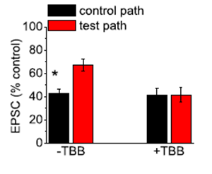
Role of CK2 in the switch of NR2 subunits after induction of LTP
→ Increasing of sensitivity to infenprodil and no speeding of NMDA EPSC kinetics.
Notes:
Pourquoi dans la figure de droite sans

Slide 33
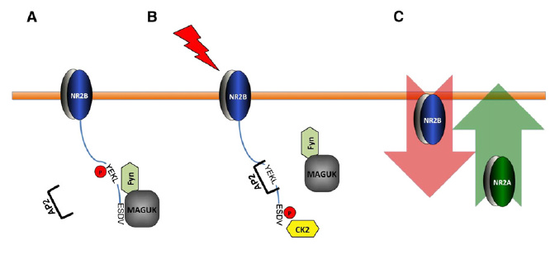
Discussion
Model of CK2 regulation of synaptic NMDARs
Notes:
In this model, there is a coordinated phosphorylation of two different residues od NR2B : S1480 within the PDZ-domain and Y1472 within the tyrosine-based YEKL endocytic motif regulates receptor endocytosis and the surface expression of NR2B.
When S1480 is phosphorylated the association between maguk protein and NR2B is disrupted. This diruption trigger a decrease in Y1472 phosphorylation and an increase of NR2B internalization by association of YEKL and AP-2.

Slide 34
Perspectives
Identifying the molecular mechanims underlying the regulation of synaptic CK2 activity
NR2B S1480 phosphorylation is regulated by synaptic activity and CamKII
CamKII phosphorylation of CK2 target CK2 to the synaptic plasma membrane allowing interaction with NR2B.
Mechanisms of spatiotemporal regulation of synaptic CK2 activity during the LTP.

