Slide 1
Activity-dependent tuning of inhibitory neurotransmission based on GABA_{A}R diffusion dynamics
Hiroko Bannai, Sabine Lévi, Claude Schweizer, Takafumi Inoue, Thomas Launey, Victor Racine, Jean-Baptiste Sibarita, Katsuhiko Mikoshiba and Antoine Triller
Neuron, 2009
Céline Devroye
M2 Neurosciences

Slide 2
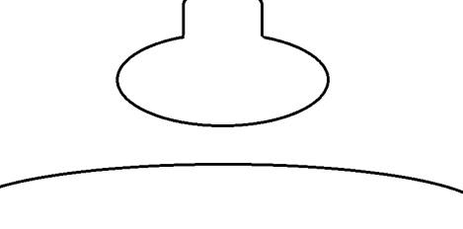

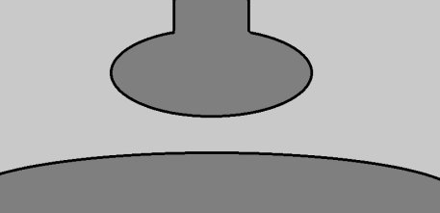

INTRODUCTION
SYNAPTIC STRENGTH
Modulation of synaptic strength Learning and memory
Depends on :
• Number of functional release sites
• Release probability
• Post-synaptic response
=> occurs at both excitatory and inhibitory synapses
What molecular and cellular mecanisms in inhibitory synapses?
GABAergic synapse

Slide 3

INTRODUCTION
GABAERGIC SYNAPSE
Hippocampus : inhibitory transmission by GABA and GABA_{A} receptors
GABA_{A}R
GABA
Gephyrin
Amount of GABA_{A}R
(post synaptic response)
Strength of synapse
Correlation between changes in GABA currents and GABA_{A}R amounts
- Lateral diffusion?
- AMPA lat diff are activity dependent
- Calcium?
Membrane insertion, removal and lateral
diffusion number of GABA_{A}R at the synapse
Neuronal activity surface expression of GABA_{A}R
Notes:
regulation of amount of receptor at the synapse

Slide 4
INTRODUCTION
QUESTION
Does neuronal activity regulates the diffusion dynamics of GABA_{A}R?

Slide 5
INTRODUCTION
EXPERIMENTAL APPROACH
Hippocampal neurons (culture)
Neuronal activity :
  Amounts of GABA_{A}R
  Amplitude of GABA currents
  Diffusion dynamics of GABA_{A}R

Slide 6
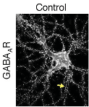
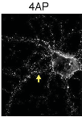


RESULTS
NEURONAL ACTIVITY - GABA_{A}R AND GEPHYRIN CLUSTER SIZES
Gephyrin: scaffolding protein of GABA_{A}R
⬥ Immunofluorescence
• GABA_{A}R γ2
• Gephyrin (scaffolding protein)
• Synapsin (synapse)
⬥ Treatment
• CNQX + AP5 (blocks AMPAR and NMDAR)
 NEURONAL ACTIVITY
• 4AP (blocks potassium channels)
 NEURONAL ACTIVITY
• Strychnine + SR95531 (blocks GlyR and GABA_{A}R)
 NEURONAL ACTIVITY
Notes:
4AP blocks kv1 family of voltage activated K+ channels

Slide 7
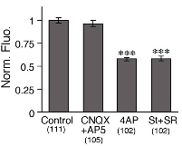
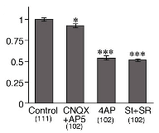
RESULTS
NEURONAL ACTIVITY - GABA_{A}R AND GEPHYRIN CLUSTER SIZES
⬥ Treatment
• CNQX + AP5 (  neuronal activity)
• 4AP (  neuronal activity)
• St+ SR (  neuronal activity)
GABA_{A}R clusters
Gephyrin clusters
Increased excitatory activity
decreases synaptic GABA_{A}R and gephyrin cluster sizes

Slide 8




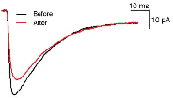
RESULTS
NEURONAL ACTIVITY - GABAERGIC mIPSC AMPLITUDE
number of synaptic GABA_{A}R Amplitude of mIPSC
// 4AP induced hyperactivity
⬥ Patch clamp (whole cell)
Recording mIPSC
SR 95531 : antagonizes GABA_{A}R
TTX + NBQX
◆ Depolarizing stimuli decrease GABAergic mIPSC amplitudes
Notes:
What changes in GABAergic currents when neuronal activity is increased?
Consistent with fig 1
Several studies: gaba mediated inhibition is reduced after repetitive stimulation protocols

Slide 9
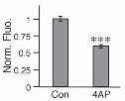
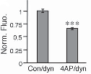
RESULTS
NEURONAL ACTIVITY - GABAERGIC mIPSC AMPLITUDE
 GABAergic mIPSC
Internalization of GABA_{A}R?
⬥ Immunofluorescence : GABA_{A}R γ2
⬥ Treatment : 4AP
⬥ Dynasore : membrane-permeable dynamin inhibitor
◆ No dynamin-dependent internalization of GABA_{A}R

Slide 10


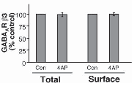
RESULTS
NEURONAL ACTIVITY - GABAERGIC mIPSC AMPLITUDE
Total and surface GABA_{A}R
⬥ Treatment : 4AP
⬥ Biotynilation (to isolate surface receptors)
⬥ Western blot GABA_{A}R β3
No difference between total and surface receptors amounts
⬥ Quantification
Depolarizing stimuli decrease GABAergic mIPSC amplitudes
without internalization

Slide 11
RESULTS
NEURONAL ACTIVITY - LATERAL DIFFUSION OF GABA_{A}R
Lateral diffusion and local trapping
number of synapse receptors
GABA_{A}R
GABA
Gephyrin
Could neuronal activity alterate lateral diffusion?

Slide 12
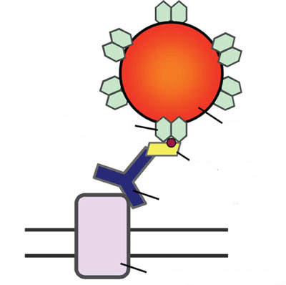
RESULTS
NEURONAL ACTIVITY - LATERAL DIFFUSION OF GABA_{A}R
⬥ Single particle tracking (SPT) / of GABA_{A}R
=> QD GABA_{A}R
Streptavidin
Quantum dot
⬥ FM4-64: active synapses
Biotynilated Fab
Excitatory activity modifies GABA_{A}R trapping at synapses
Anti GABA_{A}R γ2
GABA_{A}R
GABA
Gephyrin
GABA_{A}R
Most have diffusive behavior
Extra synaptic
Synaptic
Extra synaptic
⬥ Treatment
• CNQX + AP5 ( neuronal activity)
• 4AP ( neuronal activity)
• St+ SR ( neuronal activity)
Notes:
Could neuronal activity alterate lateral diffusion?

Slide 13






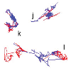

RESULTS
NEURONAL ACTIVITY - LATERAL DIFFUSION OF GABA_{A}R
Surface exploration and trajectories of GABA_{A}R
Excitatory activity modifies GABA_{A}R trapping at synapses
GABA_{A}R-QD
FM4-64
Most have diffusive behavior
Synaptic
Extrasynaptic

Slide 14
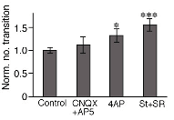
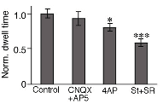
RESULTS
NEURONAL ACTIVITY - LATERAL DIFFUSION OF GABA_{A}R
Synaptic dwell time (time a receptor remains in a synapse) and synaptic in-out transitions
Dwell time
Synaptic in-out transitions
Synaptic stability of GABA_{A}R is reduced when neuronal activity is increased
Notes:
Excitatory activity modifies GABA_{A}R trapping at synapses

Slide 15
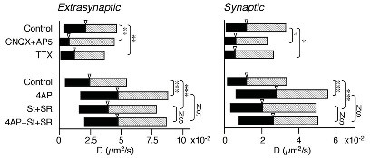
RESULTS
NEURONAL ACTIVITY - DIFFUSION PROPERTIES OF GABA_{A}R
Neuronal activity diffusion coefficients and confinement of GABA_{A}R?
⬥ GABA_{A}R-QD
⬥ FM4-64 (synaptic area)
Diffusion coefficients
◆ Increased neuronal activity increases diffusion coefficients of GABA_{A}R
Notes:
Interquartile range (middle fifty, midspread) : measure of statistical dispersion. = difference between upper and lower quartiles. Used to characterize the data when extremeties might skew the data.

Slide 16

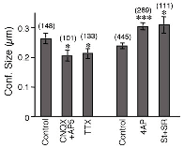
RESULTS
NEURONAL ACTIVITY - DIFFUSION PROPERTIES OF GABA_{A}R
Inhibitory or excitatory synapses?
⬥ Venus-tagged gephyrin construct
Confinement size (surface of lateral diffusion)
◆ Increased neuronal activity increases confinement size of GABA_{A}R

Slide 17
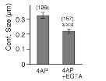

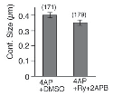

RESULTS
NEURONAL ACTIVITY - DIFFUSION PROPERTIES OF GABA_{A}R
Neuronal activity changes in Ca²⁺
Extracellular or intracellular source of Ca²⁺?
⬥ EGTA : Ca²⁺ chelator
⬥ Ryanodine blocks ryanodine receptors
⬥ 2APB blocks IP3 receptors
◆ Ca²⁺ entry from the extracellular space is required for 4-AP dependent regulation of GABA_{A}R dynamics

Slide 18
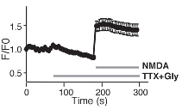
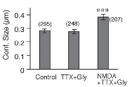
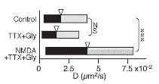
RESULTS
NEURONAL ACTIVITY - DIFFUSION PROPERTIES OF GABA_{A}R
CA²⁺ /NMDA receptor reduces GABAergic transmission
CA²⁺ entry / NMDAR Diffusion dynamics of GABA_{A}R
Increased diffusion coefficients of GABA_{A}R-QD
Increased confinement size of GABA_{A}R-QD
Intracellular Ca²⁺
Activation of NMDA receptors favors the escape of GABA_{A}R from synapses by lateral diffusion

Slide 19
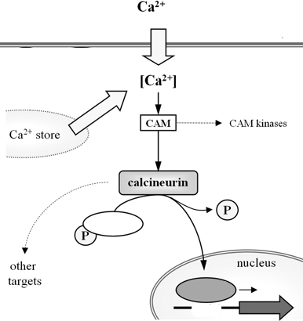
RESULTS
NEURONAL ACTIVITY - DIFFUSION PROPERTIES OF GABA_{A}R
Ca²⁺ entry / NMDAR
Long term depression at GABAergic synapses by activation of phosphatase calcineurin
Calcineurin : Ca2+ sensitive phosphatase
FT
FT
Phosphatase calcineurin GABA_{A}R diffusion dynamics

Slide 20
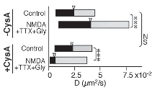
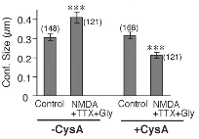
RESULTS
NEURONAL ACTIVITY / DIFFUSION PROPERTIES OF GABA_{A}R
Phosphatase calcineurin GABA_{A}R diffusion dynamics
⬥ Cyclosporin-A (CysA) : inhibitor of calcineurin
NMDAR-Calcineurin signaling pathway is involved in the activity-dependent regulation of GABA_{A}R diffusion dynamics

Slide 21
CONCLUSIONS
Synaptic accumulation and diffusion dynamics of GABA_{A}R are controlled by excitatory activity
Increased neuronal activity
- ↘ GABA_{A}R and gephyrin cluster sizes
- ↘ mIPSC / GABA_{A}R
- ↗ diffusion coefficients (synaptic and extrasynaptic) and confinement size, mediated by Ca²⁺ entry / NMDAR and calcineurin
REGULATION OF TRAPPING AT SYNAPSE

Slide 22
CONCLUSIONS
Functional implications :
During onset of LTP, depression of IPSC → enhance the ability of EPSC to elicit action potentials?
Activity-dependent regulation of diffusion dynamics of GABA_{A}R → LTP?

Slide 23
Thank you for your attention

Slide 24
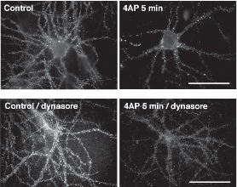

Slide 25
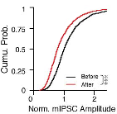
RESULTS
NEURONAL ACTIVITY / GABAERGIC mIPSC AMPLITUDE
⬥ Patch clamp (whole cell)
↘ 78 %
Recovering control levels : 10 min // recovering levels of synaptic gephyrin (figure S3)
No change in decay time = no channel kinetic changes / treatment
◆ Depolarizing stimuli ↘ GABAergic mIPSC amplitudes
Notes:
What changes in GABAergic currents when neuronal activity is increased?
Consistent with fig 1
Several studies: gaba mediated inhibition is reduced after repetitive stimulation protocols

Slide 26


