Slide 1


A readily retrievable pool of synaptic vesicles
GIRARDEAU Paul
SILVESTRE DE FERRON Benoit

Slide 2
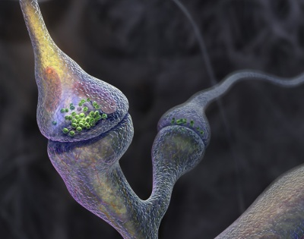
Introduction
Synaptic transmission
Synaptic transmission is limited by the recycling of synaptic vesicles
for many rounds of use
Notes:
Recycling of synaptic proteins plays an important role in this mechanism for many rounds of use

Slide 3
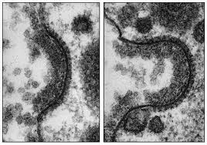
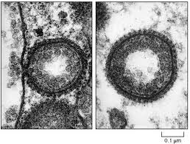
Introduction
Synaptic transmission
The main process of vesicle recycling is mediated by clathrin
The formation of clathrin-coated vesicles from the plasma membrane
→ BUT slow process (sec to mn)
Notes:
preparation of functional vesicles / right stoechiometry of membrane proteins / ten of seconds to

Slide 4
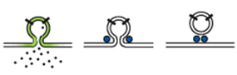
Introduction
Vesicle recycling
Continuous activity Necessity of rapid recycling
2 mechanisms identified
Clathrin-independent : Kiss and run
Clathrin mediated : Preassembled structures
Pool of preassembled vesicle proteins
At the pre-synaptic surface
What are the temporal dynamics of such a « readily retrievable pool » ?

Slide 5
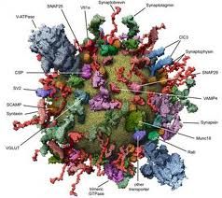
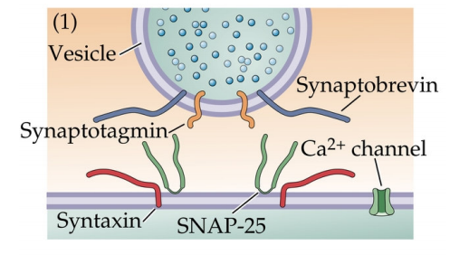
Introduction
Vesicle proteins
VARIOUS SYNAPTIC PROTEINS AT THE SYNAPTIC VESICULAR MEMBRANE
Synatptotagmin (Syt1) and Synaptobrevin (Syb2) : most numerous vesicular proteins
VGAT (vesicular transporter of amino acids in inhibitory neurons)
Labeling:
  of Syt1, Syb 2 and VGAT
  to test the hypothesis of the pool of preassembled structures
  in rat hippocampal neurons

Slide 6
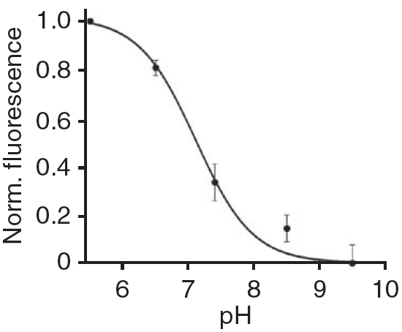
Methods
Exo-endoxytosis of endogenous synaptic vesicle proteins
Synaptotagmin 1 antibody coupled with cypHer (pH sensitive fluorophore)
anti-Syt1-cypHer
Cypher emits red fluorescence when excited at 640 nm
The fluorescence is maximal at pH 5.5
(pH of inside synaptic vesicle)
Normalized fluorescence of anti-Syt1-cypHer
VGAT antibody coupled with cypHer
(pH sensitive fluorophore)
anti-VGAT-cypHer
For studying inhibitory synapses
Notes:
In acidic compartments like synaptic vesicle, this antobody will be able to emit red fluorescence.

Slide 7
Results
Exo-endoxytosis of endogenous synaptic vesicle proteins
Spontaneous activity
pH
7,4
7,3
7,2
7,1
7,0
6,9
6,8
6,7
6,6
6,5
6,4
6,3
6,2
6,1
6,0
5,9
5,8
5,7
5,6
5,5
Synaptotagmin 1 antibody coupled with cypHer
(pH sensitive fluorophore)
Synaptotagmin 1
Red fluorescence
emission

Slide 8
Results
Exo-endoxytosis of endogenous synaptic vesicle proteins
pH
5.5
VGAT antibody coupled with cypHer
(pH sensitive fluorophore)
VGAT
Red fluorescence
emission

Slide 9
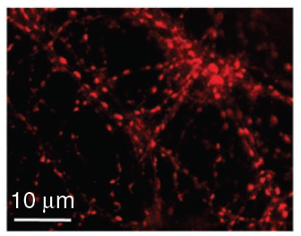
Results
Exo-endoxytosis of endogenous synaptic vesicle proteins
Fluorescence image of hippocampal neurons labeled with anti-VGAT-cypHer

Slide 10
Question
Exo-endoxytosis of endogenous synaptic vesicle proteins
Are these probes efficiency to report stimulation-dependent exo-endocytosis?

Slide 11
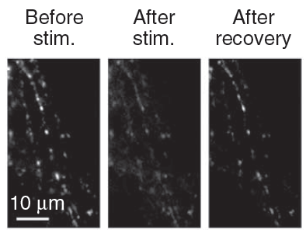
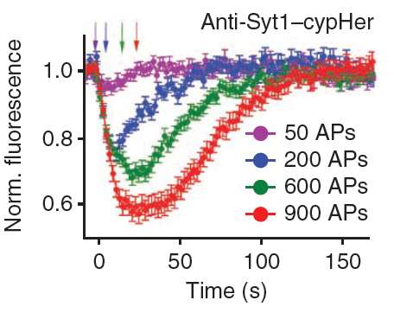
7,4
7,3
7,2
7,1
7,0
6,9
6,8
6,7
6,6
6,5
6,4
6,3
6,2
6,1
6,0
5,9
5,8
5,7
5,6
5,5
Results
Exo-endoxytosis of endogenous synaptic vesicle proteins
Elicited APs at 20 Hz
(50, 200, 600, 900)
Synaptotagmin 1 antibody coupled with cypHer
(pH sensitive fluorophore)
-> Anti-Syt1-cypHer
pH
Synaptotagmin 1
Red fluorescence
emission

Slide 12
Results
Exo-endoxytosis of endogenous synaptic vesicle proteins
Elicited APs at 20 Hz
(50, 200, 600, 900)
Synaptotagmin 1 antibody coupled with cypHer
(pH sensitive fluorophore)
-> Anti-Syt1-cypHer
Synaptotagmin 1
Red fluorescence
emission
pH
7,4
7,3
7,2
7,1
7,0
6,9
6,8
6,7
6,6
6,5
6,4
6,3
6,2
6,1
6,0
5,9
5,8
5,7
5,6
5,5

Slide 13
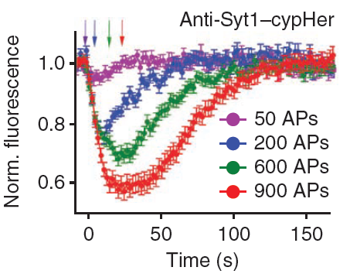
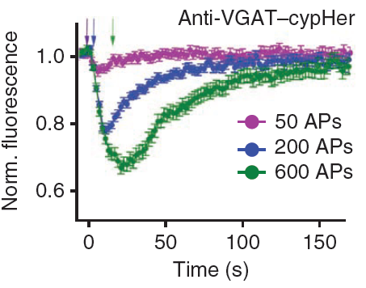
Results
Exo-endoxytosis of endogenous synaptic vesicle proteins
These probes are efficiency to report stimulation dependent exo-endocytosis

Slide 14
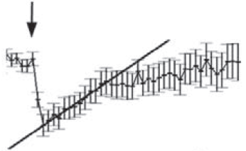
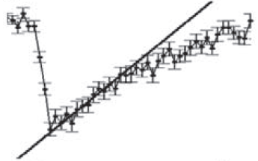
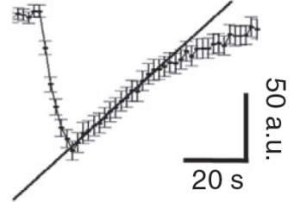
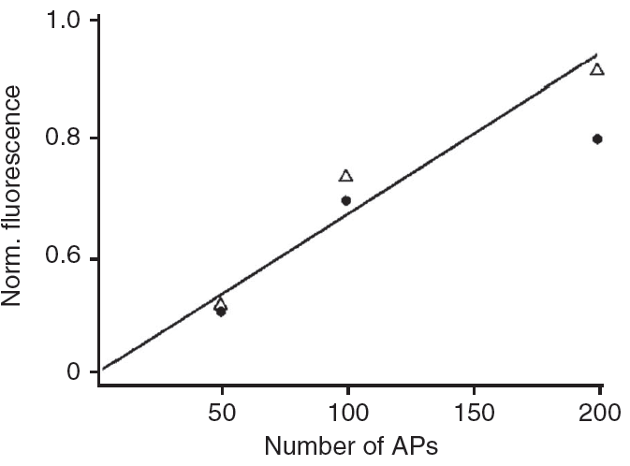

Results
Size of the surface pool of synaptic vesicle constituents
50 APs
100 APs
200 APs
Previous studies :
Endocytic rate after stimulus = Endocytic rate during the stimulus
200 APs
Fluorescence variations rise linearly with stimulus strength

Slide 15
Question
Size of the surface pool of synaptic vesicle constituents
Are endogenous synaptic vesicle proteins already present on the presynaptic membrane?

Slide 16
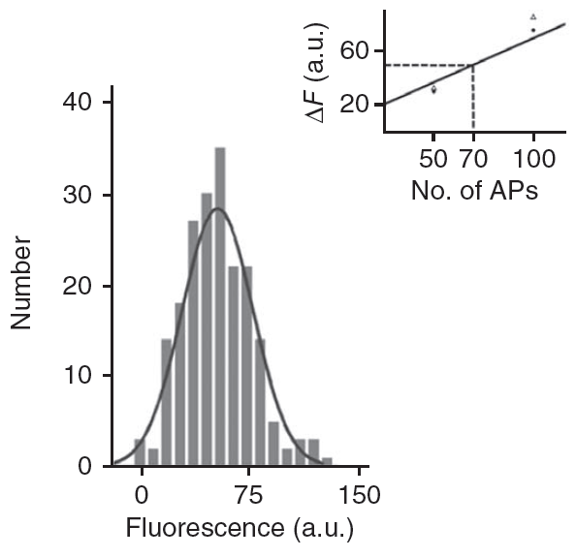
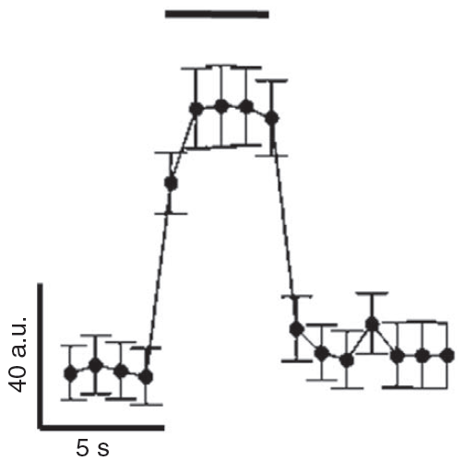

Results
Size of the surface pool of synaptic vesicle constituents
Synaptotagmin 1 antibody coupled with cypHer
(pH sensitive fluorophore)
-> Anti-Syt1-cypHer
pH
7,4
7,3
7,2
7,1
7,0
6,9
6,8
6,7
6,6
6,5
6,4
6,3
6,2
6,1
6,0
5,9
5,8
5,7
5,6
5,5
Synaptotagmin 1
Red fluorescence
emission
Buffer of pH 5,5
Buffer of pH 5,5
Proteins already presents on the presynaptic membrane
Number of boutons
ΔF = size of the surface pool
ΔF
ΔF ~ 50 a.u.
These proteins are able of compensating exocytosis induced by 70 APs

Slide 17
Methods
Labeled antibodies report same recycling kinectics as spH
Dual-color imaging
Exogenous probe
Synaptotagmin 1 antibody coupled with cypHer (pH sensitive fluorophore)
anti-Syt1-cypHer
Fluorescence in acidic compartments
Overexpressed probe
Synaptobrevin 2 coupled with pHluorin (pH sensitive GFP)
SpH
Fluorescence in neutral compartments

Slide 18
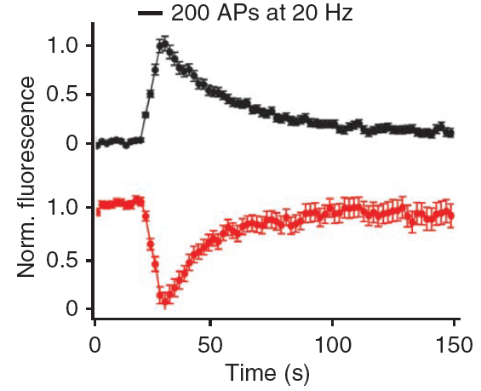

Results
Labeled antibodies report same recycling kinectics as spH
200 APs at 20 Hz
Synaptotagmin 1 antibody coupled with cypHer
(pH sensitive fluorophore)
-> Anti-Syt1-cypHer
pH
5,5
Synaptotagmin 1
Red fluorescence
emission
Synaptobrevin 2 coupled with pHluorin (pH sensitive fluorophore)
-> SpH
Green fluorescence
emission
7,4
Notes:
Pour simplifier, les protéines sont représentées dans des vésicules différentes, mais il est courant de les retrouver dans les mêmes vésicules.

Slide 19
Results
Labeled antibodies report same recycling kinectics as spH
200 APs at 20 Hz
Synaptotagmin 1 antibody coupled with cypHer
(pH sensitive fluorophore)
-> Anti-Syt1-cypHer
5,5
Synaptotagmin 1
Red fluorescence
emission
Synaptobrevin 2 coupled with pHluorin (pH sensitive fluorophore)
-> SpH
pH
Green fluorescence
emission
7,4
Mirror-image signals
These probes report exo-endocytosis
Notes:
Pour simplifier, les protéines sont représentées dans des vésicules différentes, mais il est courant de les retrouver dans les mêmes vésicules.

Slide 20
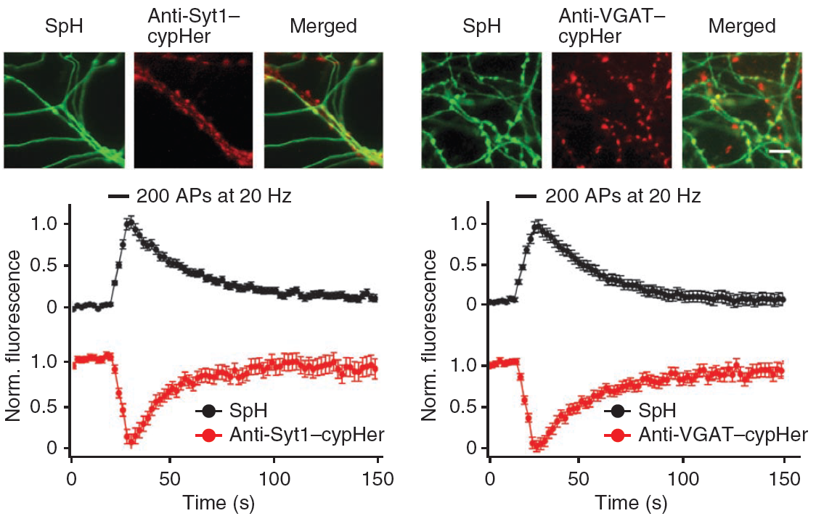
Results
Labeled antibodies report same recycling kinectics as spH
Same results in inhibitory synapses with VGAT

Slide 21
Question
A surface RRetP of synaptic vesicle constituents
Vesicle proteins already present on the presynaptic membrane
Are synaptic vesicle proteins, exo- and endocytosed by the same stimulus,
identical or different?

Slide 22
Methods
A surface RRetP of synaptic vesicle constituents
First experiment
Inactivation of Synaptobrevin 2 fluorescence on the presynaptic membrane
→ TEV cleavage site between Synaptobrevin 2 and pHluorin
Second experiment
Inactivation of Synaptotagmin 1 fluorescence on the vesicles
→ Photobleaching

Slide 23
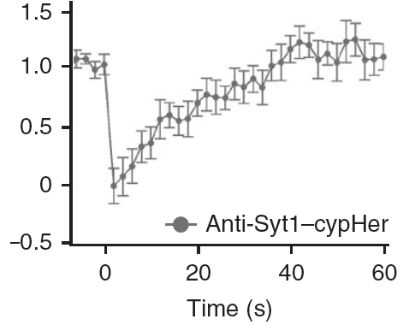
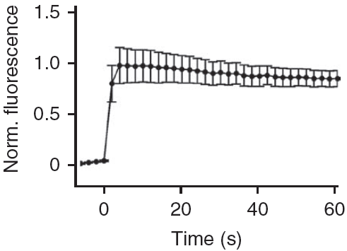


Results
A surface RRetP of synaptic vesicle constituents
50 APs at 20 Hz
Synaptotagmin 1 antibody coupled with cypHer
(pH sensitive fluorophore)
-> Anti-Syt1-cypHer
pH
5,5
Synaptotagmin 1
Synaptobrevin 2 coupled with pHluorin (pH sensitive fluorophore)
-> SpH
TEV cleavage site
pH
Tobacco etch virus (TEV) protease
7,4
A surface pool of vesicle proteins is endocytosed
Notes:
Pour simplifier, les protéines sont représentées dans des vésicules différentes, mais il est courant de les retrouver dans les mêmes vésicules.

Slide 24
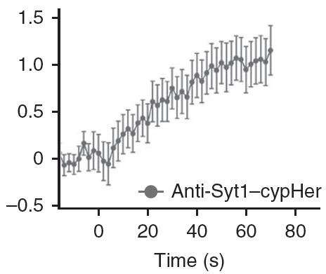
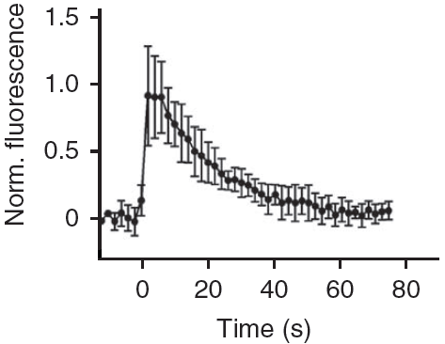
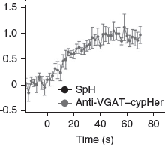
Results
A surface RRetP of synaptic vesicle constituents
50 APs at 20 Hz
Photobleaching
pH
5,5
Synaptotagmin 1
antibody coupled with
cypHer (pH sensitive fluorophore)
-> Anti-Syt1-cypHer
Synaptotagmin 1
Synaptobrevin 2
coupled with pHluorin (pH sensitive
fluorophore)
-> SpH
pH
7,4
Presorted synaptic vesicle proteins are preferentially endocytosed on exocytosis
Notes:
Pour simplifier, les protéines sont représentées dans des vésicules différentes, mais il est courant de les retrouver dans les mêmes vésicules.

Slide 25
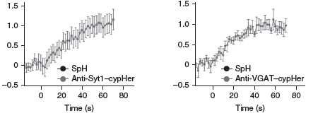
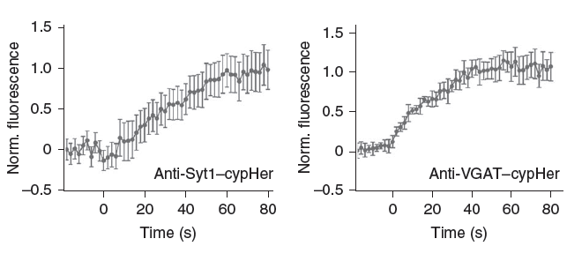
Results
A surface RRetP of synaptic vesicle constituents
With spH overexpression
Without spH overexpression
Endocytosis of Syt1 or VGAT is not perturbed by spH overexression

Slide 26
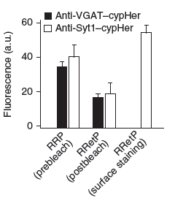
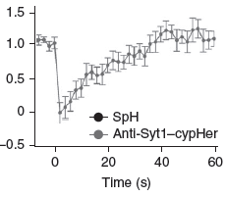
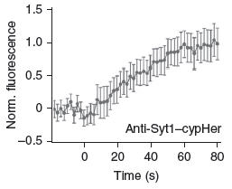
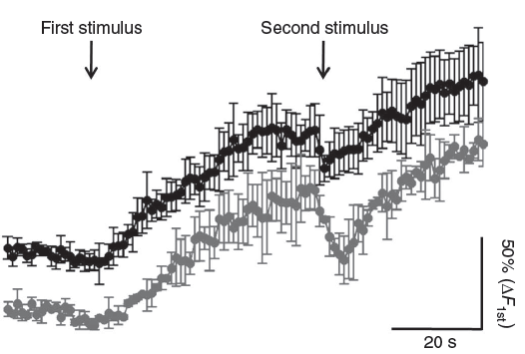
Results
A surface RRetP of synaptic vesicle constituents
Readily Releasable Pool (RRP)
Partial bleaching of the surface pool
Readily Retrievable Pool (RRetP)
RRP seems to be counterbalanced by an RRetP of similar size

Slide 27
Question
Spatial organization of the RRetP
How is the functionnal surface pool spatially organized at the presynapse?

Slide 28
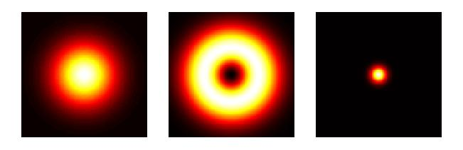
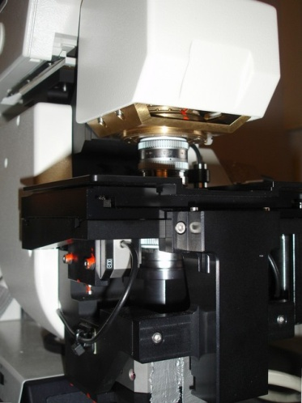
Methods
Spatial organization of the RRetP
First labeling
Second labeling
Antibody to Synaptotagmin 1
Secondary antibody
Antibody to Synaptotagmin 1
Secondary antibody
Antibody to RIM (Active Zone)
Secondary antibody
Antibody to Homer1 (Post Synaptic Density)
Secondary antibody
IsoSTED microscopy
4Pi microscopy

Slide 29
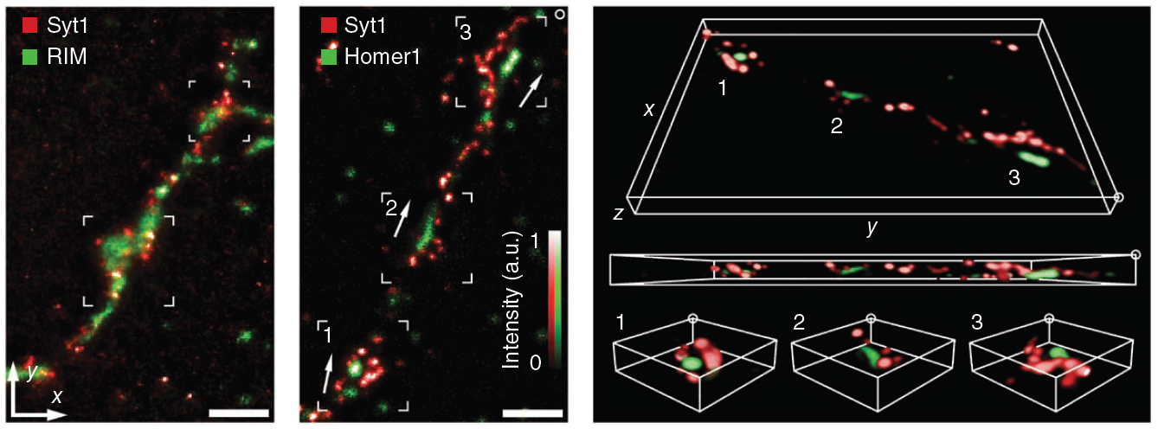
Results
Spatial organization of the RRetP
?
R
RIM (AZ)
Presynaptic
Postsynaptic
R
H
H
Homer1 (PSD)
R
H
Syt1 (?)
R
H
IsoSTED

Slide 30
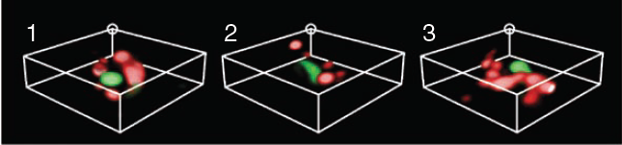
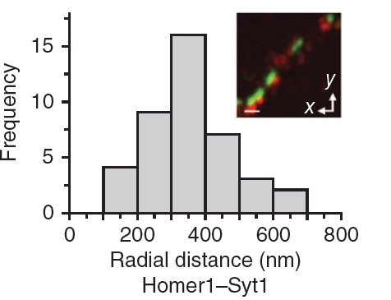
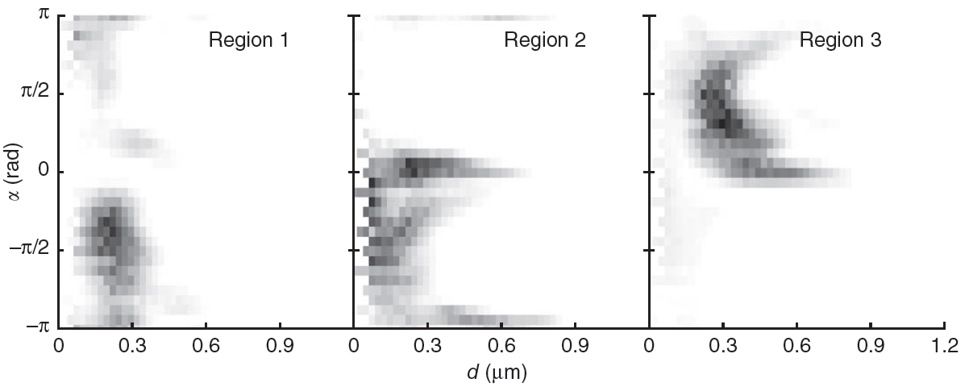
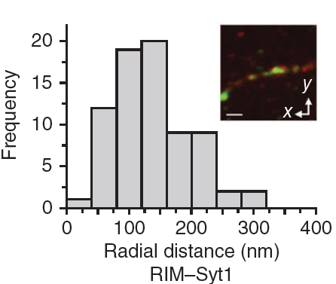
Results
Spatial organization of the RRetP
?
α
Presynaptic
Postsynaptic
R
RIM
R
H
d
H
Homer1
R
H
R
H
Syt1
Axon
Doghnut-like arrangement around the active zone
of the RRetP

Slide 31
Discussion
and conclusion
Vesicle proteins already presents on the presynaptic membrane
Presorted synaptic vesicle proteins are preferentially endocytosed on exocytosis
RRP seems to be counterbalanced by an RRetP of similar size
Doghnut-like arrangement around the active zone
of the RRetP
Notes:
Il faut trouver une technique pour marquer spécifiquement les vésicules prêtes à être exocytées, déjà dockées.

Slide 32
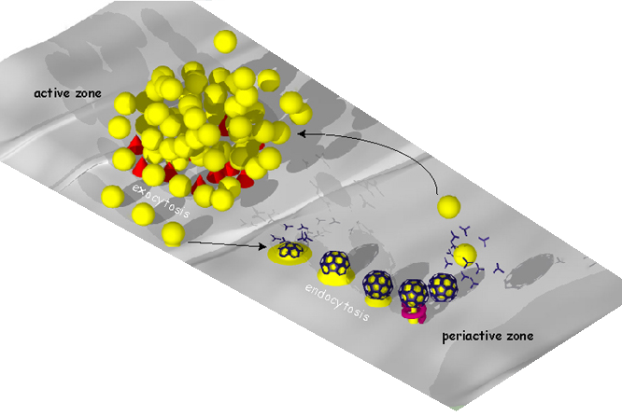
Discussion
and conclusion

Slide 33
THANK YOU FOR YOUR ATTENTION

Slide 35
Results
A surface RRetP of synaptic vesicle constituents
50 APs
200 APs
Incomplete depletion of the RRetP during the 1st stimulus
Partial replenishment of the RRetP after the 1st stimulus

