Slide 1


La France
9-sep-11
07:22
Sound on Please

Slide 2
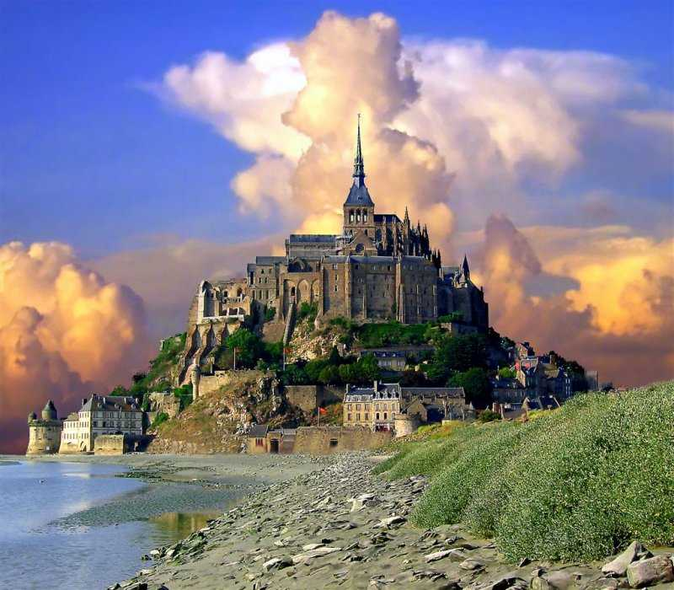
Abbey St.Michel, Normandy

Slide 3
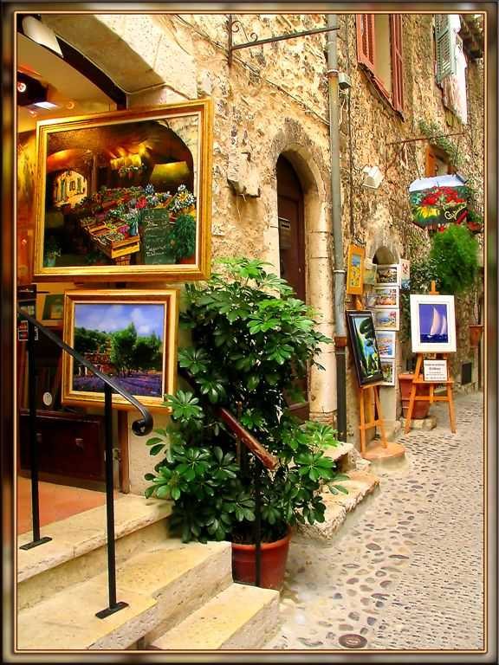
Art Boutiques, St.Paul, Nice

Slide 4
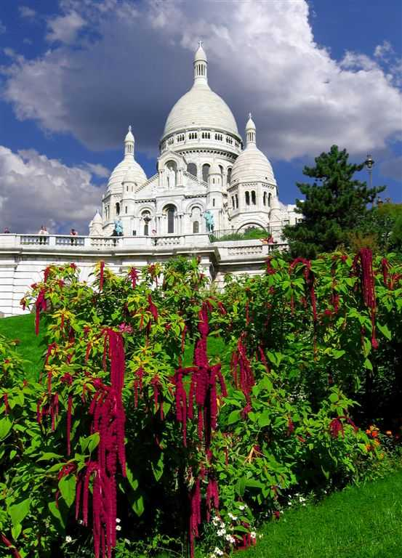
Basilique Sacre Coeur, Paris

Slide 5
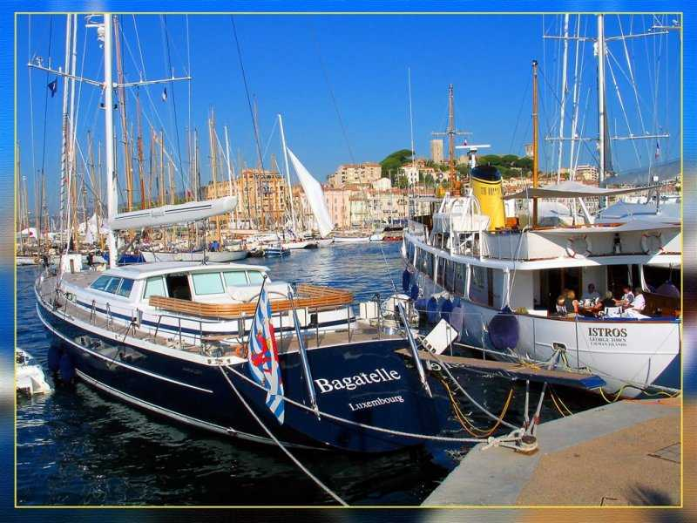
Breakfast Of Rich, Cannes

Slide 6
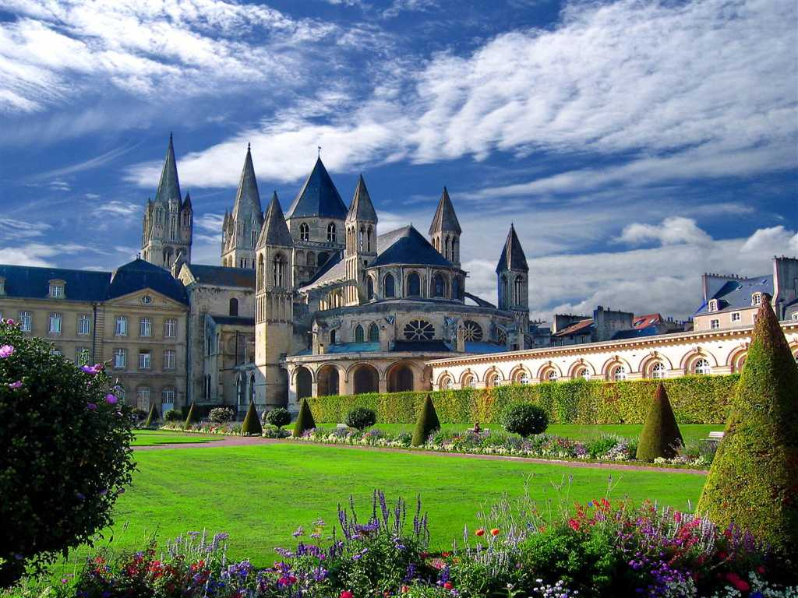
Brotherhood Closter In Caen, Normandy

Slide 7
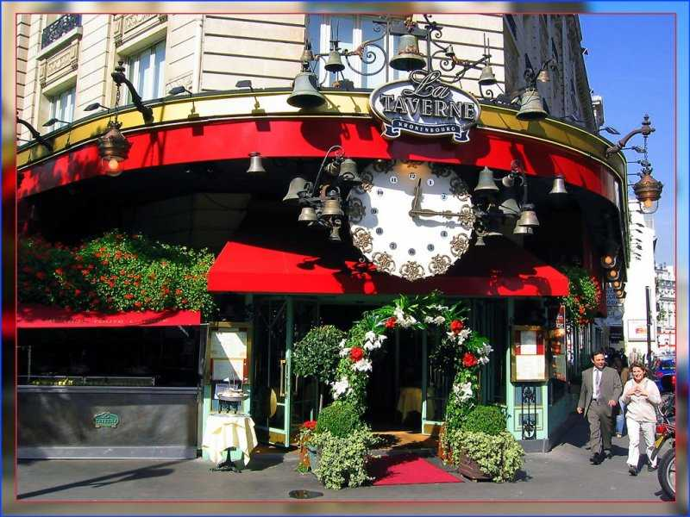
Cafe en Paris

Slide 8
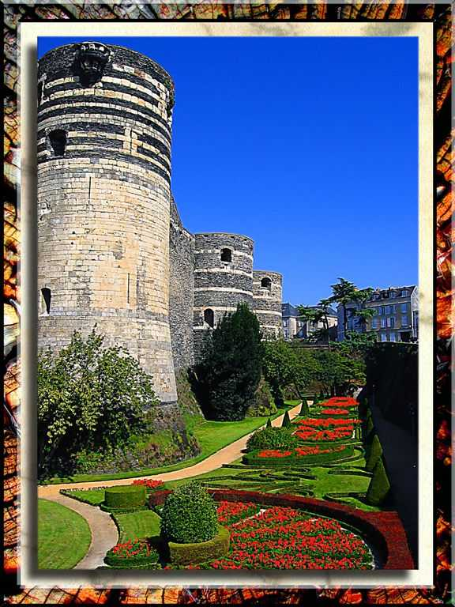
Castle D'Anger

Slide 9
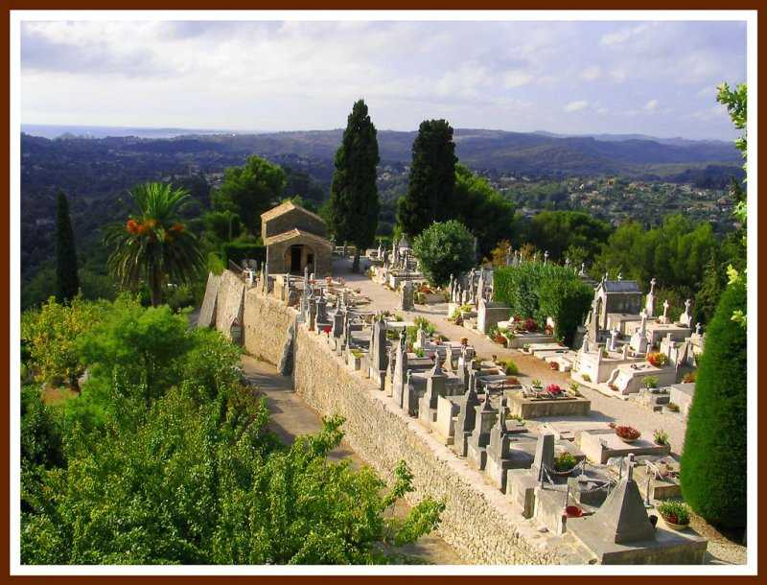
Cemetery In St.Paul, Resting Place Of
Mark Chagal

Slide 10
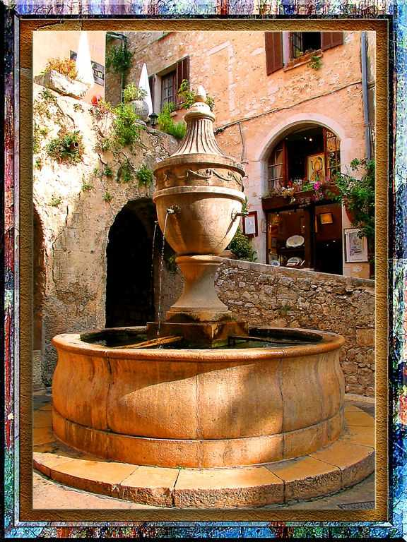
Charming Fountain, St.Paul, Provence

Slide 11
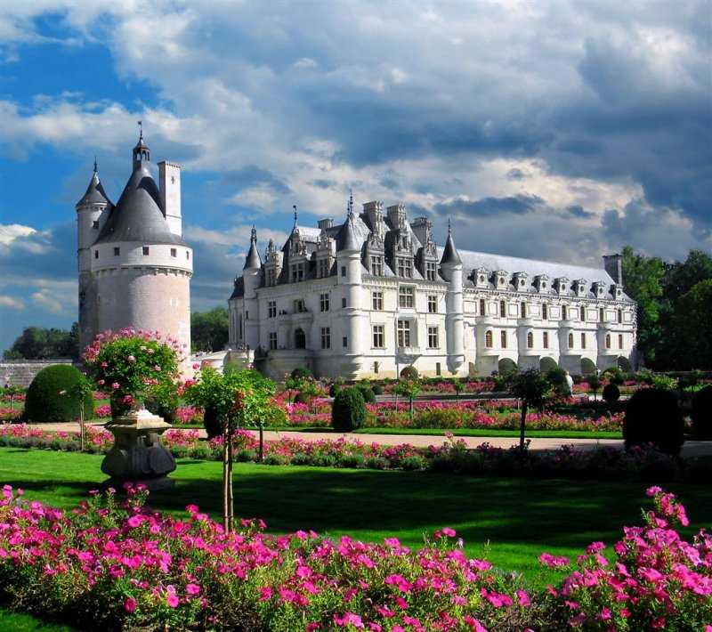
Chateau Chenonceaux, Loire Valley

Slide 12
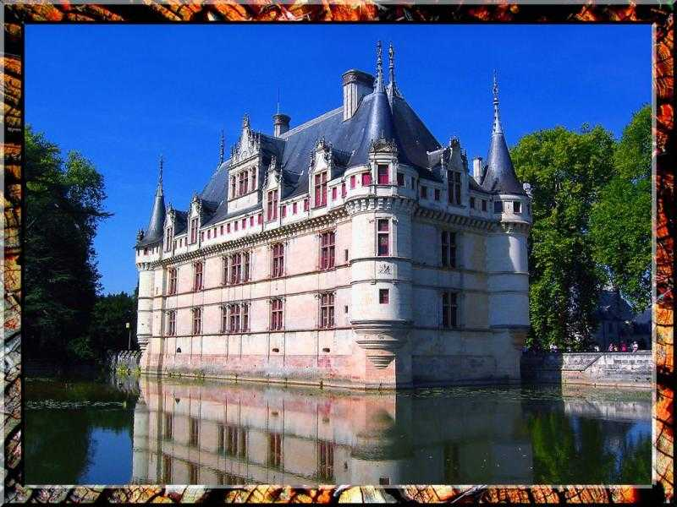
Chateau Eau-Des-Auseuax

Slide 13
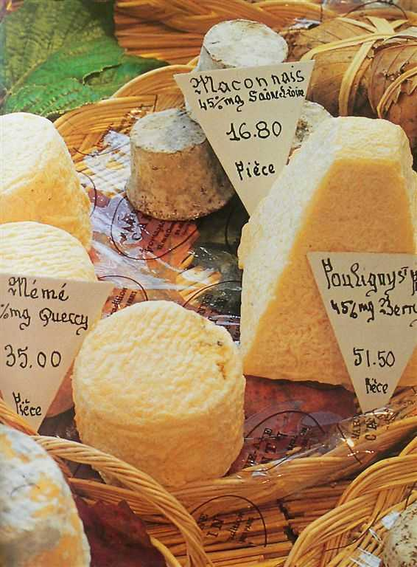
Cheese Fest,
Dijon

Slide 14
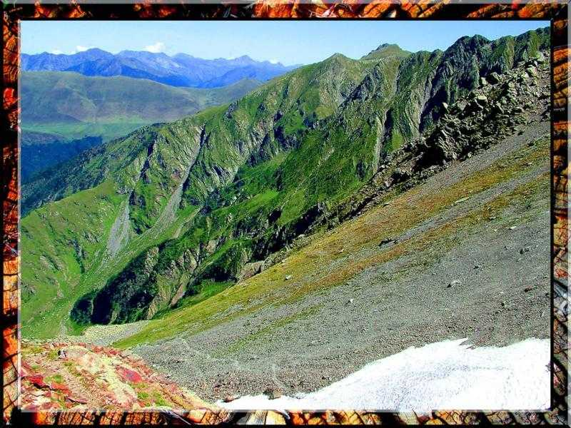

Slide 15
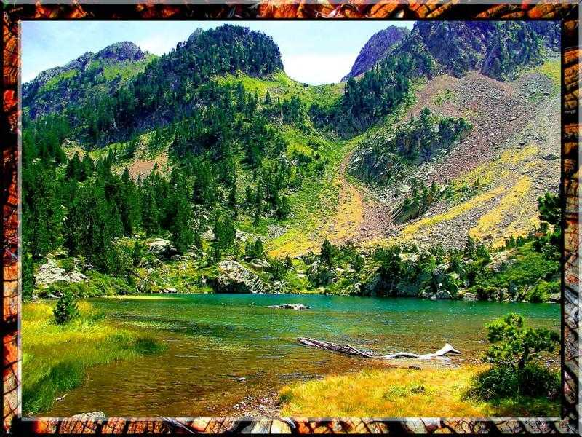

Slide 16
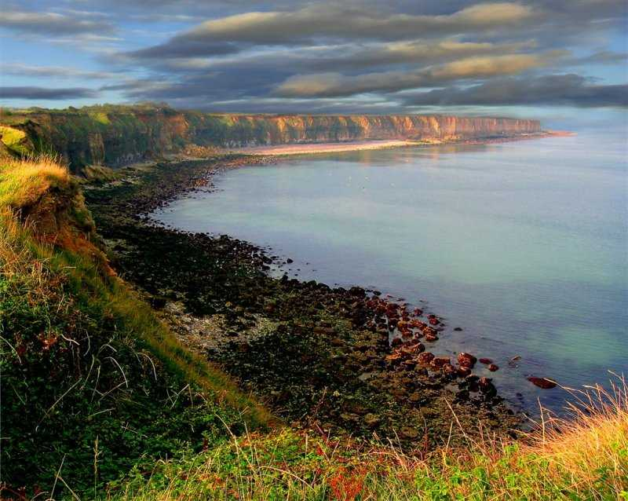

Slide 17
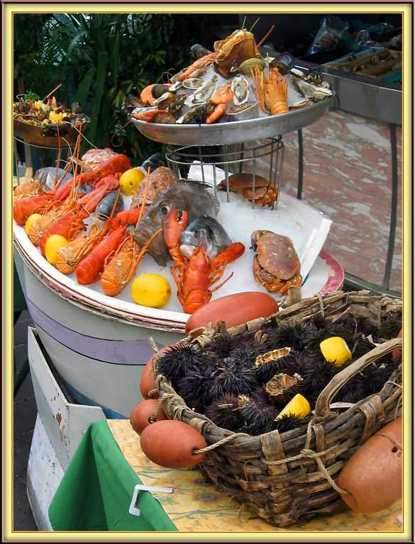
Fish Market In Nice, Provence

Slide 18
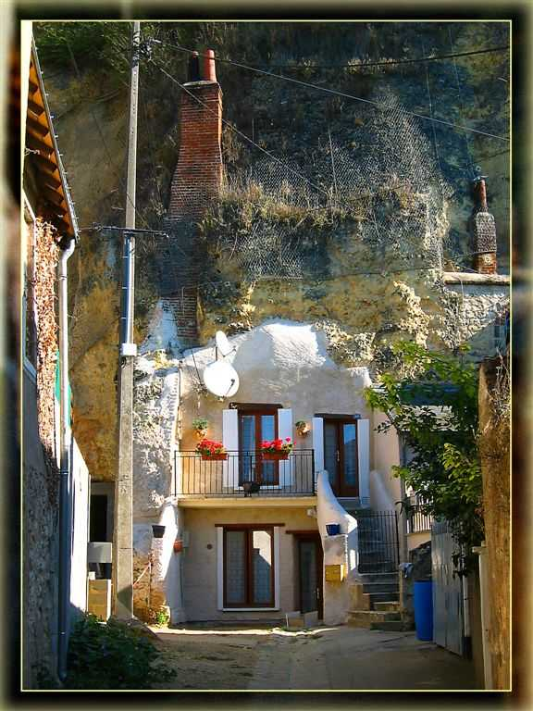
French Condominium In Troglodytes, Amboise

Slide 19
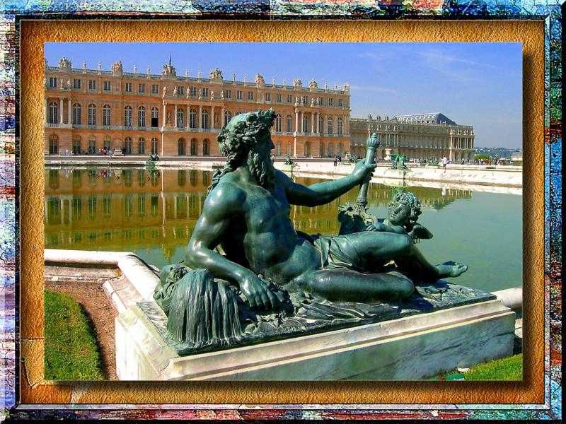
Chateaux De Versailles, Ille De France

Slide 20
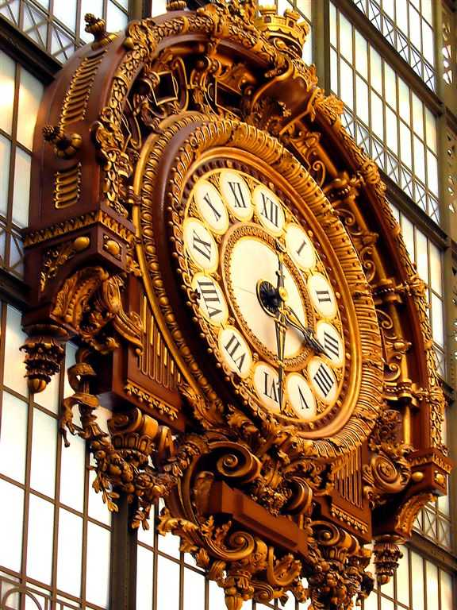
Grand Horloge In Musee D'Orsay

Slide 21
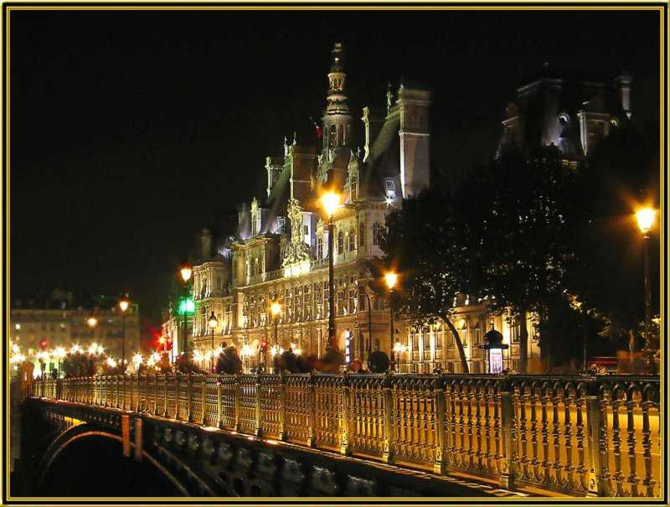
Hotel De Ville, Paris

Slide 22
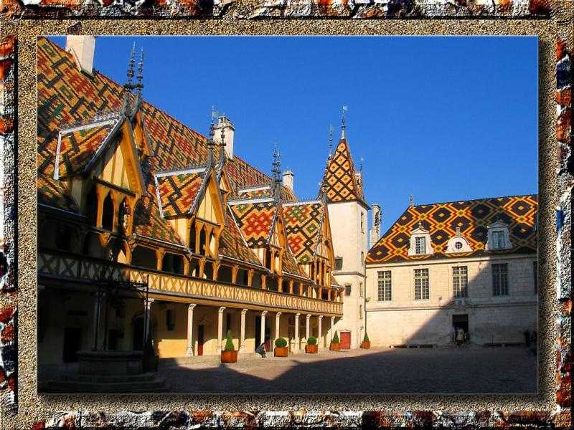
Hotel Dieu In Beanne, Burgundy

Slide 23
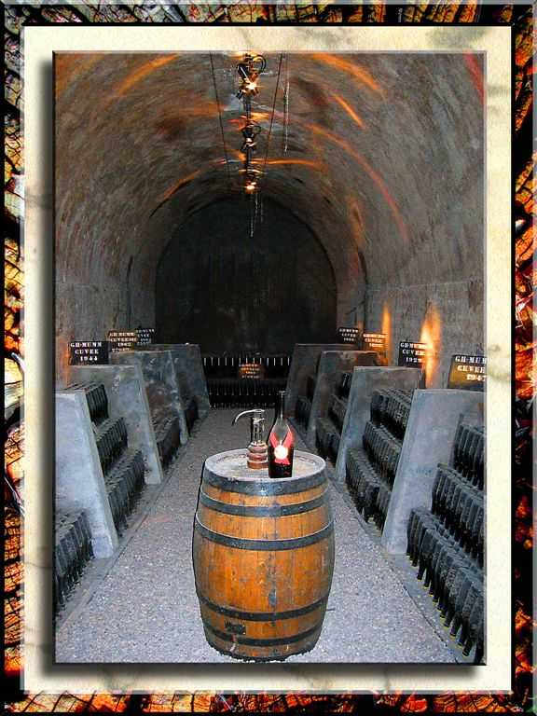
In Mumm's Champagne Cellars

Slide 24
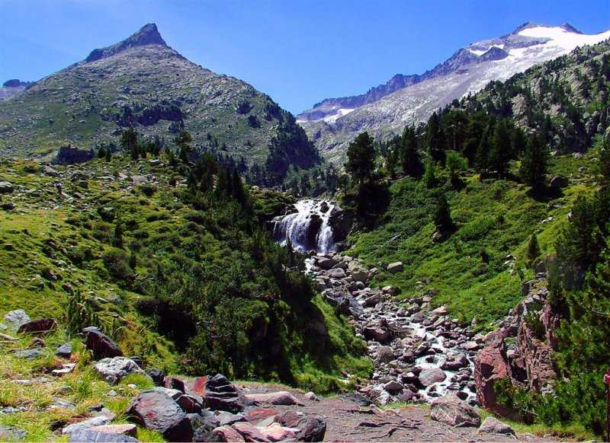

Slide 25
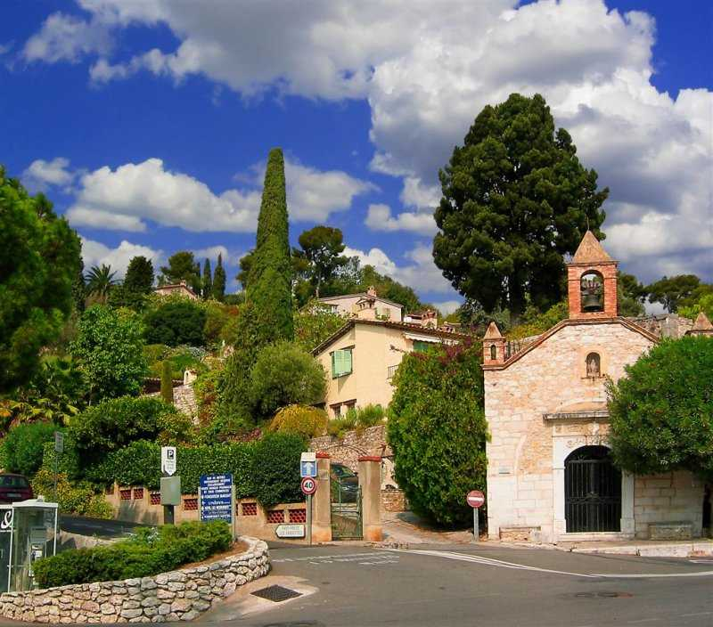
Lovely St. Paul, Provence

Slide 26
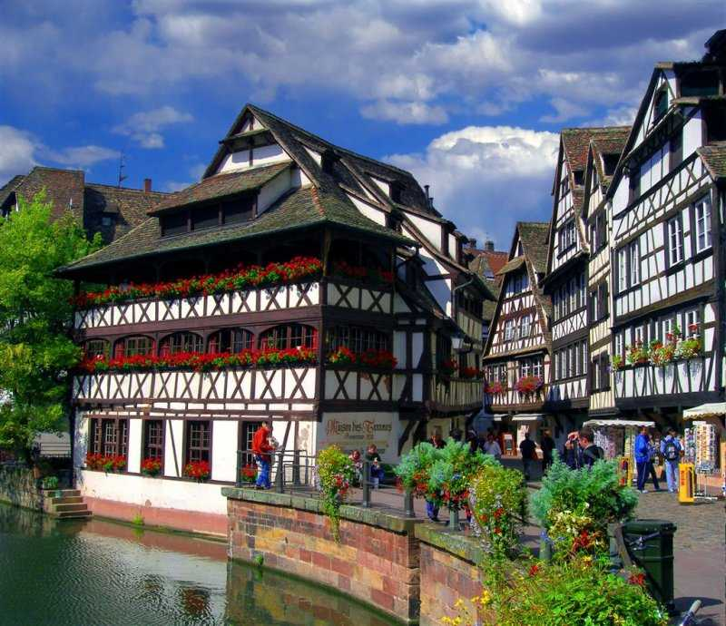
Medieval Petite France, Strasburg

Slide 27
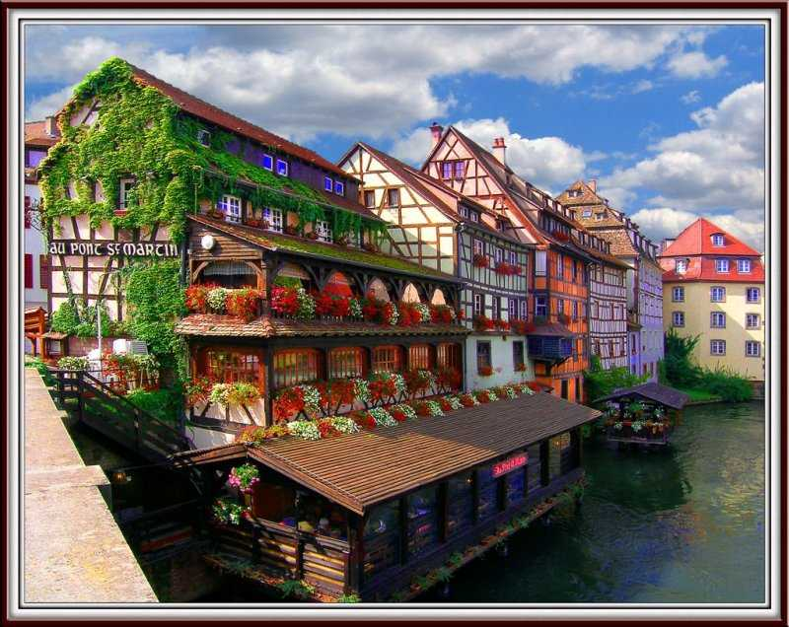
Medieval Strasburg, Alsace

Slide 28
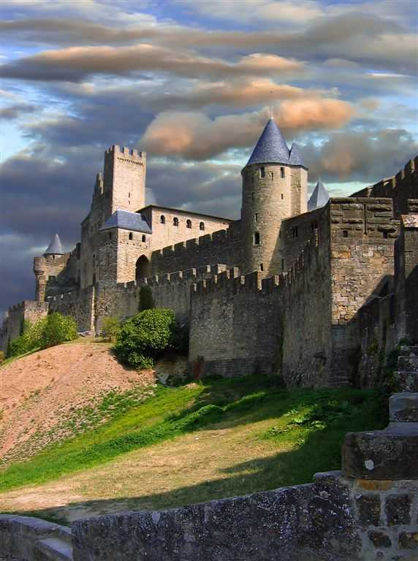
Medieval Towers Of Carcassonne, Provence

Slide 29
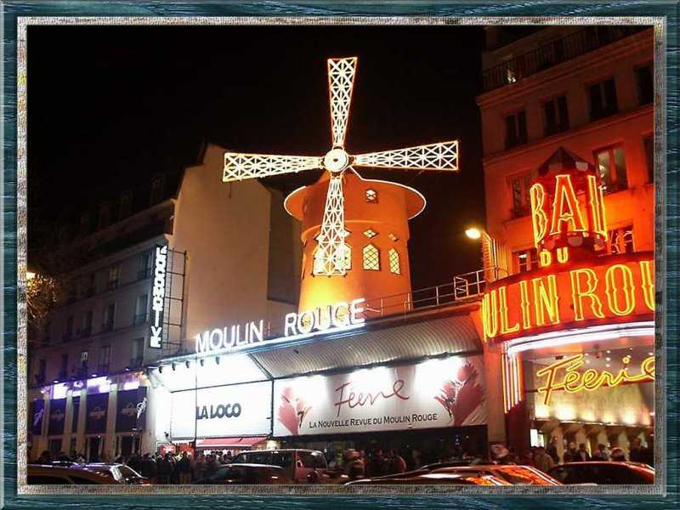

Slide 30
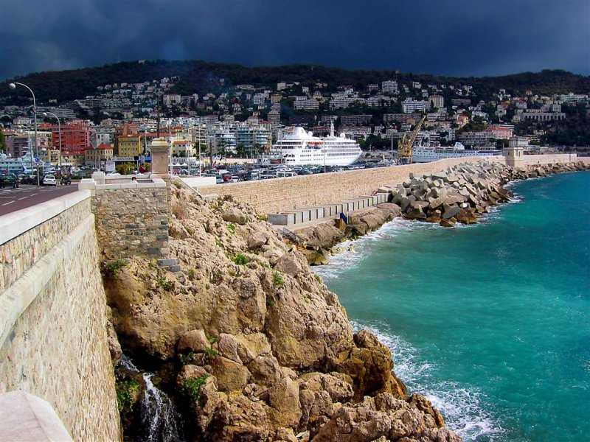
Nice, Provence

Slide 31
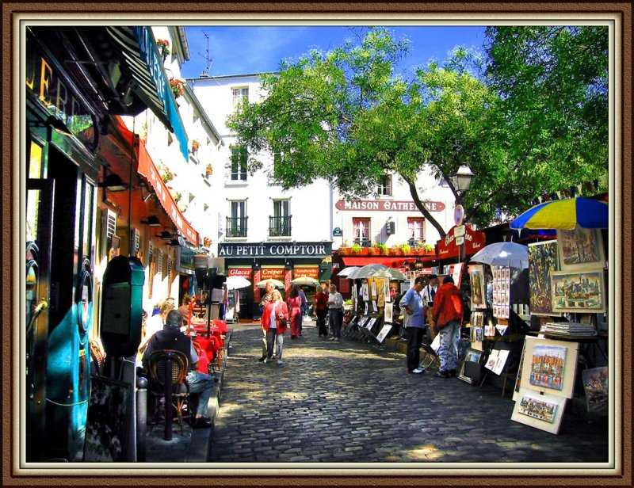
On The Heights Of Monmartre, Paris

Slide 32
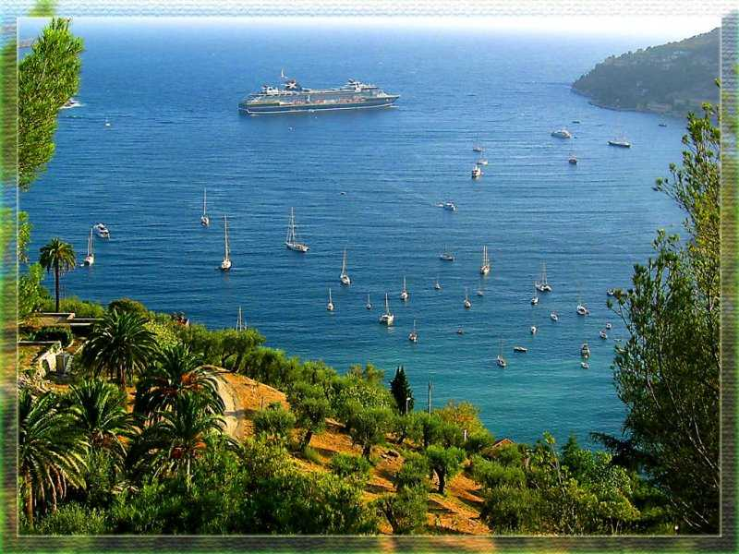
One Of Monaco's Harbours

Slide 33
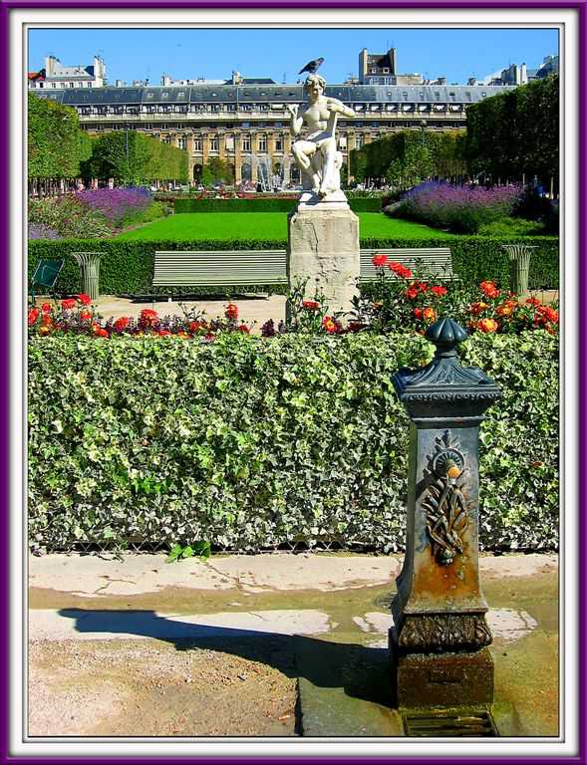
Palais Royal, Paris

Slide 34
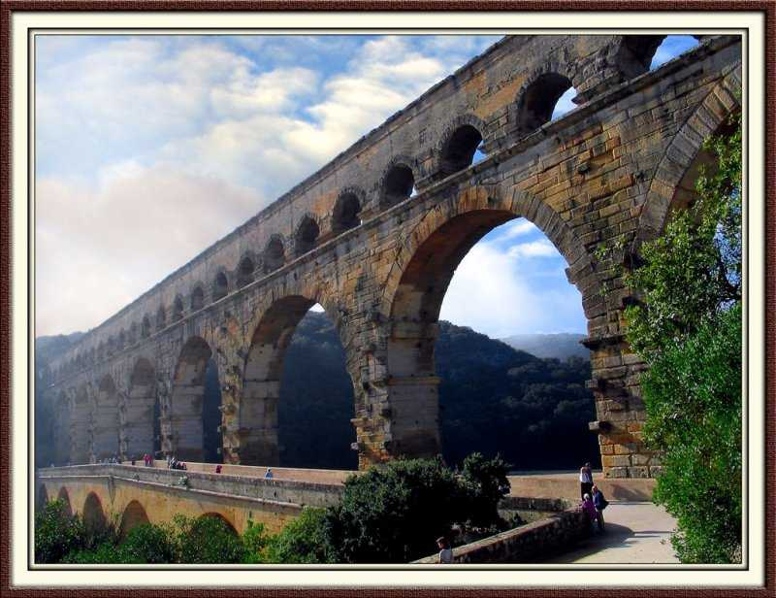
Pont-Du-Gard,- 2500 Year Old Roman Aqueduct

Slide 35
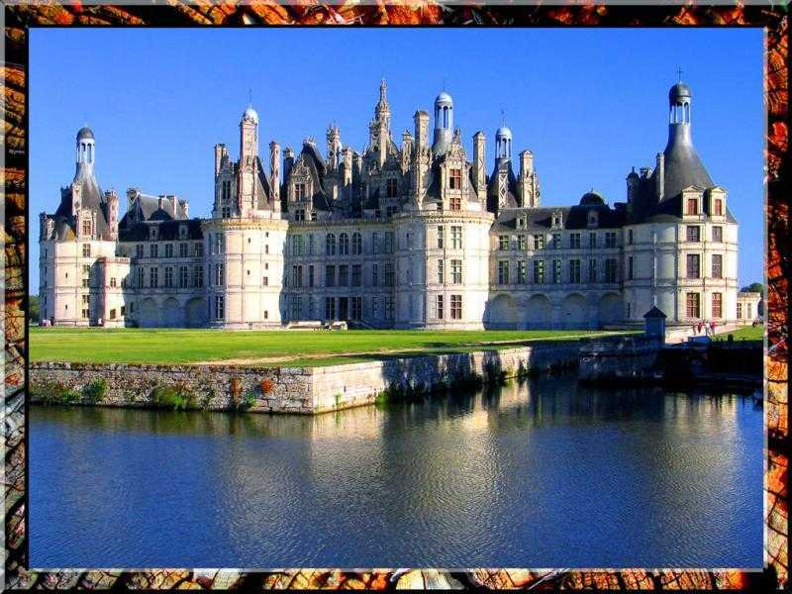
Royal Chateau Chambord, Loire Valley

Slide 36
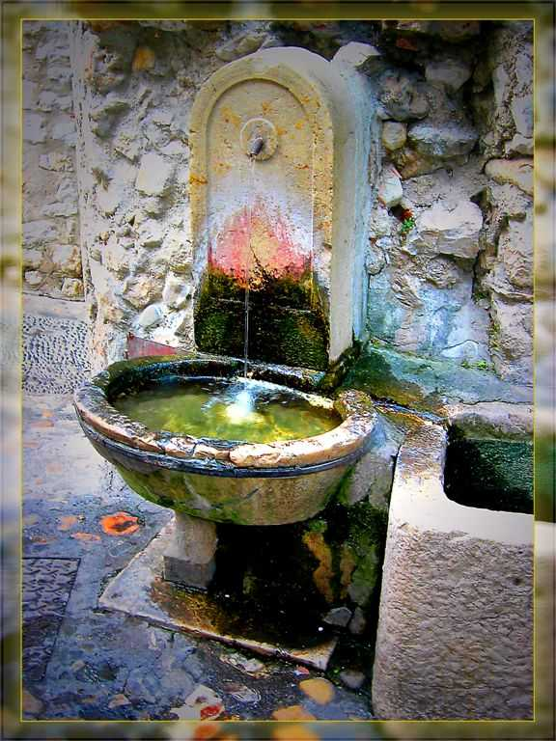
Small Fountain, St.Paul

Slide 37

Sour Cherries In Burgundy

Slide 38
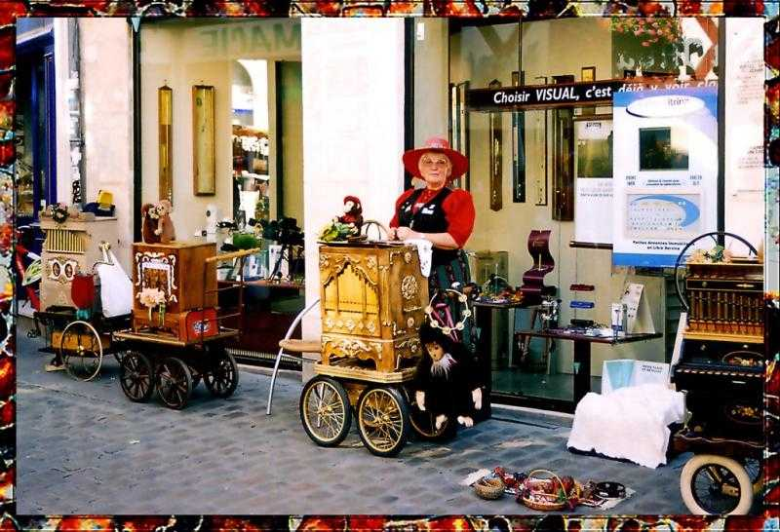
Street Festival In Montreaux

Slide 39
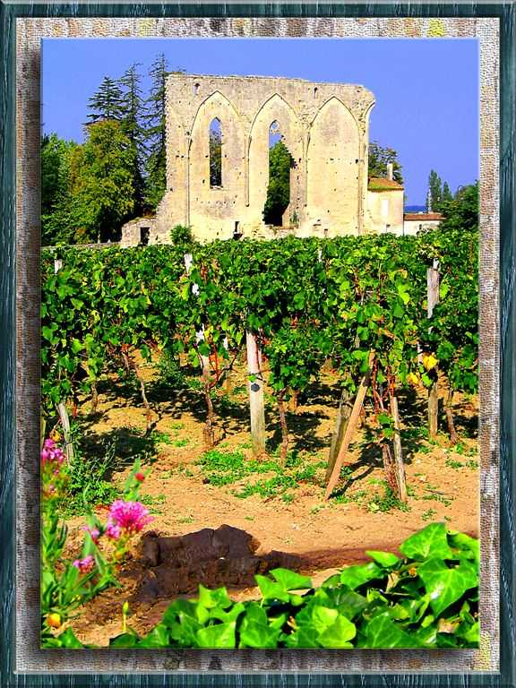
Vineyards In St.Emillion

Slide 40
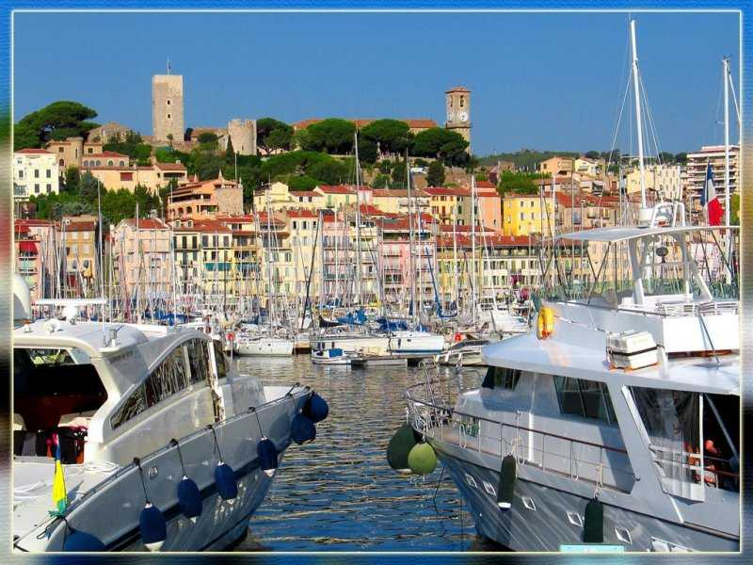
Yachts In Cannes, Provence

Slide 41
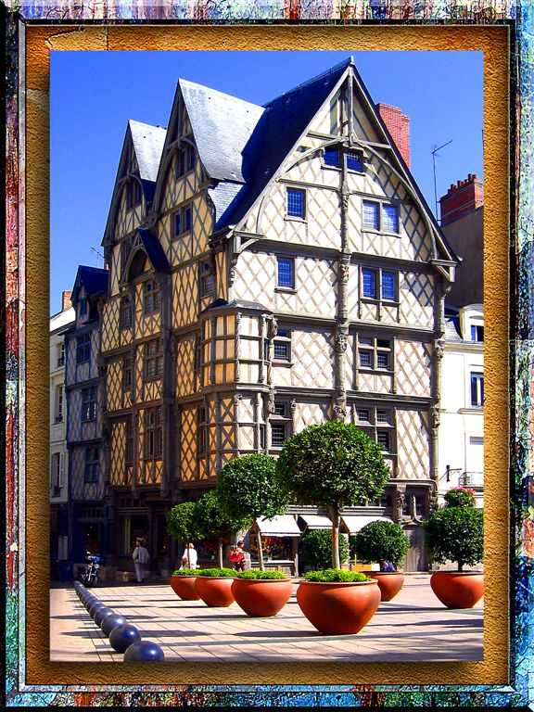
XIV Century House
In Anger
Oscar
Last slide. .

